Slide 1

New approaches to metabolic toxicity screening using DNA damage endpoints
James F. Rusling
Professor of Chemistry and Surgery
Dhanuka P. Wasalathanthri, Ronaldo C. Faria, Vigneshwaran Mani
Spundana Malla, Karteek Kadimisetty, Amit A. Joshi
University of Connecticut and UConn Health
Funded by National Institutes of Health (USA)
Website: http://web2.uconn.edu/rusling/
Email: James.Rusling@uconn.edu

Slide 2
Chemical toxicity: a critical public health problem
• New drugs & agricultural, cosmetic, or household chemicals must be proven safe
• $1-2 billion to develop a single drug candidate!
• clinical failures approach 30% due to toxicity
• existing bioassays give yes/no answer, no structural details
• animal models often fail; interspecies differences
• toxicity often involves metabolites, not parent compounds

Slide 3
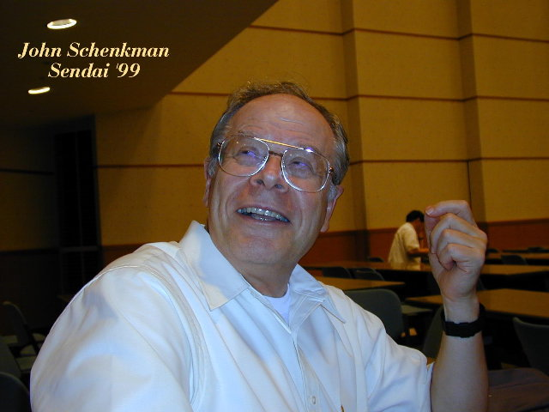
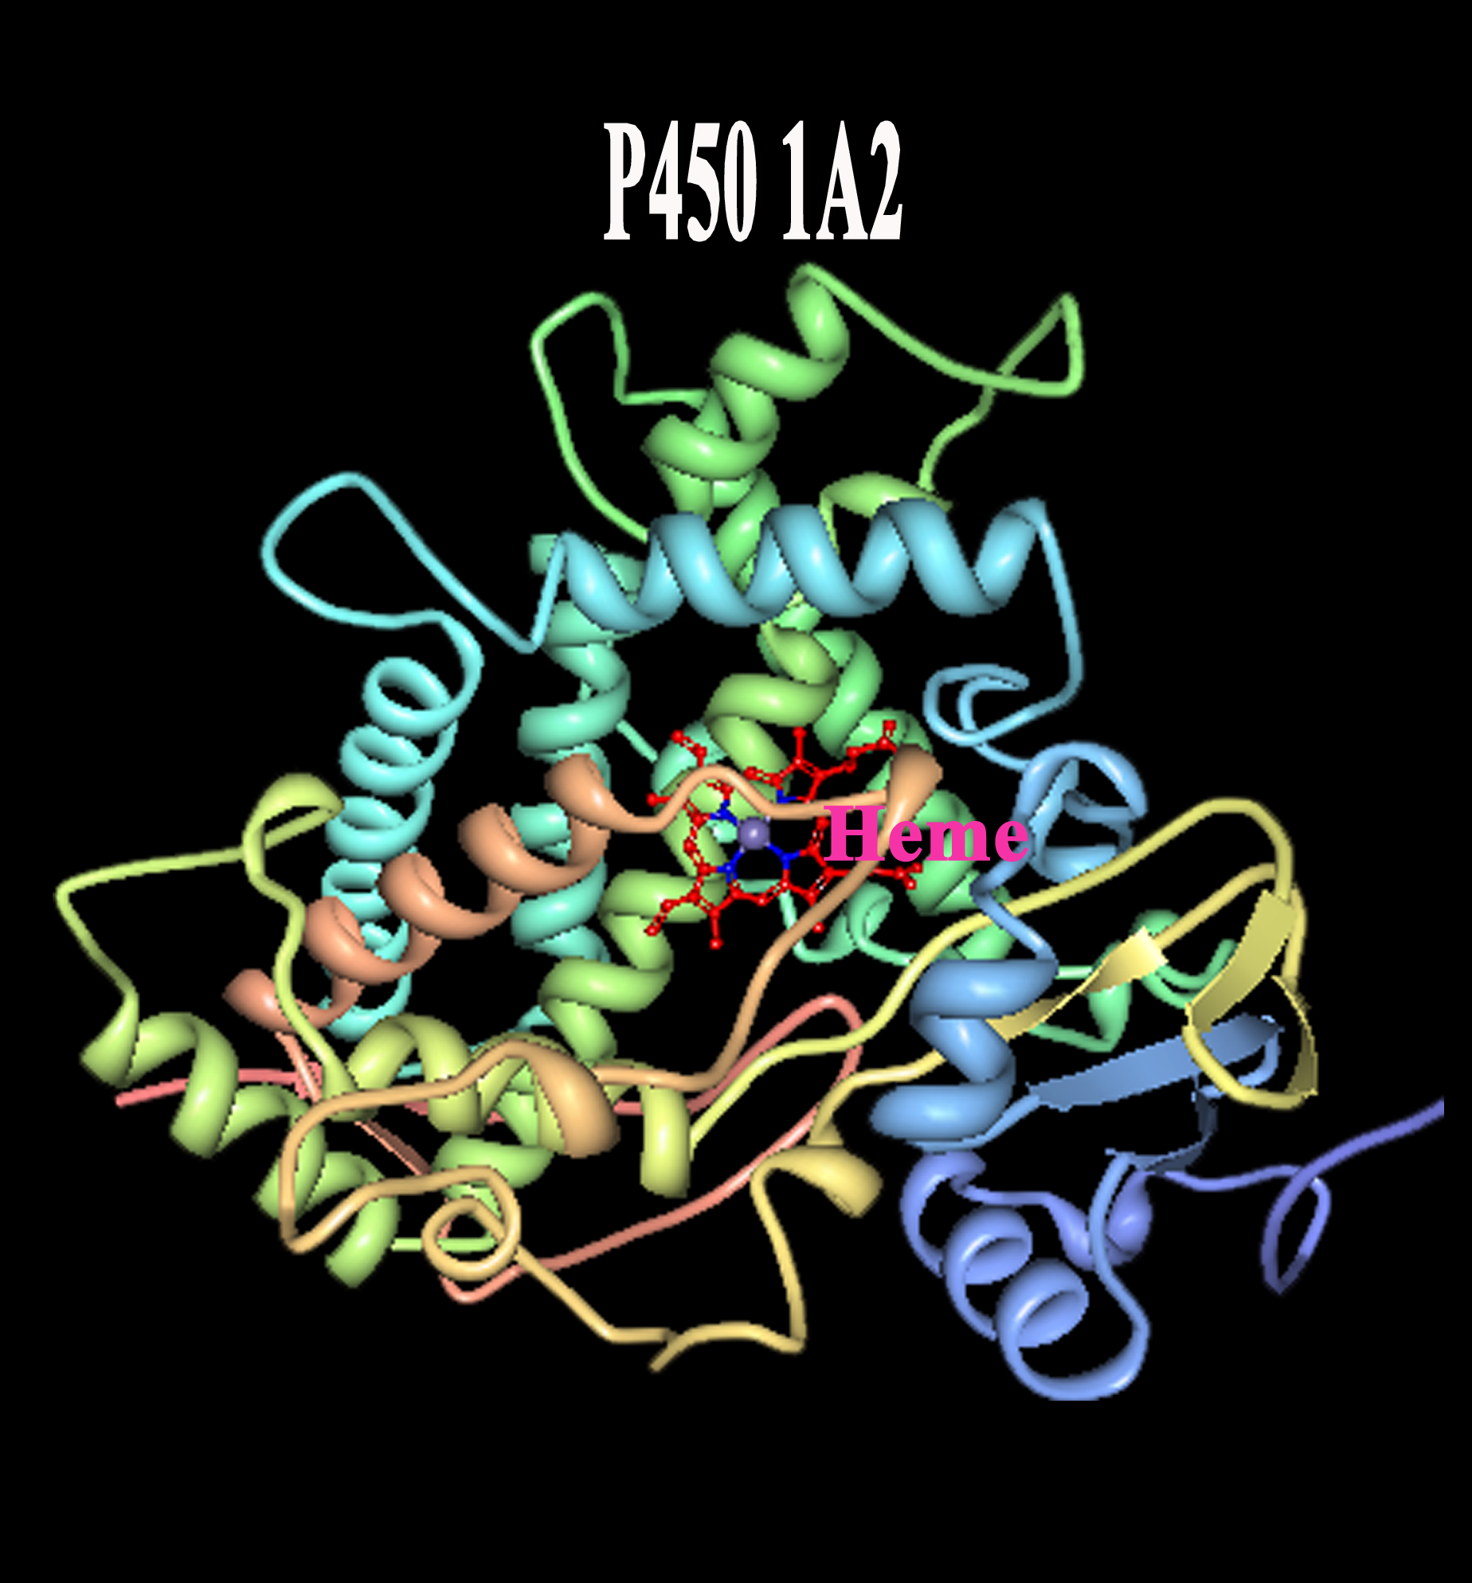
Cytochrome P450 enzymes
Iron heme enzymes – Catalyze metabolic oxidations
Can bioactivate lipophilic pollutants/drugs
metabolites can react with DNA & proteins;
resulting in toxicity
Prof. John Schenkman,
Uconn Health Center
PDB:2HI4
PDB:2HI4
E. H. Johnson et al. 2007
F. P. Guengerich Chem.Res.Toxicol. 2008

Slide 4
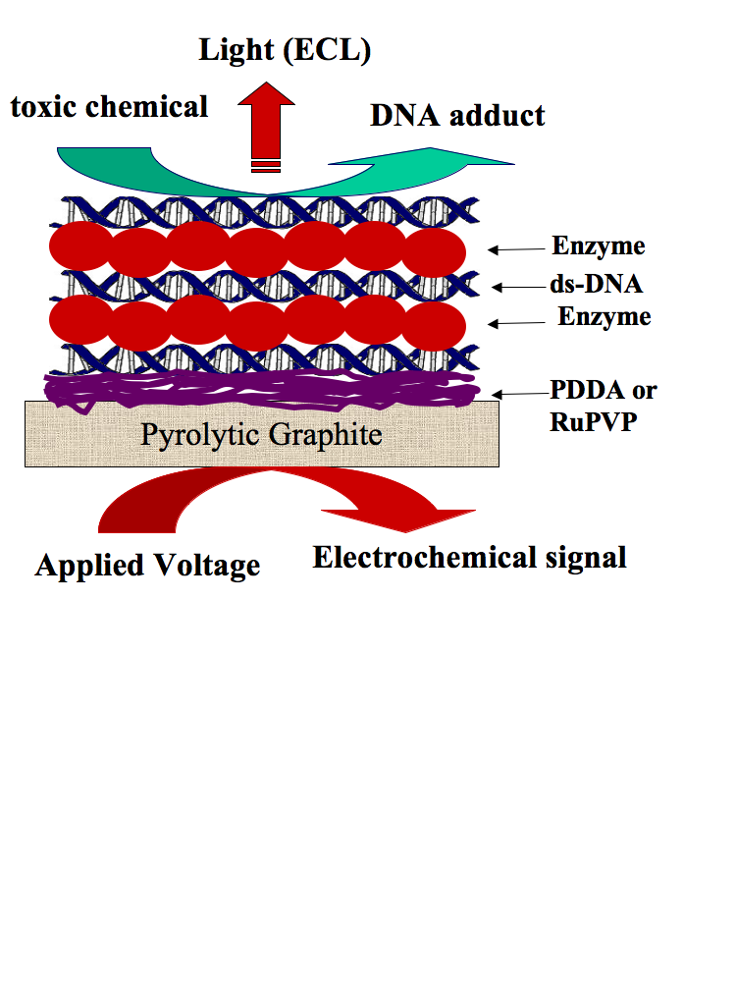
Basic film architecture and approaches for genotoxicity arrays
LbL Films
(Lvov, Decher)
20-40 nm
thick
(ECL polymer)
Eli G. Hvastkovs, John B. Schenkman and James F Rusling, Metabolic Toxicity Screening Using Electrochemiluminescence Arrays Coupled with Enzyme-DNA biocolloid reactors and LC-MS, Annu. Rev. Anal. Chem., 2012, 5, 79–105.

Slide 5
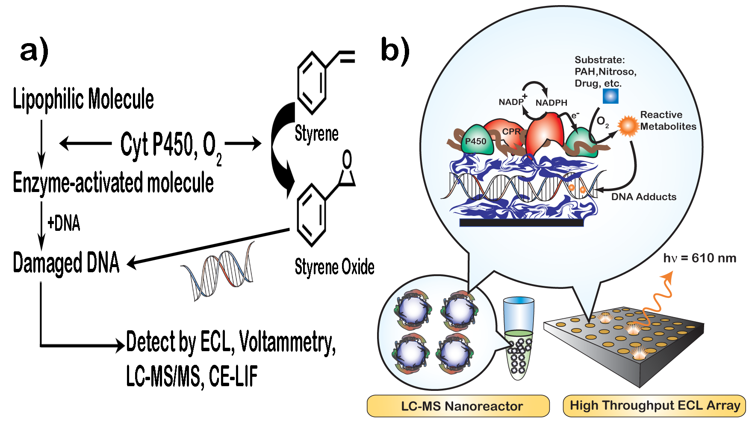
Two strategies for genotoxicity screening
Microsomes = nanoparticles of lipids, cyt P450s, CPR
P450s driven
By NADPH
Microsome
particles
LC-MS gives molecular details
Measure rel. rate of
DNA damage

Slide 6
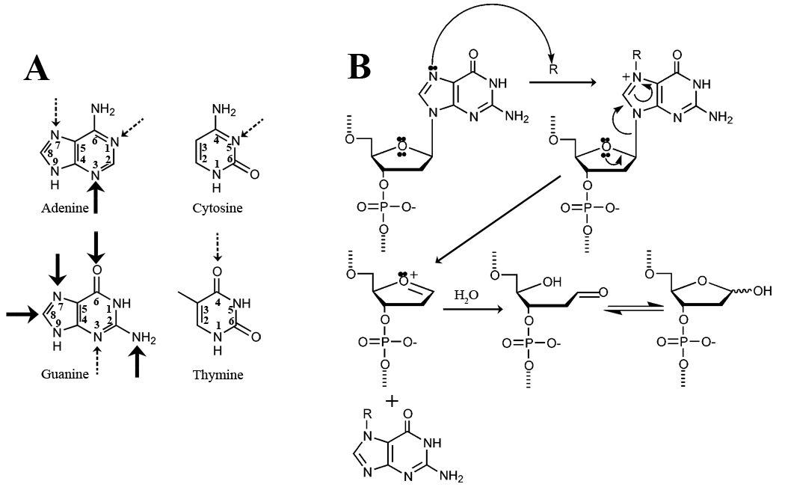
DNA damage and damaged base release
• Our methods detect DNA damage - and structures of adducts (MS)

Slide 7
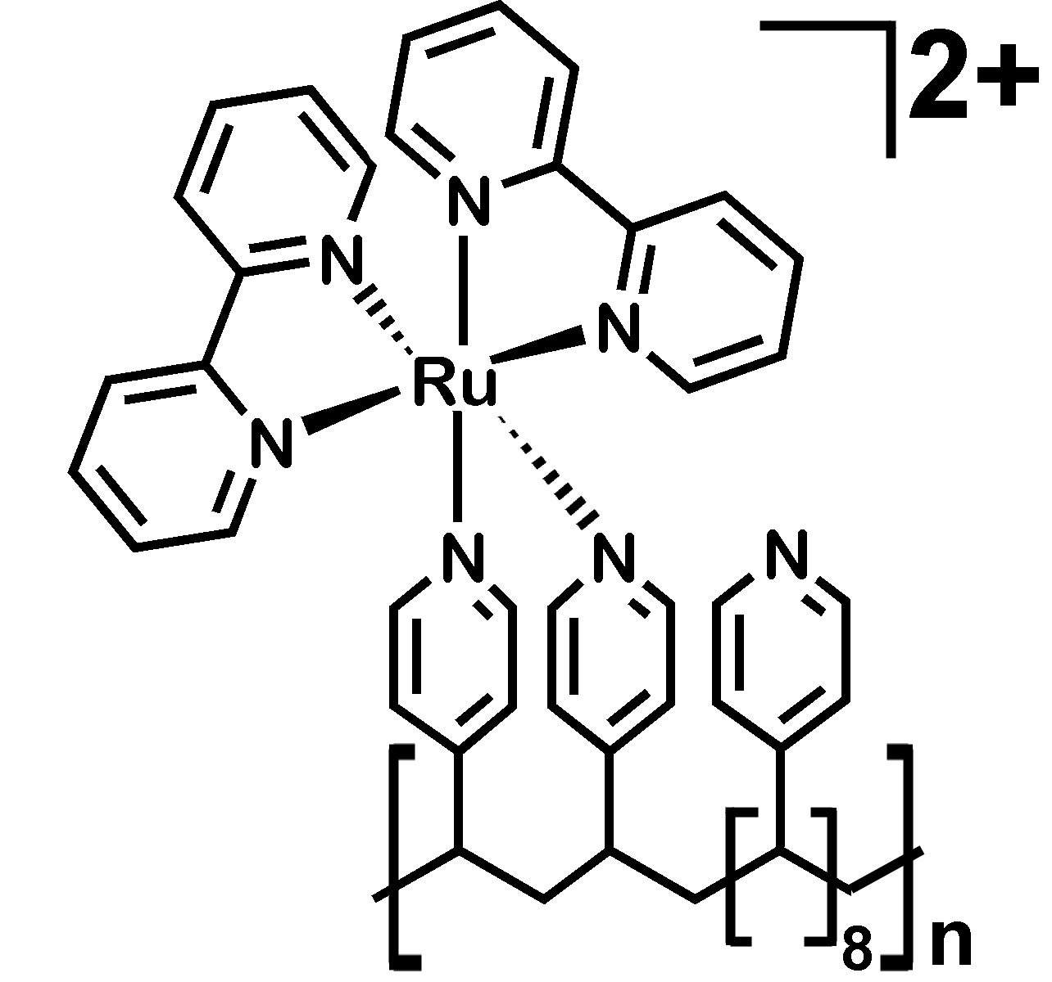
RuPVP
Spots contain enzyme,
DNA, And RuPVP ECL
polymer

Slide 8
Screening Metabolic Toxicity – 2 Steps
1. Enzyme reaction + DNA:
Reactant ---> metabolites + DNA
2. Analysis by
electrochemiluminescence (ECL)
Detection reaction
RuL²⁺ = RuL³⁺ + e- (in film)
RuL³⁺ + DNA-G --> [RuL²⁺]* + DNA-G•
In ECL, [RuL²⁺]* formed --> visible light

Slide 9
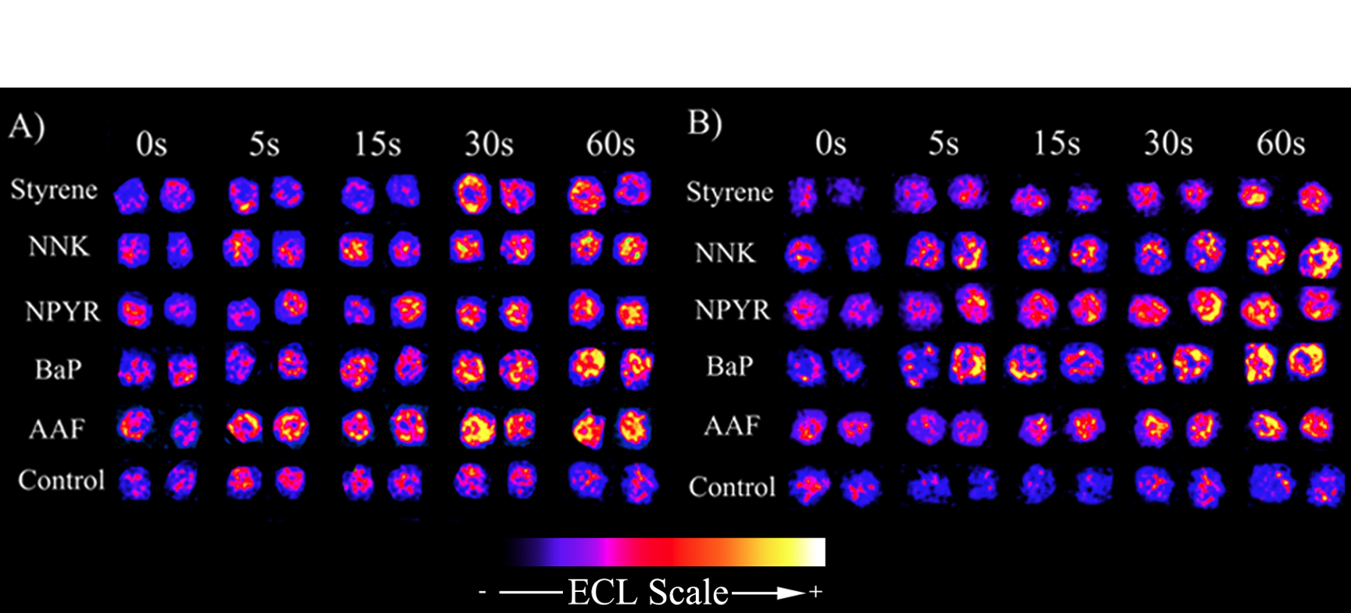
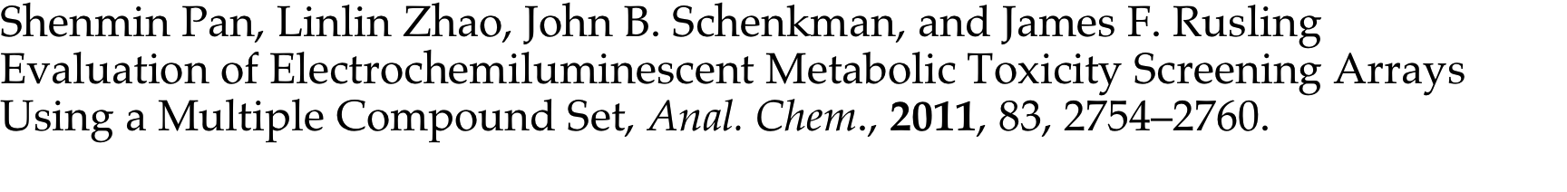
ECL arrays - relative toxicity screening using cyt P450s and
biioconjugation liver metabolic enzymes
Human enzymes rat enzymes
More light means more DNA damage

Slide 10
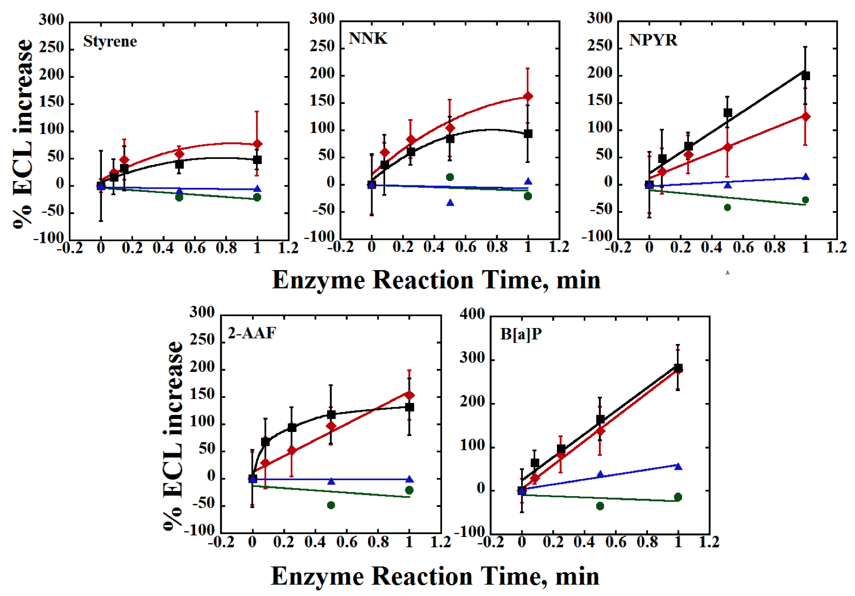
human
rat
controls
Initial slopes correlate with rate of DNA adduct formation, LC-MS
Provides relative turnover rate for reactive metabolite formation

Slide 11
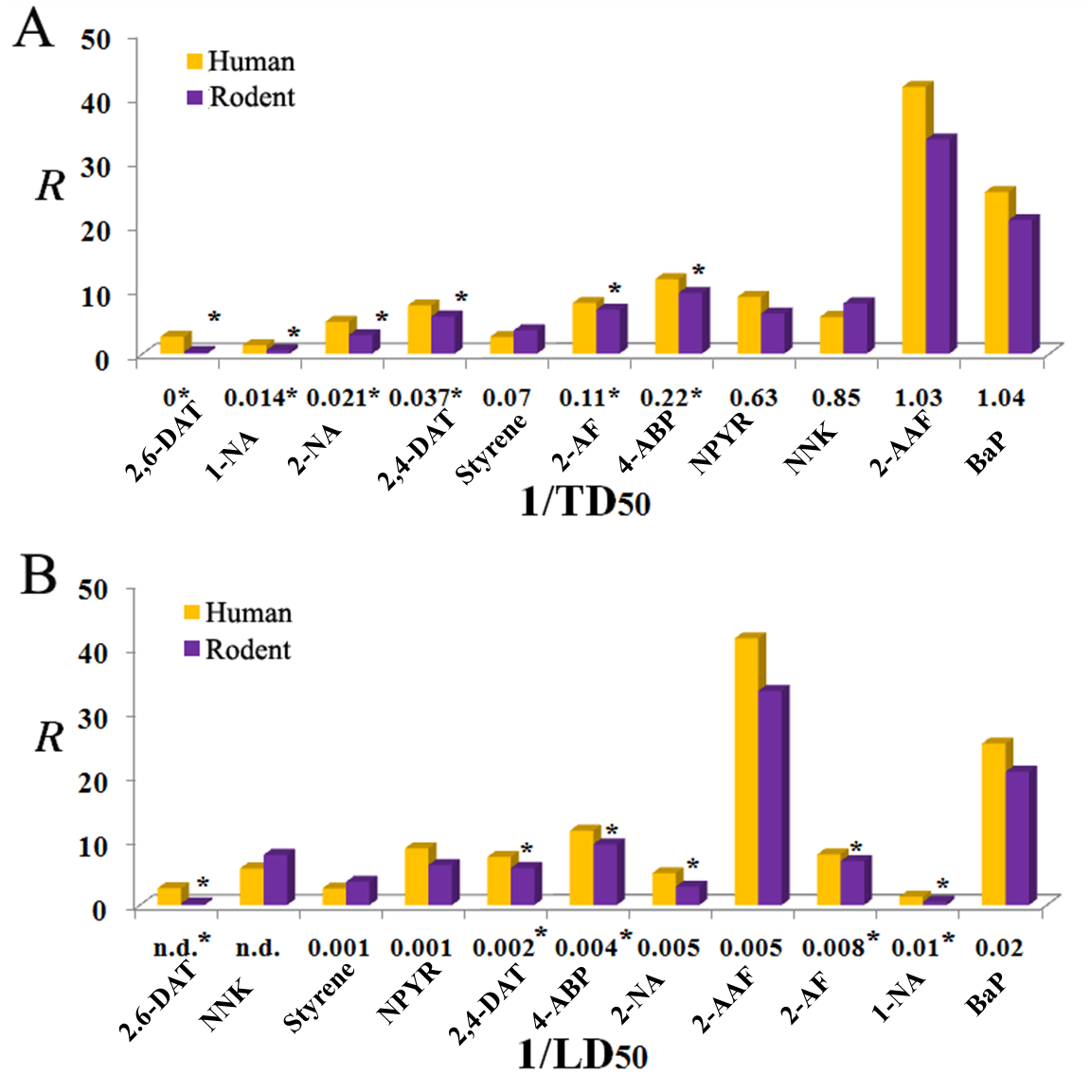
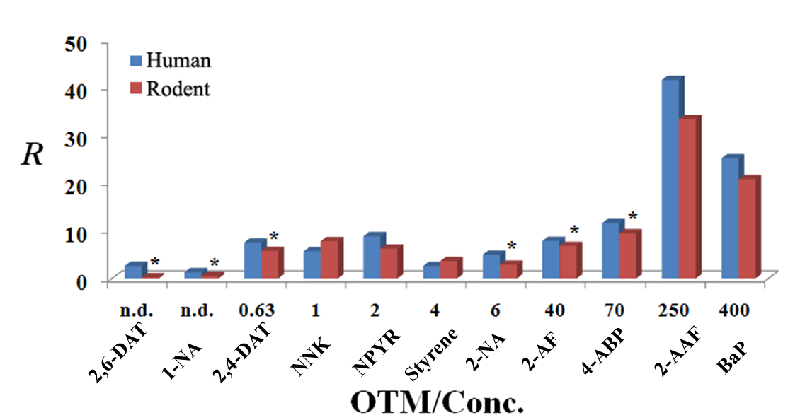
ECL toxicity array correlations
Rat liver carcinogenicity
R = turnover
rate for reactive
metabolite
Formation from
ARRAY
DNA damage in cells

Slide 12
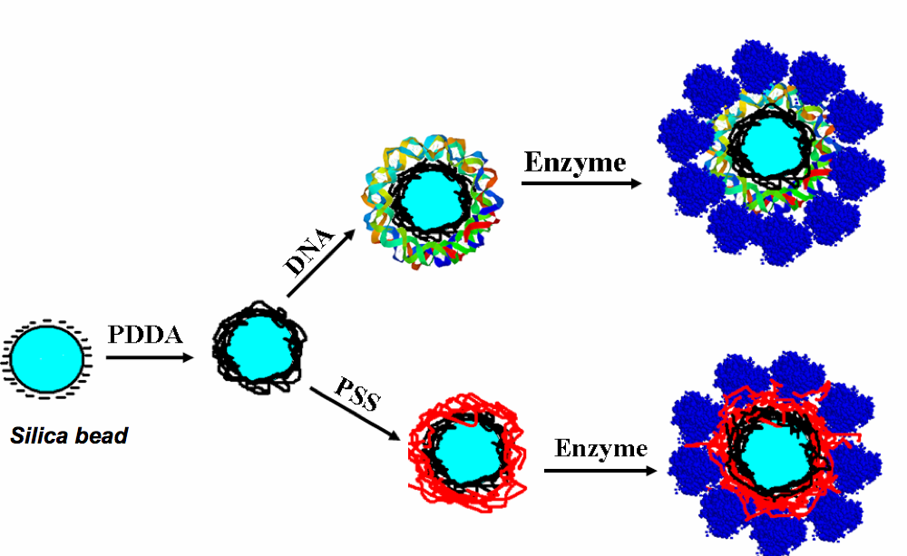
Biocolloid Reactors:
Enzyme/DNA films on nanoparticles for LC-MS
• tiny amts of enzymes or microsomes
• high conc. of DNA for reactions
• metabolites, DNA adducts; inhibition
• 100-200 μL reaction volumes

Slide 13
High-throughput system for LC-MS based toxicity screening

Slide 14
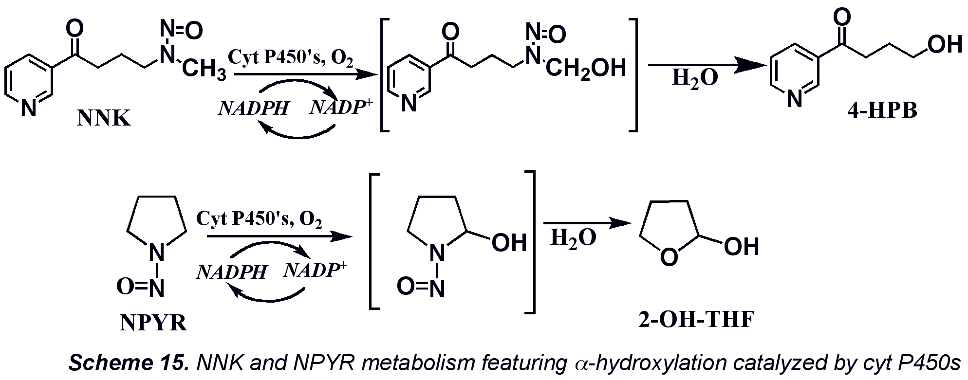

Slide 15
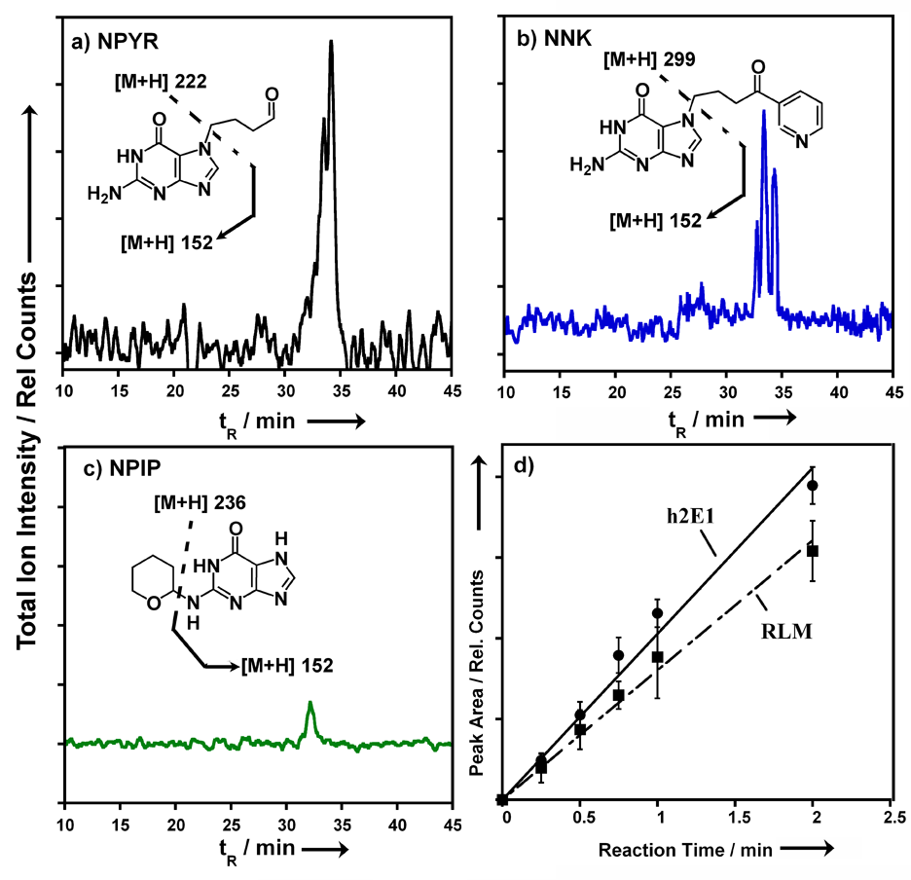
Using microsomes
as enzyme source:
•RLM-metabolic enzymes
• cyt P450s + CPR
• driven by NADPH
• h2E1 = cyt P450 2E1
+ CPR
• same DNA adducts as
reported previously

Slide 16
Case Study: Tamoxifen
Widely used chemotherapeutic and chemopreventive agent for breast cancer
DNA adducts and liver cancer in rats
Low liver cancer risk for humans
Species specific toxic chemistry?
Jordan, Nat. Rev. Drug Discovery, 2003, 2, 205-213.
White, Curr. Drug Metab. 2003, 4, 223-239.
Fisher et al. Natl. Cancer Inst., 1998, 90, 1371-1388.

Slide 17
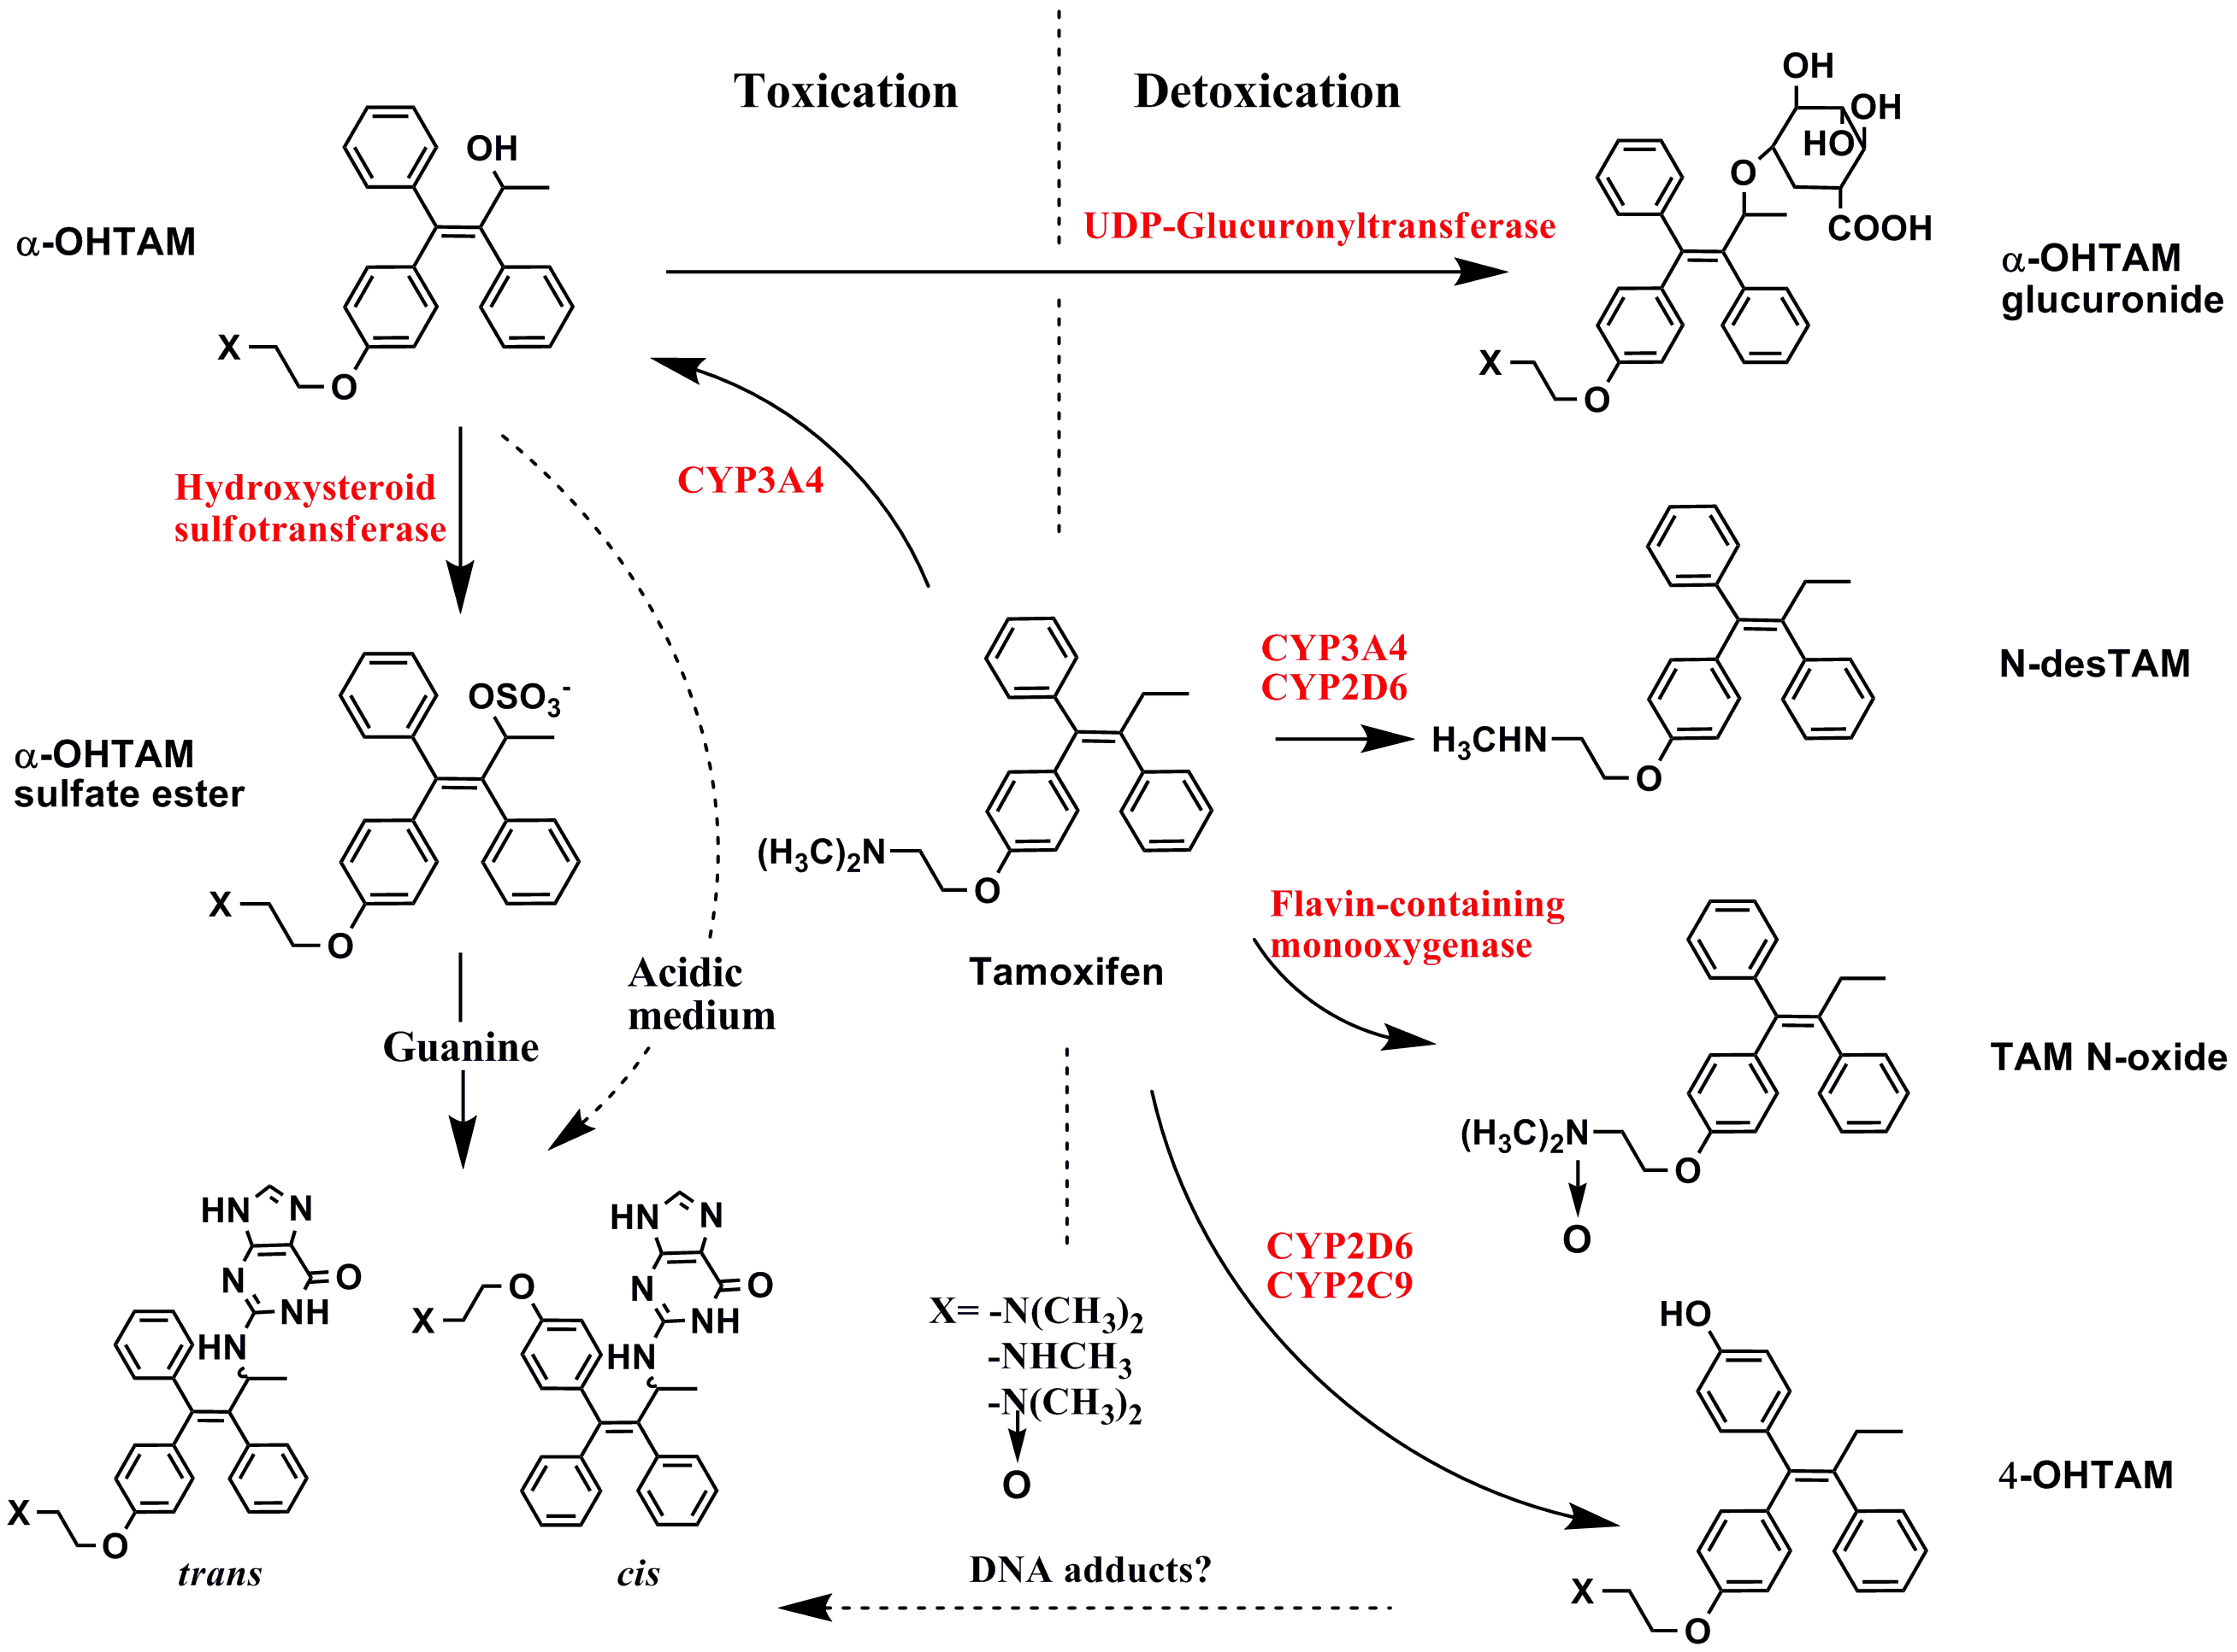
Tamoxifen Metabolism
Zhao et al, Chem. Res. Toxicol., 2009, 22, 341-347.

Slide 18
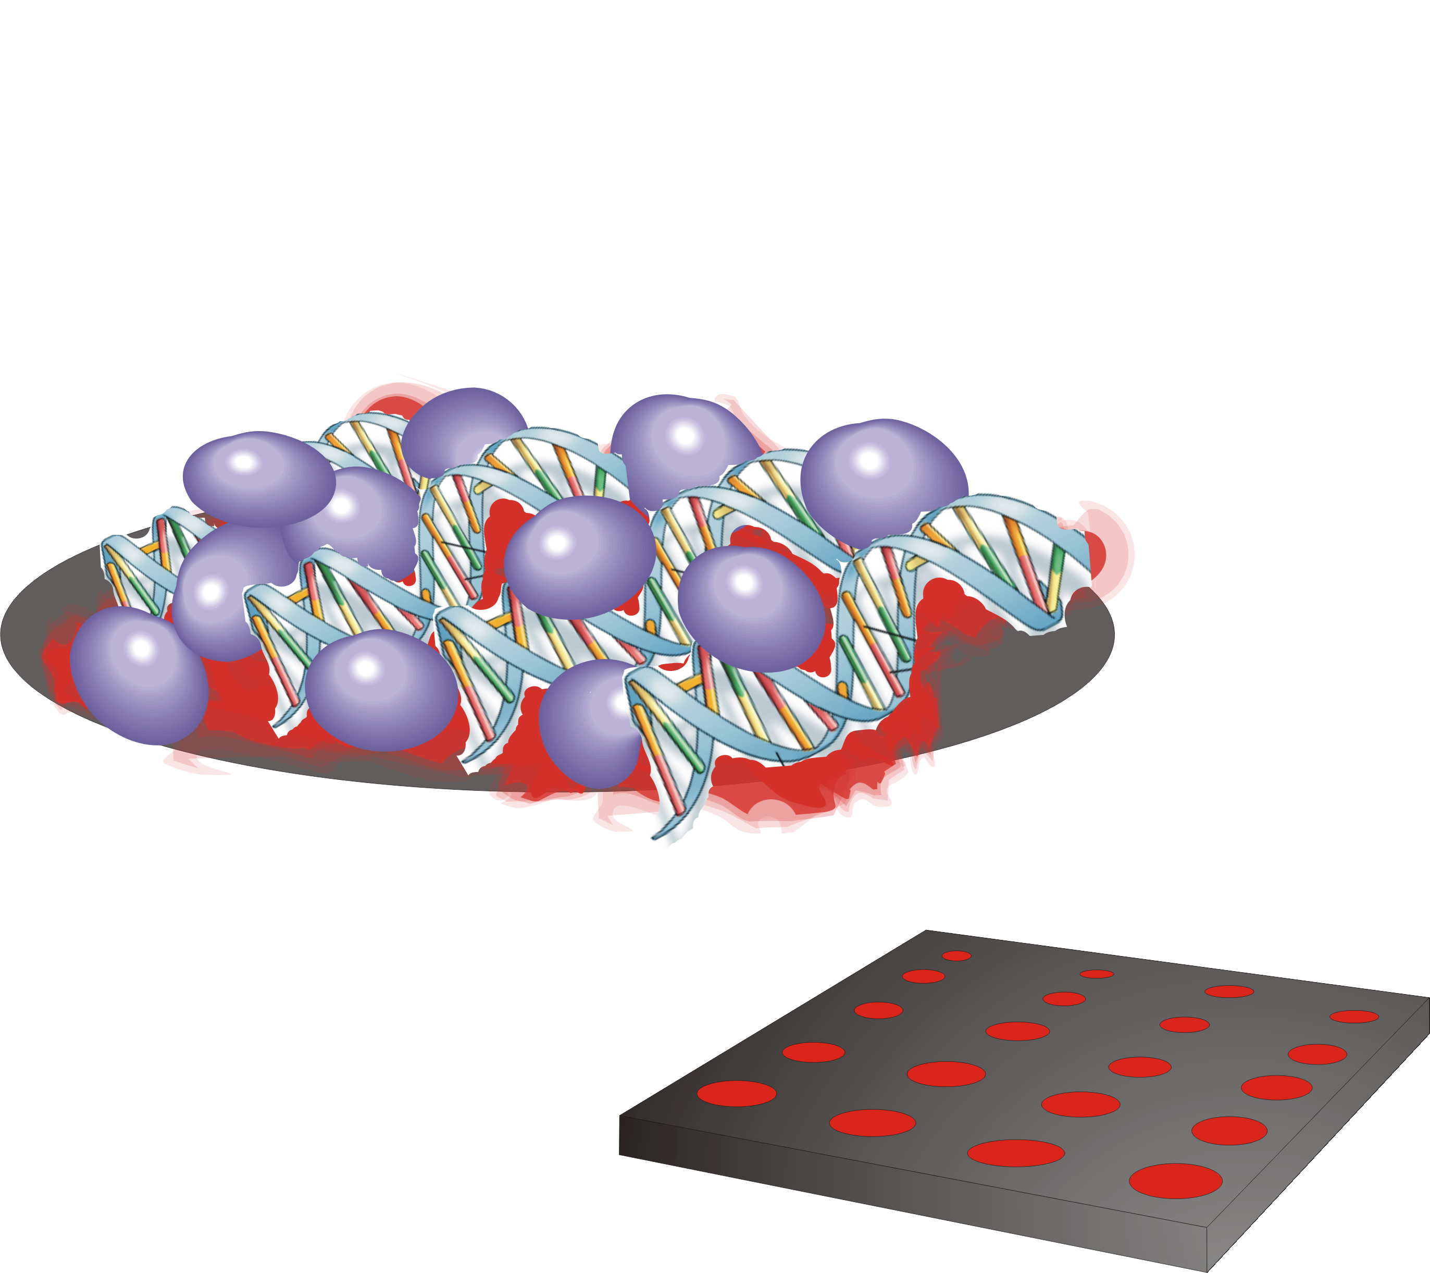
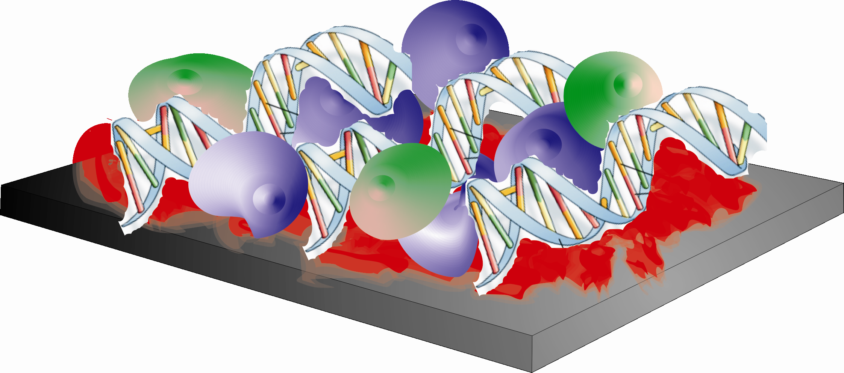
Enzyme Reaction
Rat/human liver microsomes
ECL ruthenium polymer [Ru(bpy)₂PVP₁₀]²⁺ ,
PVP = poly(vinylpyridine)
Droplet: substrate and enzyme cofactors
Tamoxifen
Reactive metabolite
Pyrolytic graphite (PG) chip
P450s
UGTs
DNA adduct

Slide 19
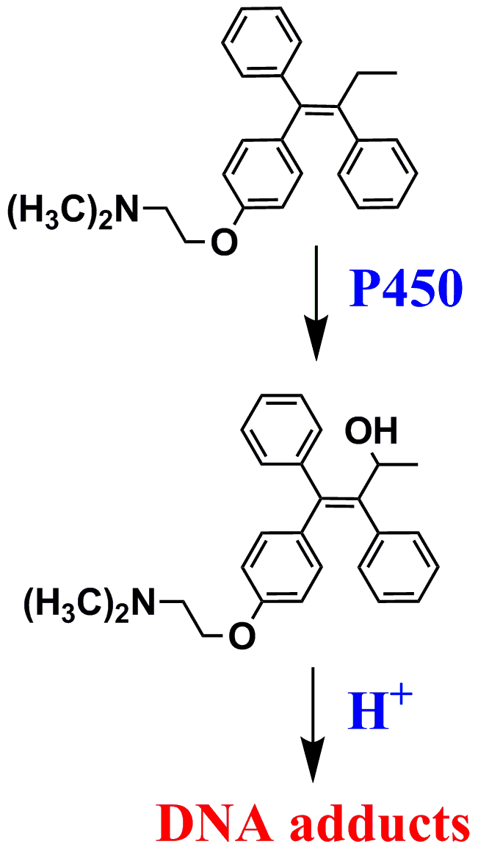
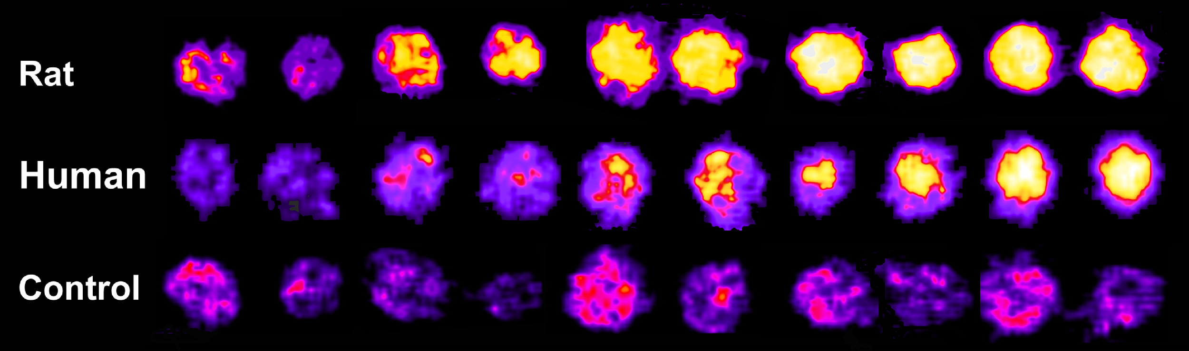

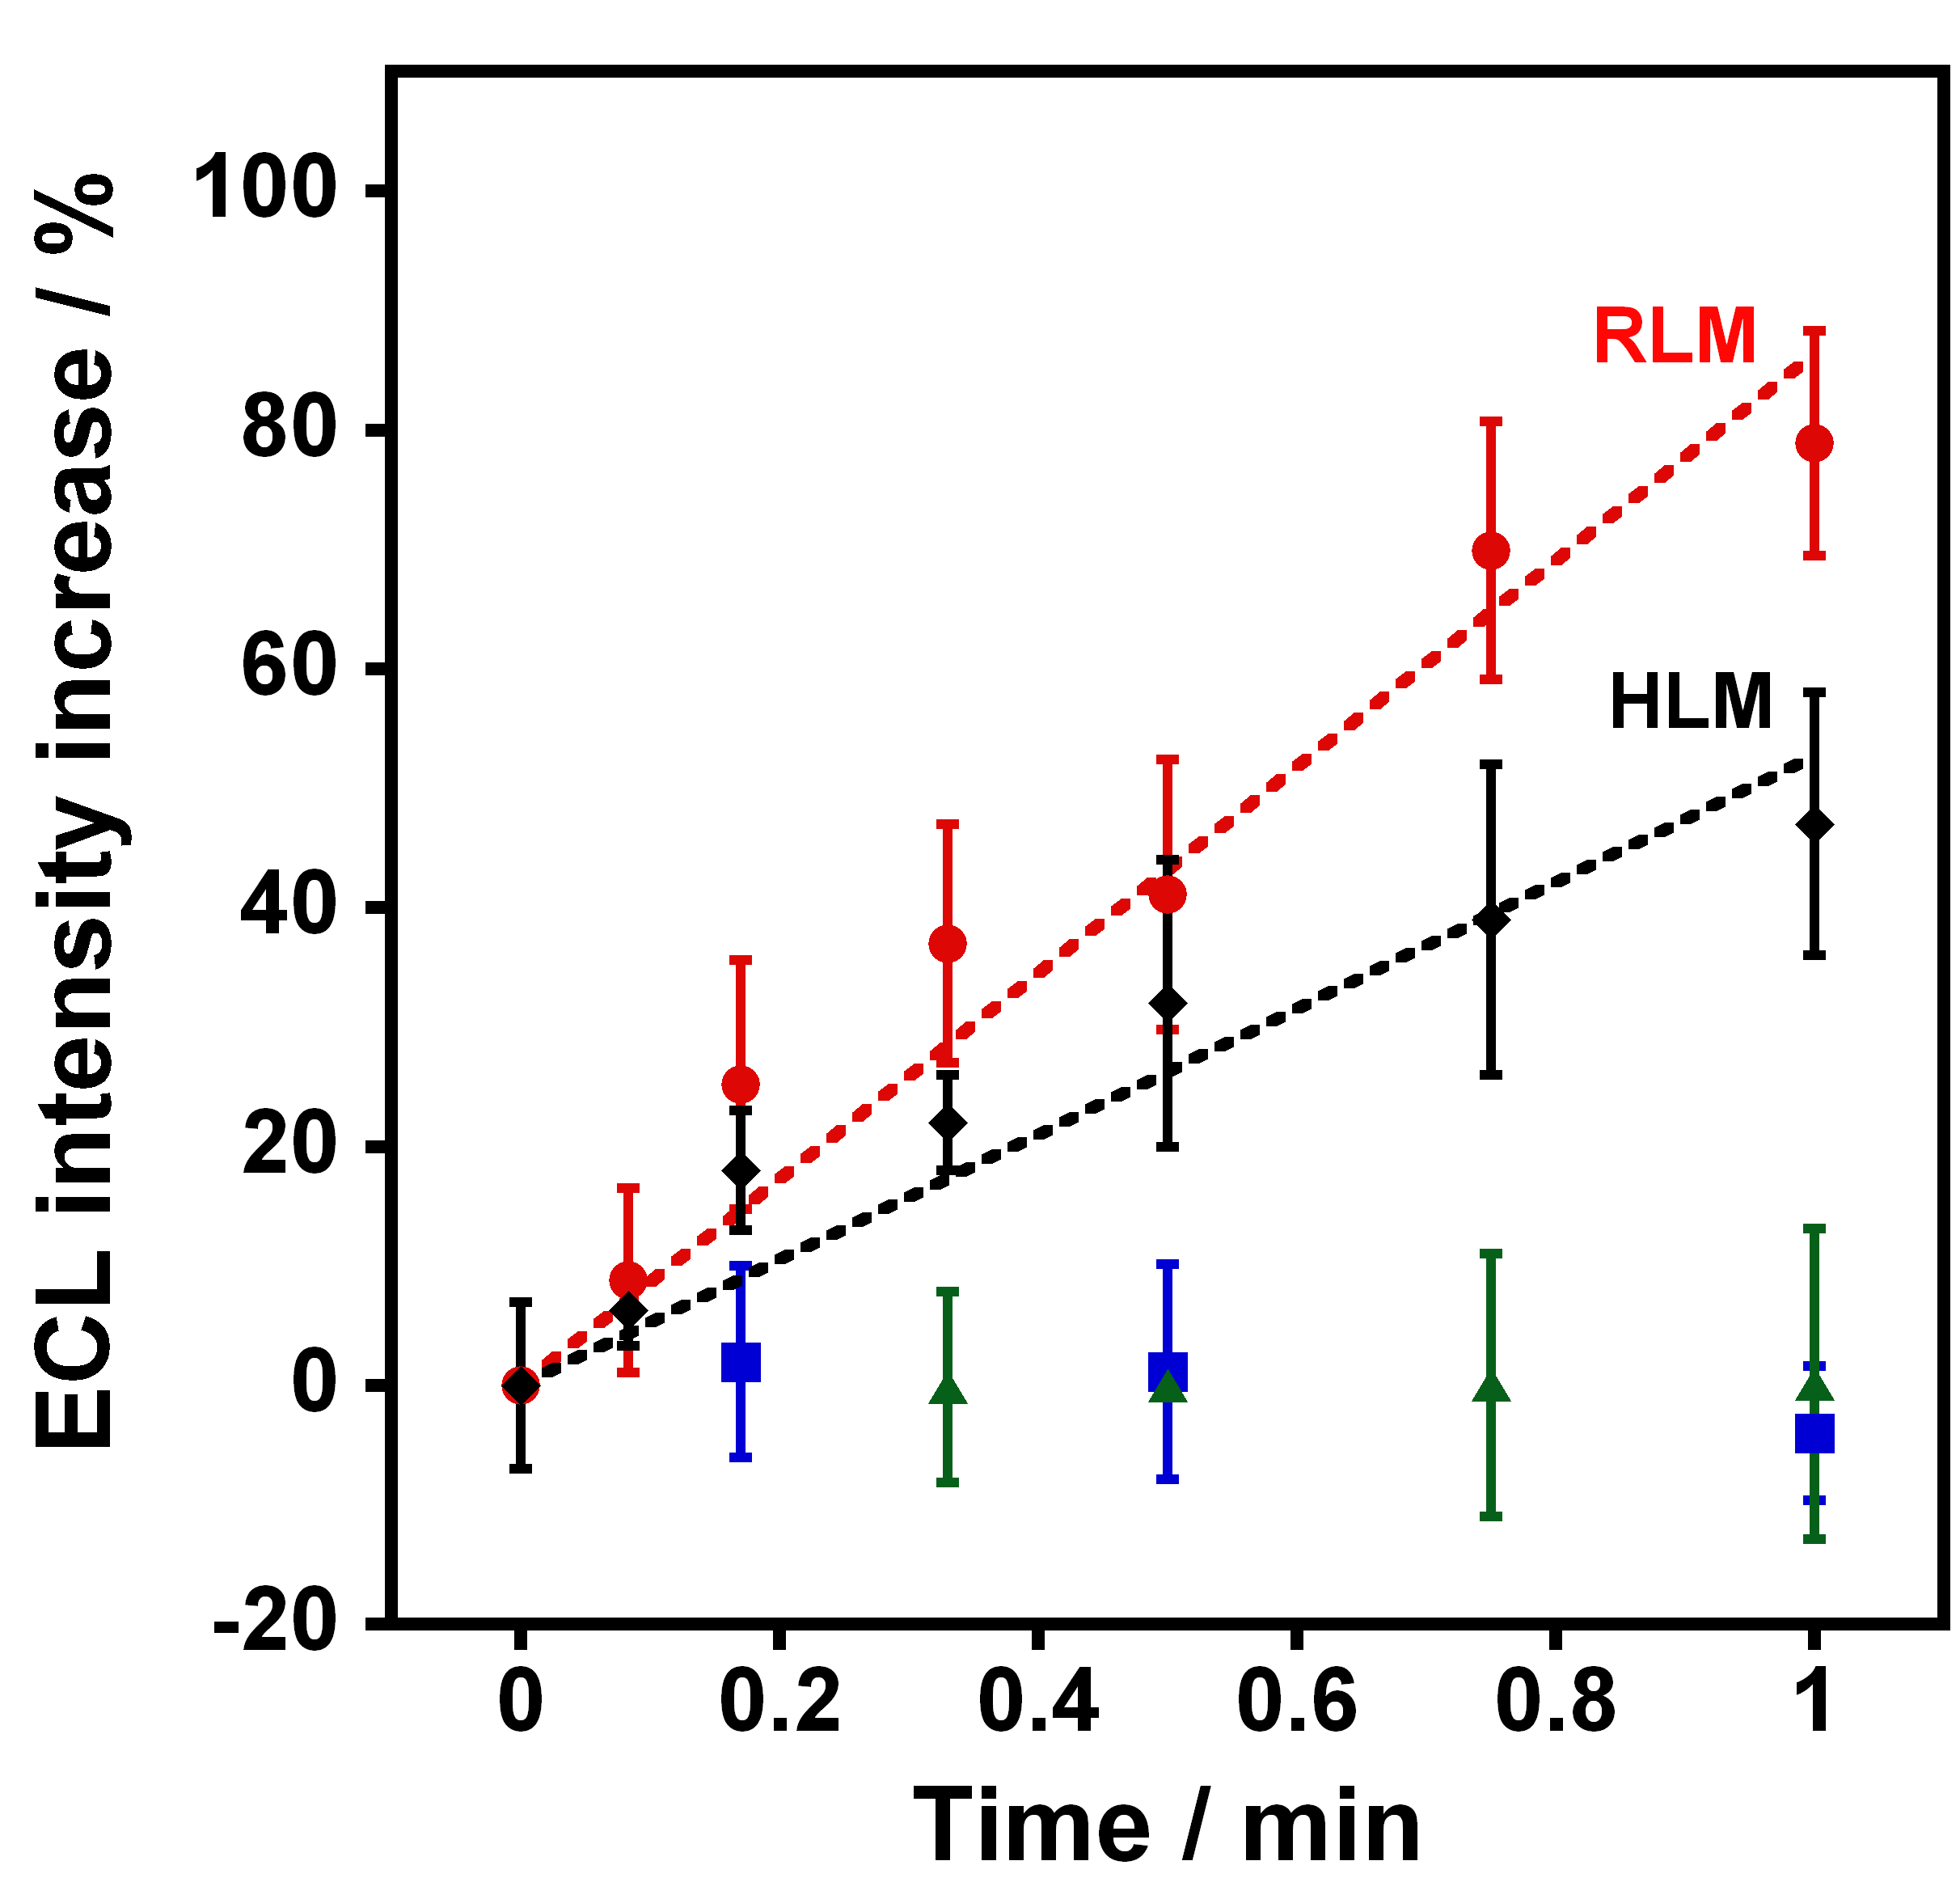
Tamoxifen activation
0s 15s 30s 45s 60s
RLM
HLM
Slightly larger ECL for RLM than HLM; faster DNA adduct formation rate for RLM
Zhao et al, Chem. Res. Toxicol., 2009, 22, 341-347.

Slide 20
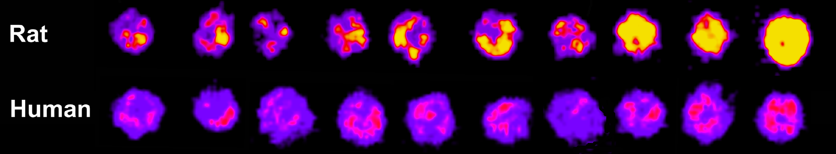
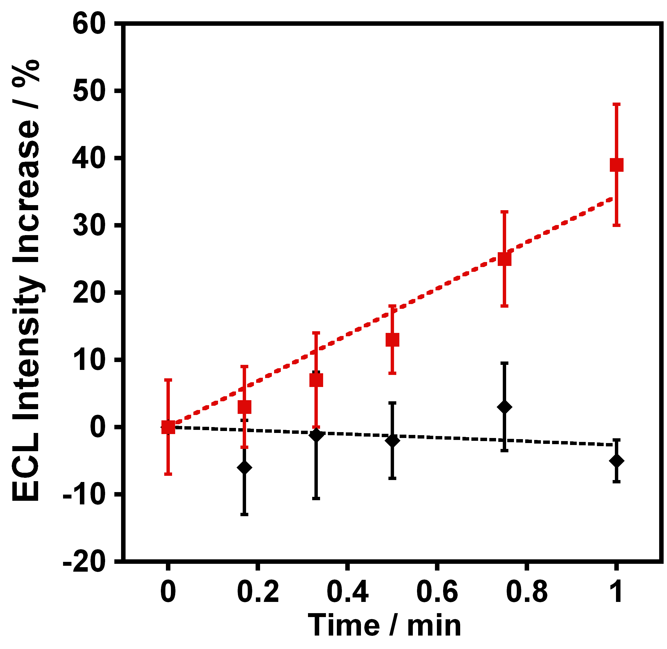
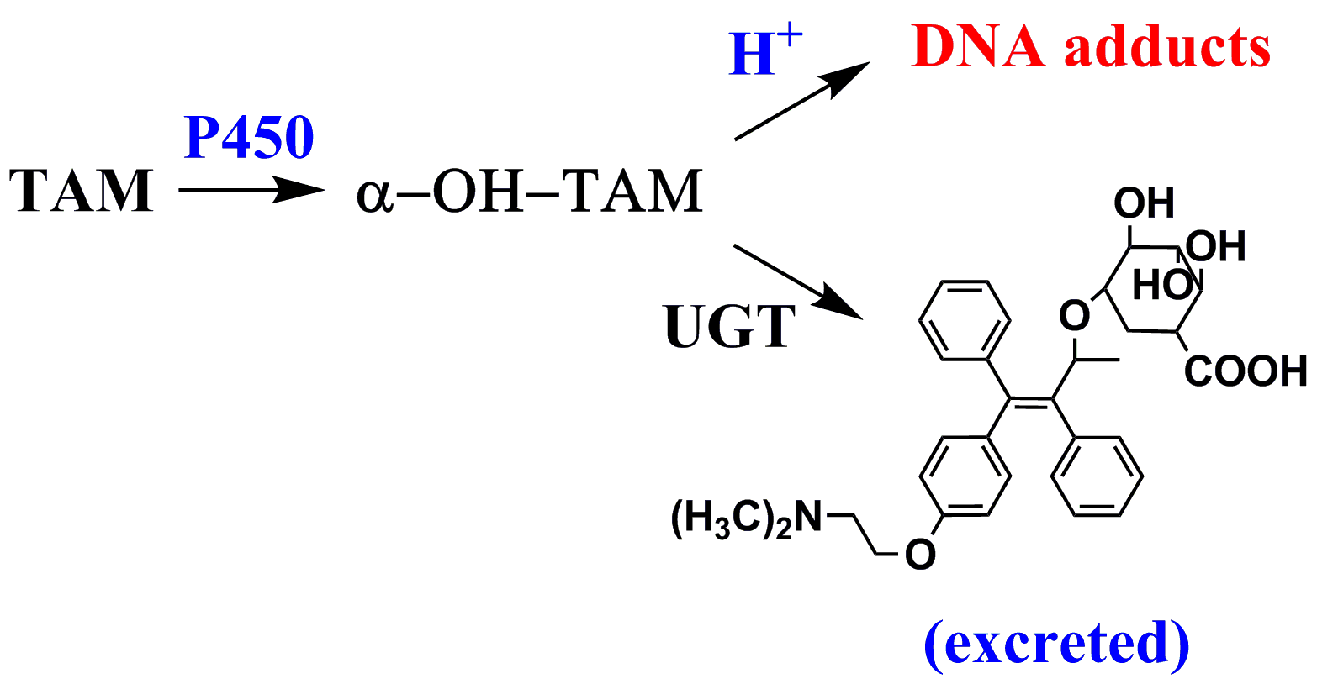
Detoxification via UGTs
(UDP-Glucuronyltransferase)
0s 15s 30s 45s 60s
RLM
HLM
RLM
HLM
No ECL increase for HLM + UGT
Better detoxication of tamoxifen via HLM – UGT lowers liver toxicity
confirmed by LC-MS
Zhao et al, Chem. Res. Toxicol., 2009, 22, 341-347.

Slide 21
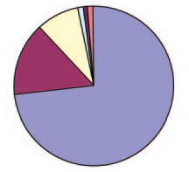
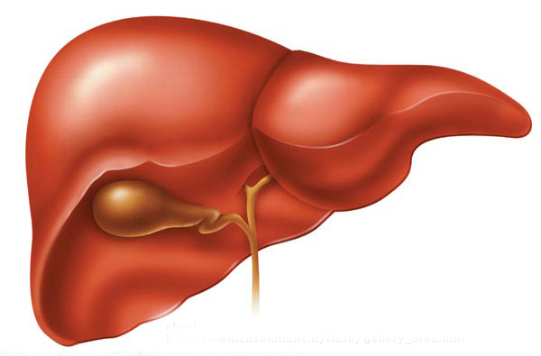
General platform for metabolic toxicity screening
Metabolic Enzymes
FMO
NAT
MAO
Esterase
Cyt P450s
UGT
N-acetyltransferase (NAT)
glutathione transferase (GST)
sulfotransferase (SUL)
UGT
P450
Homogenize
Low speed centrifugation
High speed centrifugation
Cytosol
Microsomes
S9 liver fraction
Williams et al. Drug Metab. Dispos. 2004, 32, 1201-1208.
Wienkers et al. Nat Rev Drug Discov. 2005, 4, 825-833.

Slide 22
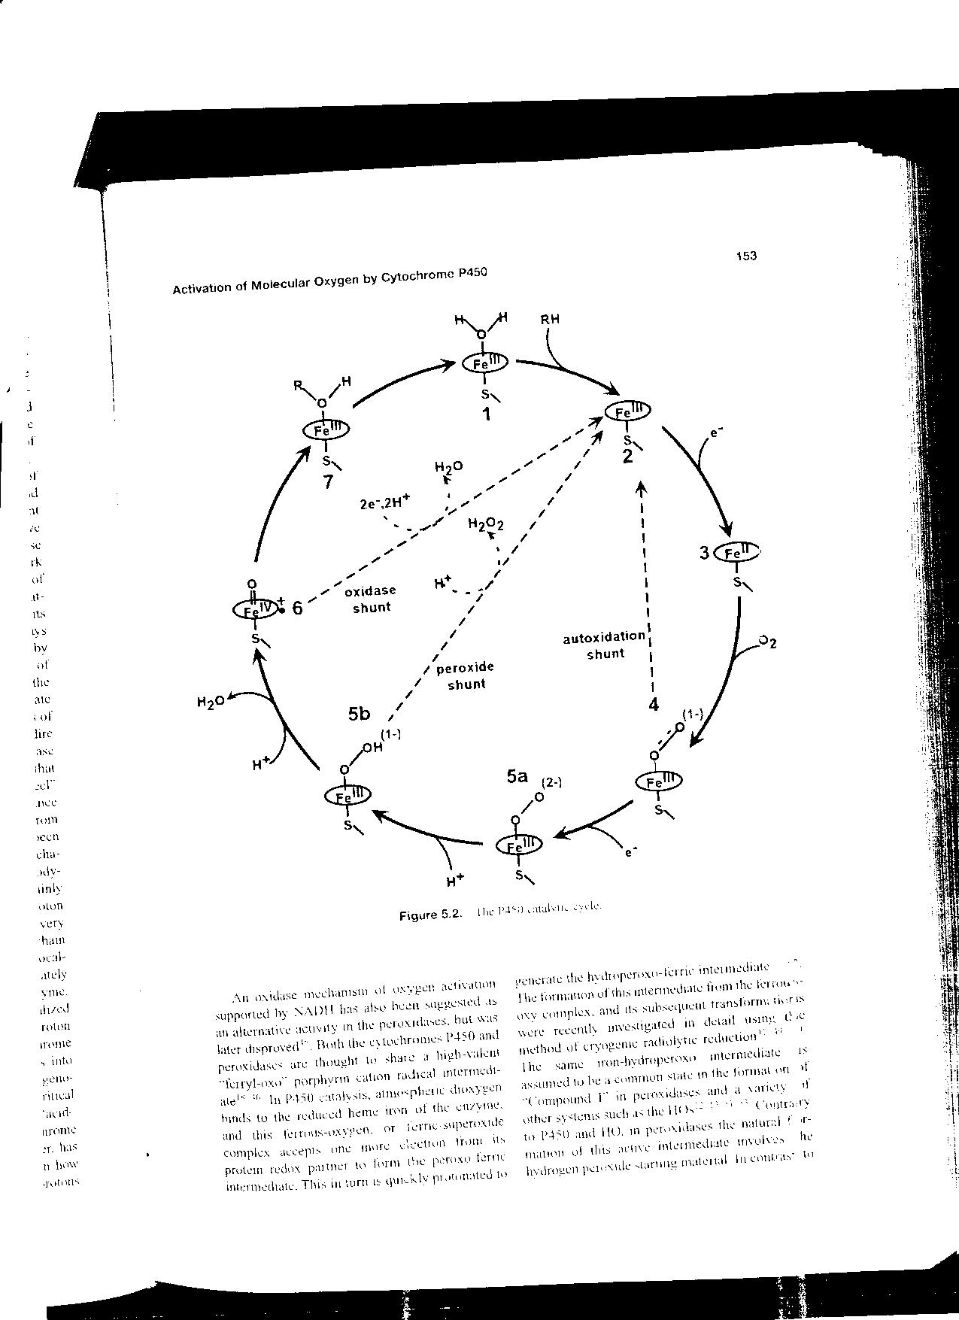
Cyt P450 Catalytic cycle
Ferric
heme
R-OH
(NADPH cyt P450 reductase - CPR)
Complex formed
H₂O₂
H⁺
(cyt b₅ or
CPR)
Sadagopan Krishnan, John B. Schenkman and James F Rusling, Feature Article: Bioelectronic Delivery of Electrons to Cytochrome P450 Enzymes. J. Phys. Chem. B 2011, 115 8371–8380.
Ortiz de Montellano, P.R. (ed) Cytochrome P450s, 2005

Slide 23
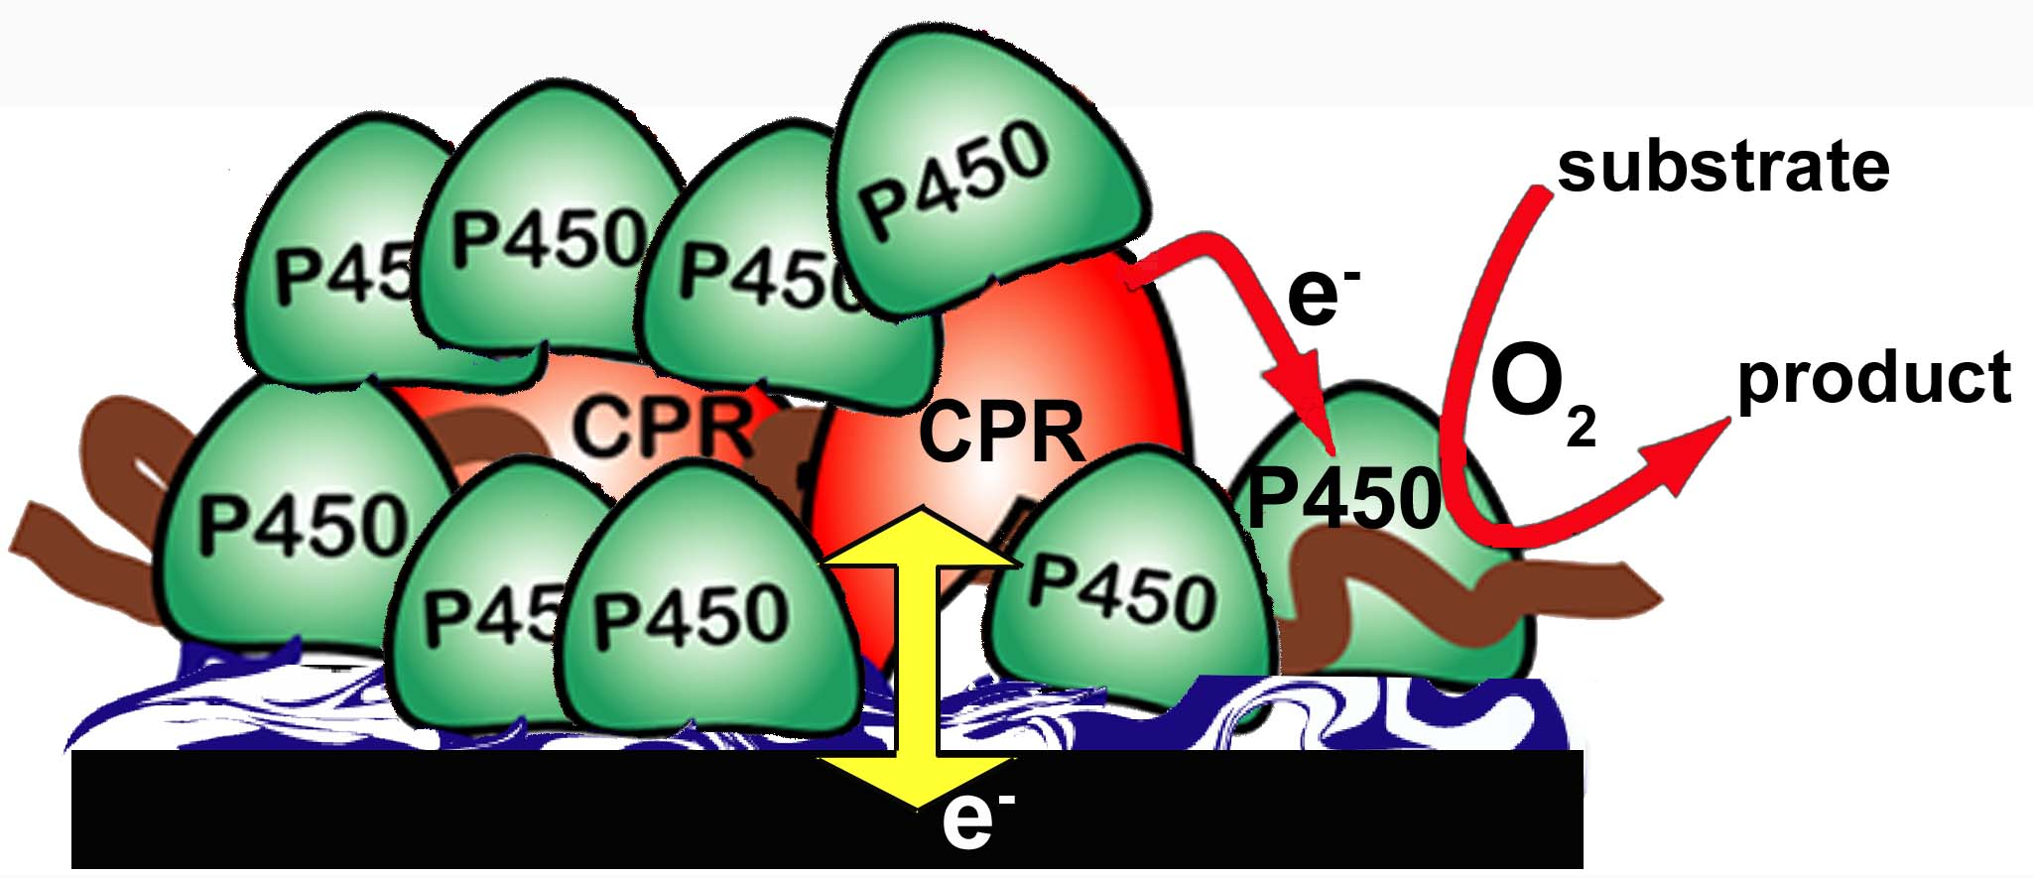
Electrode-driven activation of films of cyt P450s + reductase (CPR) mimics natural catalytic cycle
At pH 7.0; LbL film construction features:
Human Cyt P450s are positively charged (pI > 8.0)
Microsomes with CRP & Cyt b₅ are negatively charged (pI < 6.0)
Can also be done with liver microsomes (human or rat)
S. Krishnan, D. Wasalathanthri, L. Zhao, J. B. Schenkman, J. F. Rusling, Efficient Bioelectronic Actuation of the Natural Catalytic Pathway of Human Metabolic Cytochrome P450s, J. Am. Chem. Soc., 2011, 133, 1459.

Slide 24
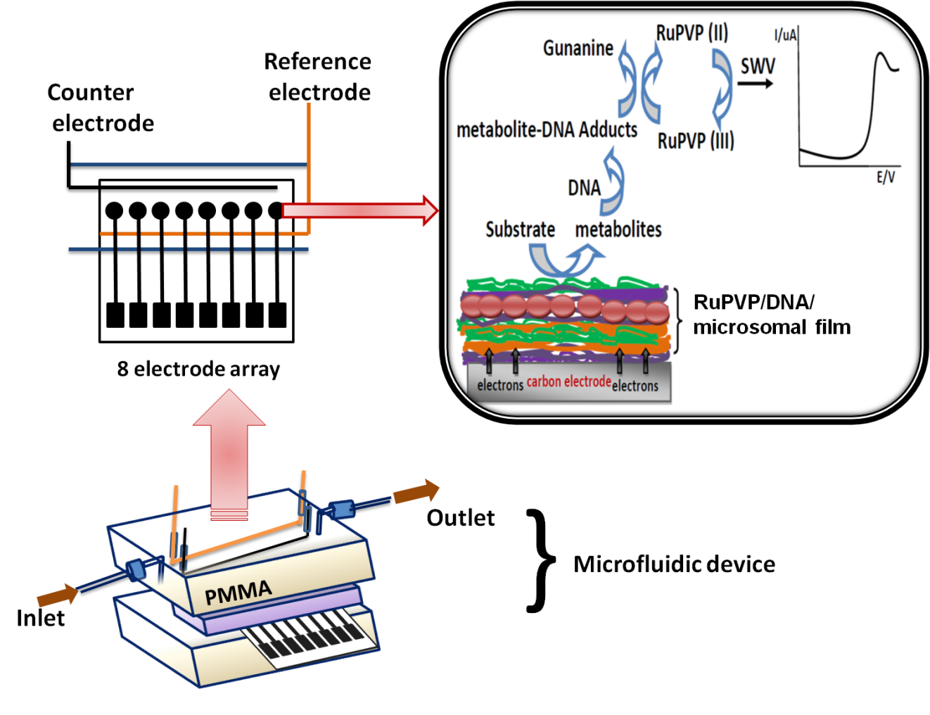
    Microfluidic electrochemical toxicity screening arrays using
    CPR/cyt P450 films
+ cyt P450s
Dhanuka P. Wasalathanthri, Vigneshwaran Mani, Chi K. Tang, James F. Rusling. Microfluidic Electrochemical Array for Detection of Reactive Metabolites Formed by Cytochrome P450 Enzymes, Anal. Chem, 2011, 83, 9499–9506.

Slide 25
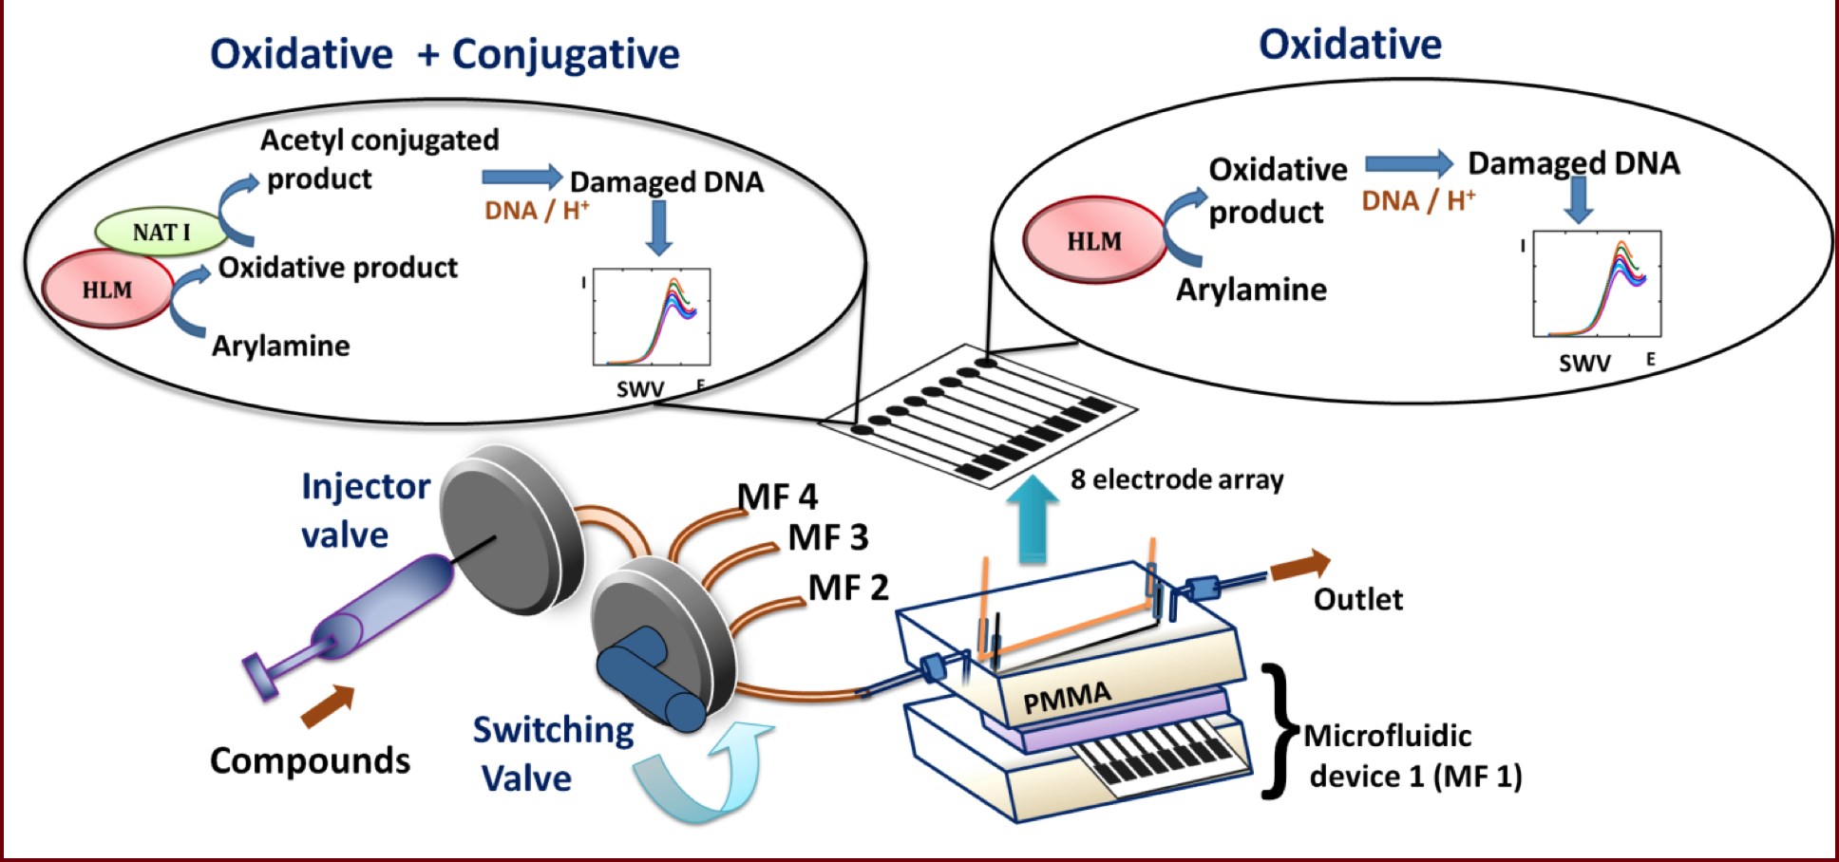
High throughput screening using microfluidic SWV system
Multiplexed toxicity screening platform, with reference to aryamine metabolism. Each microfluidic device features a polydimethylsiloxane (PDMS) channel in a poly(methylmethacrylate) (PMMA) housing. Ag/AgCl reference and Pt counter wire electrodes are symmetrically located along the channel housing replaceable 8-sensor arrays.

Slide 26
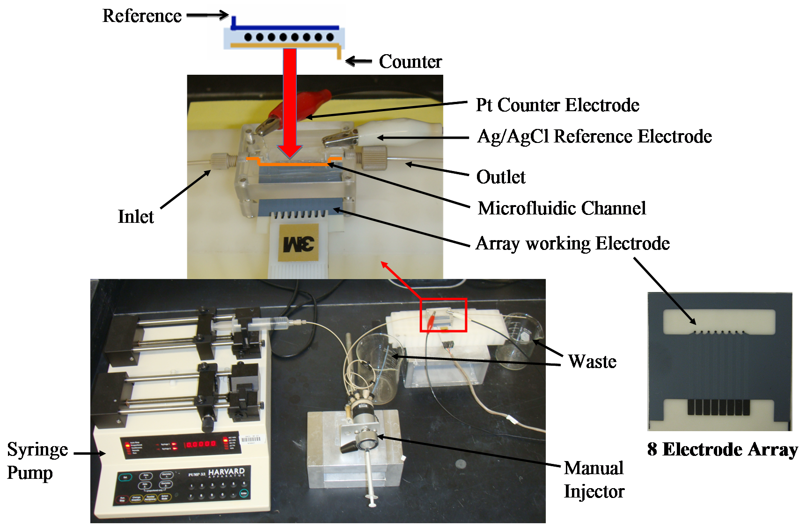
Microfluidic assay system
Kanichi, UK

Slide 27
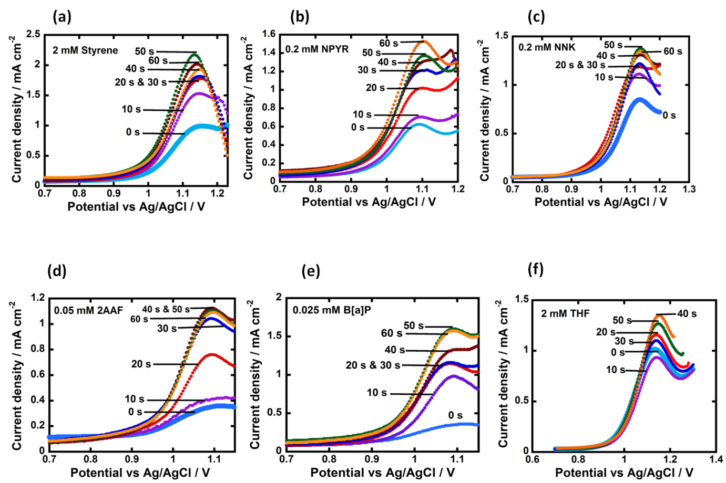
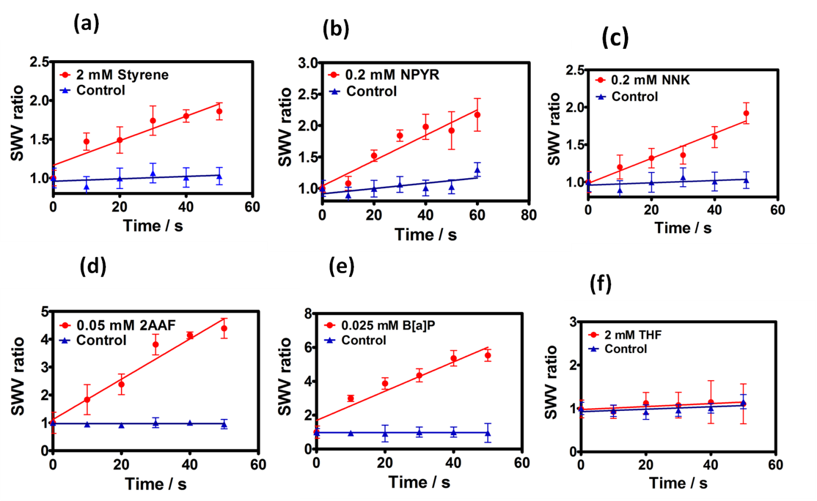
Slope of SWV signal vs. enzyme reaction time = relative rate of DNA damage

Slide 28
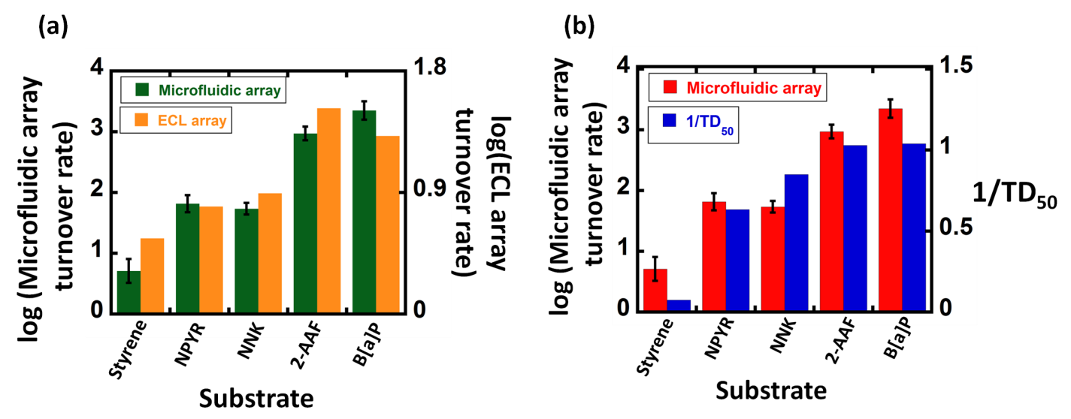
Correlations of Screening Array Data
With ECL arrays
With TD50 in rats

Slide 29
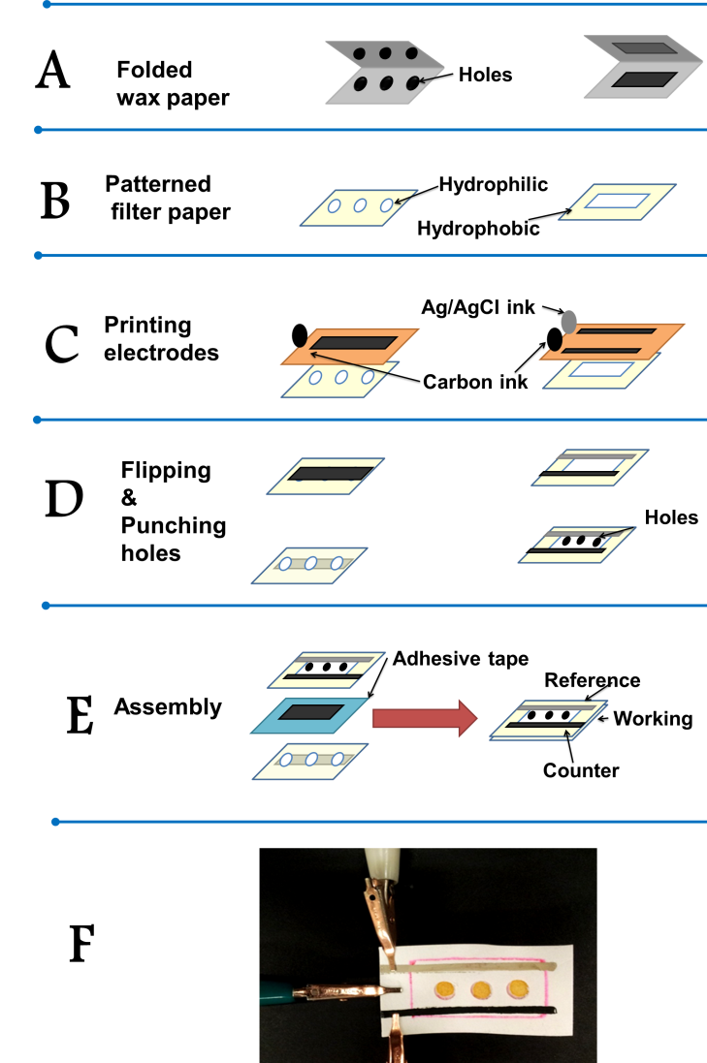
Paper-based Electrochemiluminescent Screening

Slide 30
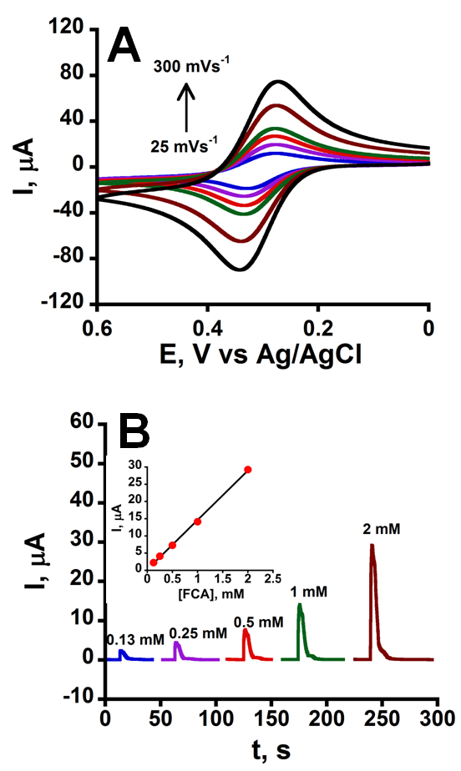
Figure 1. Electrochemical characterization of the basic microfluidic electrochemical device (mPED): (A) Cyclic voltammograms of 2 mM ferrocene carboxylic acid (FCA) in 0.5 M KCl at pH 7.0 (oxidation current is downward); (B) Amperometric oxidation current after injecting 0.13 to 2 mM ferrocene carboxylic acid into the fluidic channel at a potential of 0.36 V vs. Ag/AgCl

Slide 31
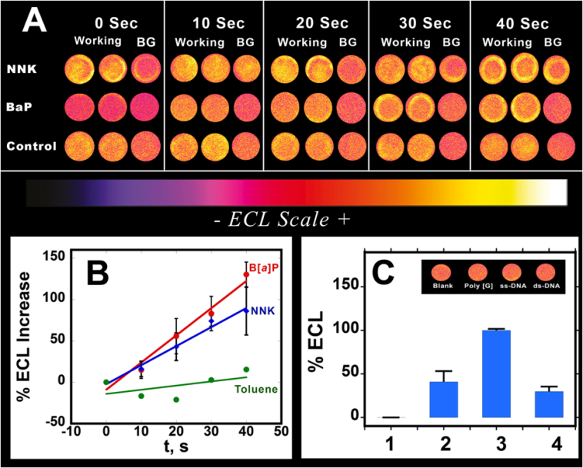
mPED tests for Benzopyrene and NNK
Spots are RuPVP+DNA+rat liver microsomes
ssDNA
polyG
PAA,
control
dsDNA

Slide 32
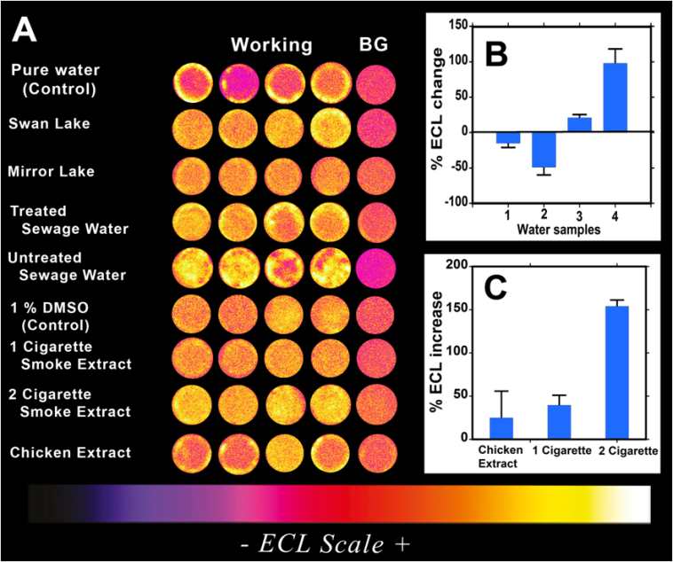
Testing environmental samples with the μPED

Slide 33
SUMMARY
• ECL and SWV arrays using RuPVP/DNA/enzyme films provide
complimentary results to conventional toxicity metrics
• Molecular information from LC-MS/MS using 96-well system with magnetic beads having DNA/enzyme films as “biocolloid” reactors
• Microfluidics provides constant reactant and oxygen flow, better sensitivity,
partial automation and faster assays (24 in ~30 min.)
• Paper-based microfluidic array (~$0.80/ea.) enables rapid, cheap field tests;
(need to improve reproducibility)
• Future: Organ-specific toxicity, incorporate oxidative DNA damage,
specific damage sites on tumor suppressor genes.

Slide 34
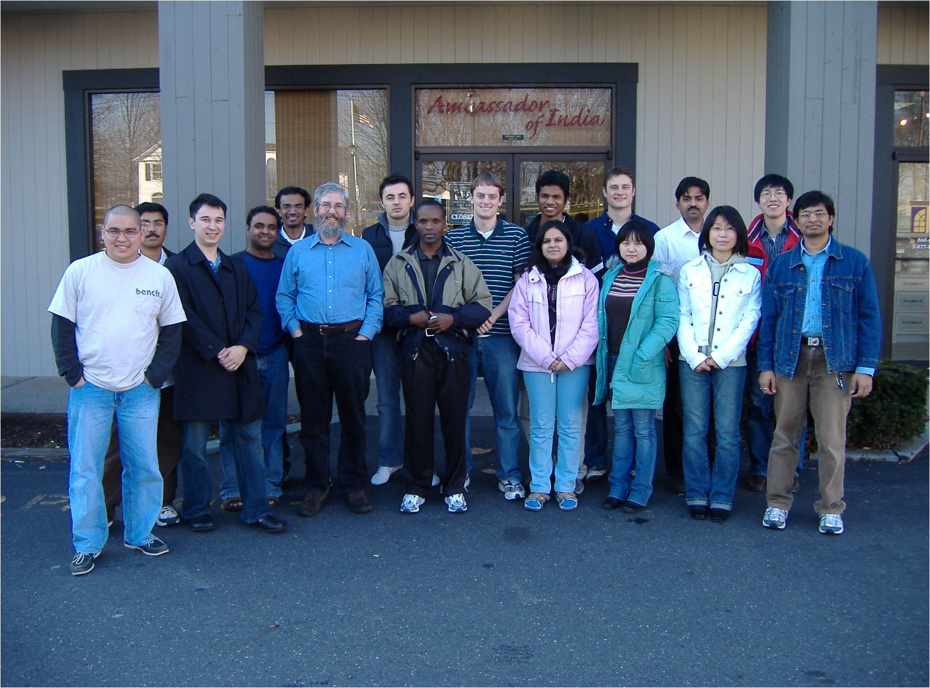
2008

Slide 35
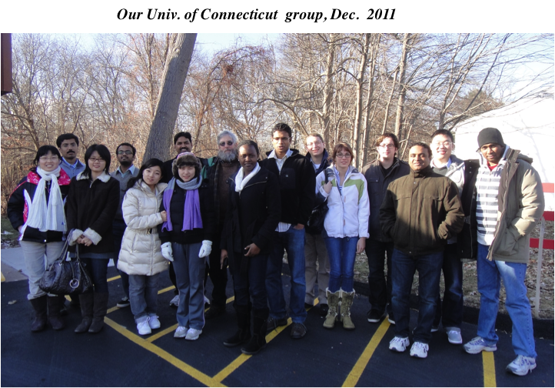

Slide 36
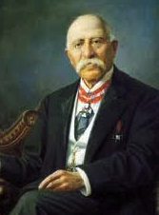
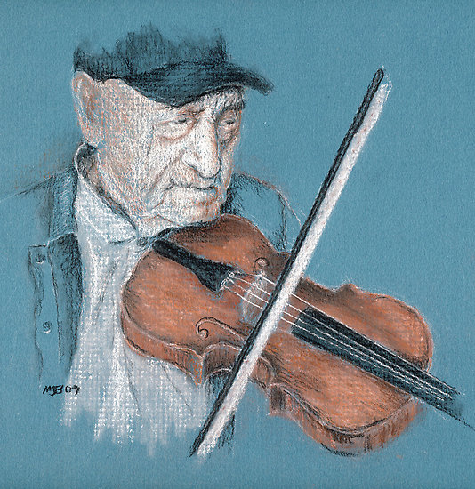




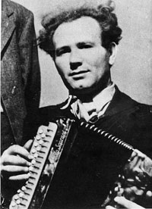

Thanks to NIEHS/NIH in US for funding!
Thanks again to all coworkers and collaborators
http://web.uconn.edu/rusling/
Grazie mille!

