Slide 1

INTRODUCTION TO ELECTROCHEMICAL BIOSENSORS
Modern and future approaches to medical diagnostics
James F. Rusling
Depts. of Chemistry, Univ. CT
Dept. of Surgery & Neag Cancer Center, Uconn Health
School of Chemistry, NUI Galway, Ireland

Slide 2
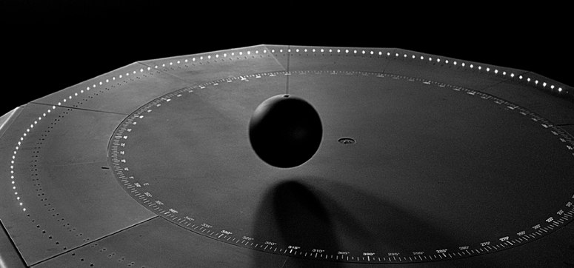
Sensors – all around us
Foucault’s Pendulum (1851)
(Palazzo della Ragione)
Earth's rotation causes the trajectory of the pendulum to change over time, monitored by a position sensor

Slide 3
Medical Diagnostics
Doctors increasingly rely on testing
Needs: rapid, cheap, and “low tech”
Done by technicians or patients
Some needs for in-vivo operation, with feedback

Slide 4
Principle of Electrochemical Biosensors
substrate
product
Enzyme
(label)
electrode
Apply voltage
Measure current prop.
to concentration of substrate
• Fast
• low cost
• high sensitivity
• possible to miniaturize

Slide 5
Equipment for developing electrochemical biosensors
potentiostat
insulator
electrode
material
reference
N₂
inlet
Protein film
counter
working electrode
E-t waveform
Cyclic
voltammetry
E, V
Electrochemical cell
time
Figure1

Slide 6
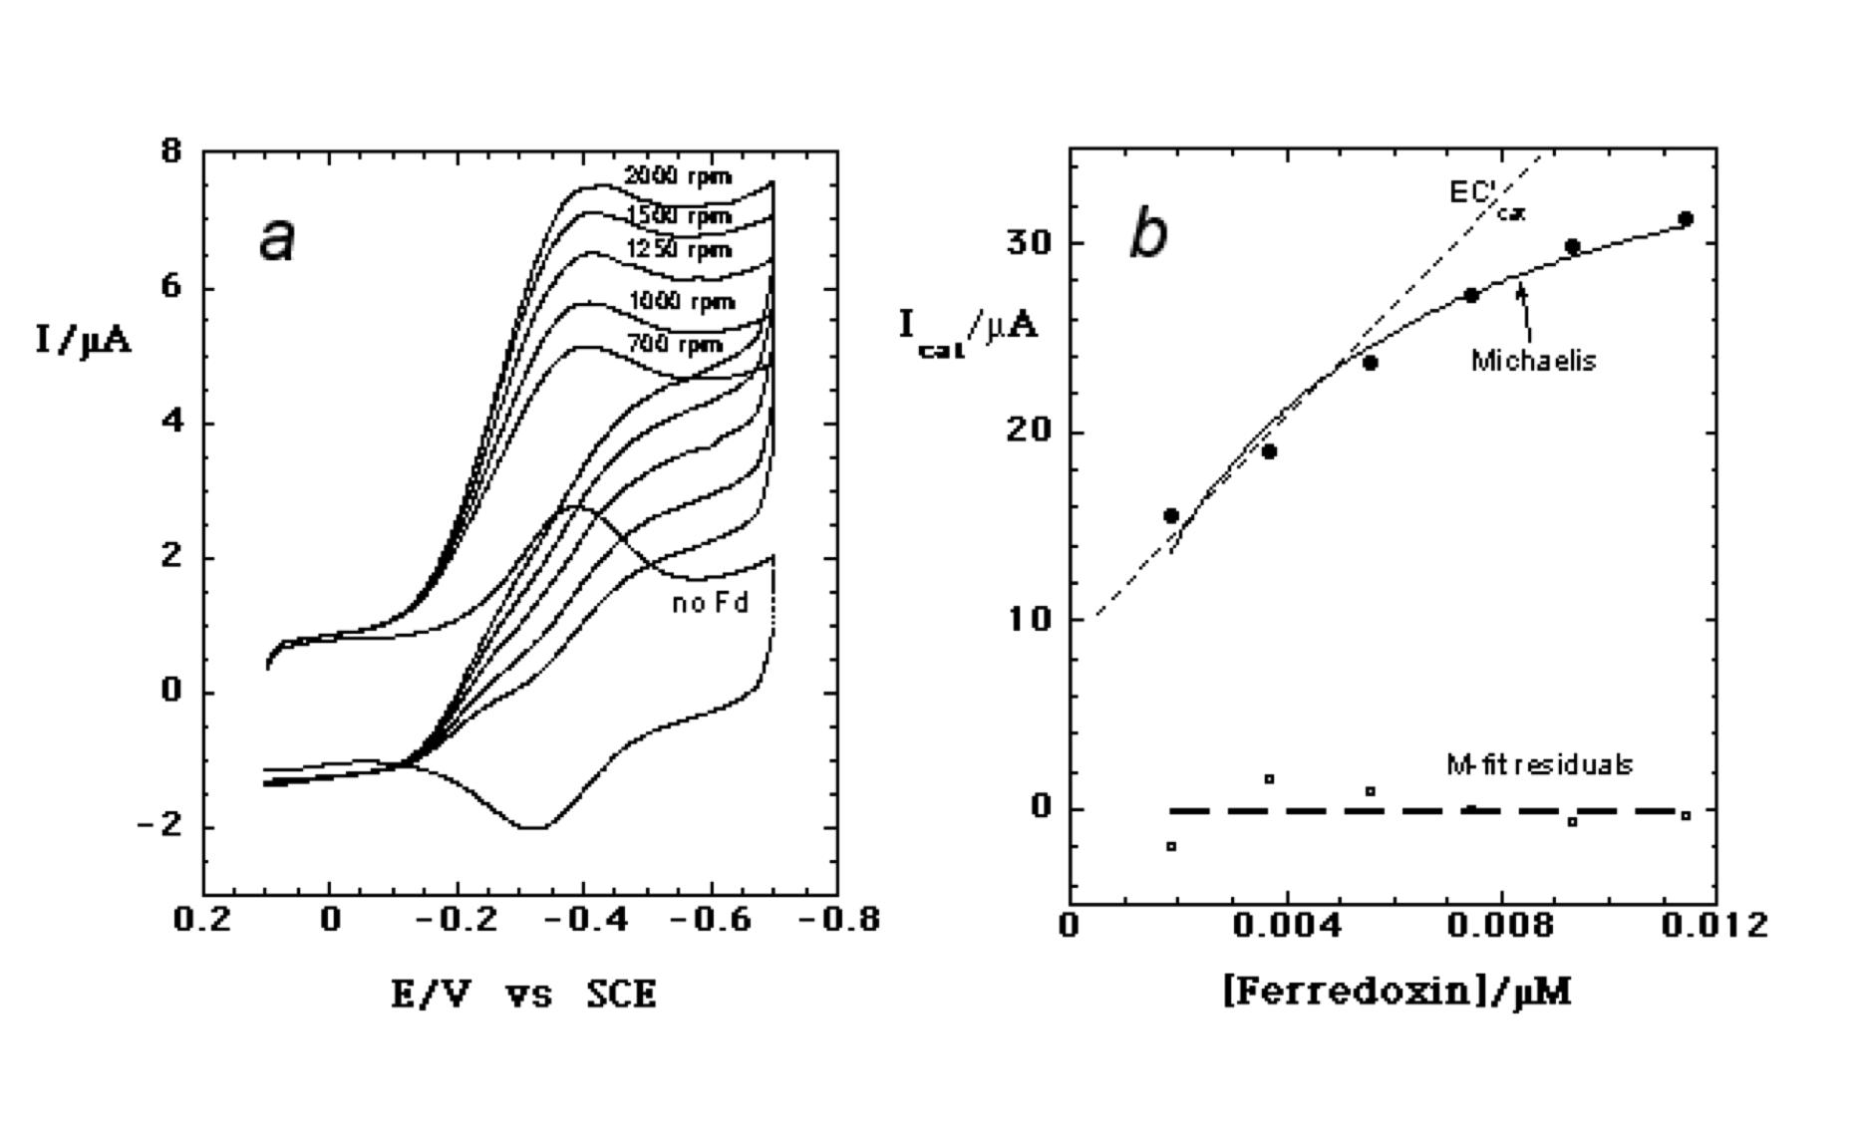
Example: Mb + Fd ⇔ Mb(Fd) → Mb + reduced Fd
k_{cat} = 102 s⁻¹ K_{M} = 112 ,
k_{cat}/K_{M} = 9.1 x 10⁴ M⁻¹ s⁻¹
RDVs of myoglobin-lipid film (a) on PG electrode with and without 3.9 mM ferredoxin (Fd) in pH 7 buffer; (b) Influence of ferredoxin concentration on I_{cat} showing non-linear regression fit onto Michaelis-Menten model (solid line) and a linear fit to the simple EC' catalytic model (dashed line).

Slide 7
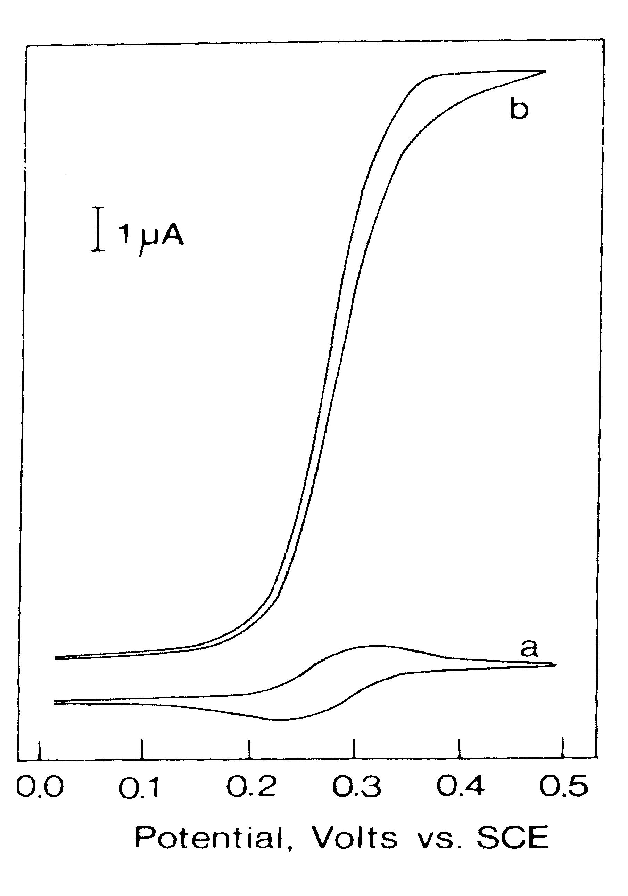
Catalytic enzyme electrochemistry
a basis for glucose biosensor - glucose oxidase
I = f [glucose]
oxidation
Fc + glucose
+ enzyme
Mediator shuttles
Electrons between
Enzyme and electrode
Fc mediator

Slide 8
• Most sensors use enzyme called glucose oxidase (GO)
• Most sensors are constructed on electrodes, and use a
mediator to carry electrons from enzyme to GO
Fc = mediator, ferrocene, an iron complex
These reactions occur in the sensor:
Fc
Fc⁺ + e- (measured)
GO_{R} + 2 Fc ⁺ --> GO_{ox} + 2 Fc
GO_{ox} + glucose --> GO_{R} + gluconolactone
Reach and Wilson, Anal. Chem. 64, 381A (1992)
G. Ramsay, Commercial Biosensors, J. Wiley, 1998.

Slide 9
Commercial Glucose Sensors
Biggest biosensor success story!
Diabetic patients monitor blood glucose at home
First made by Medisense (early 1990s), now 5 or more commercial test systems
Rapid analysis from single drop of blood
Enzyme-electrochemical device on a slide

Slide 10
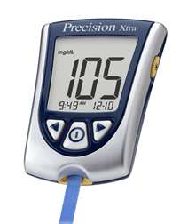
Glucose biosensor test strips (~$0.50-1.00 ea.)
Dry coating of GO + Fc
e’s
electrodes
Patient Autopipettes drop of blood
onto slide; inserted into meter
Patient reads glucose
level on meter
I
Output:
Amperometry
Constant E, more sensitive than CV
t

Slide 11
Research on glucose sensors
Non-invasive biosensors - skin, saliva
Implantable glucose sensors to accompany artificial pancreas - feedback control of insulin supply
Typical use 3-4 weeks for implantable sensors in humans;
Failure involves fouling, inflammation
In vivo calibration? Auto-calibration?

Slide 12
Other biosensors
Cholesterol - based on cholesterol oxidase
Antigen-antibody sensors - toxic substances, pathogenic bacteria, proteins
Small molecules and ions in living things: H⁺, K⁺, Na⁺, NH₃, CO₂, H₂O₂ (Abbott)
DNA genomic arrays and DNA damage
Micro or nanoarrays, optical abs. or fluorescence (proteins, small molecules)

Slide 13
Detection of hydrogen peroxide
Conductive polymers efficiently wire
peroxidase enzymes to graphite
Enzyme
PSS layer
layer
SPAN layer
(sulfonated polyaniline,
Conductive polyion)
e’s
Xin Yu, G. A. Sotzing, F. Papadimitrakopoulos, J. F. Rusling, Highly Efficient Wiring of Enzymes to Electrodes by Ultrathin Conductive Polyion Underlayers: Enhanced Catalytic Response to Hydrogen Peroxide, Anal. Chem., 2003, 75, 4565-4571.

Slide 14
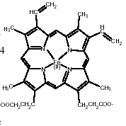
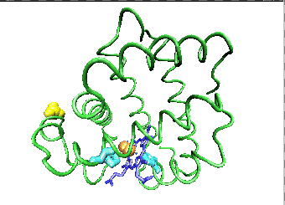
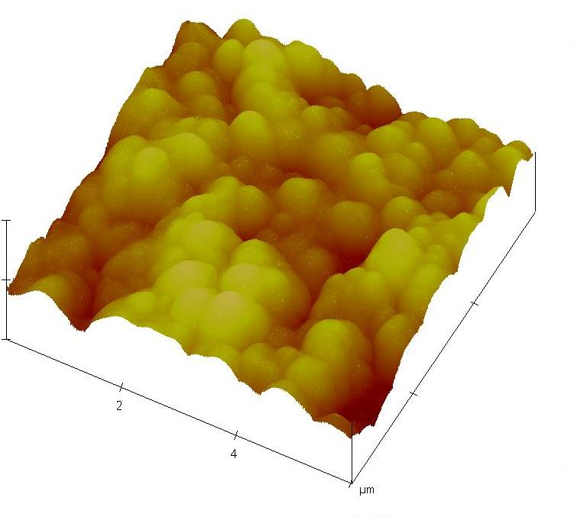
Horseradish Peroxidase (HRP)
100nm
50nm
Tapping mode atomic force microscopy (AFM) image of HRP film

Slide 16
Catalytic reduction of H₂O₂ by peroxidase films
Catalytic cycles increase current
reduction
Fe^{III}/Fe^{II}

Slide 17
3. Rotating electrode amperometry at 0 V
HRP, 50 nmol H₂O₂ additions
reduction
span
No span

Slide 18
Rotating electrode amperometry at 0 V
Span/HRP
Span/Mb
Sensitivity much higher with conductive polymer (SPAN);
Electrically wires all the protein to electrode

Slide 19
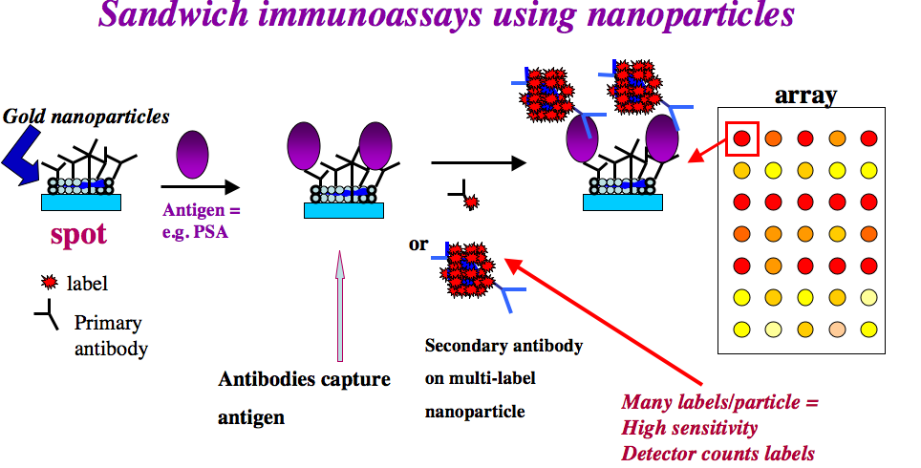
Nanoparticle Multilabel Strategies – high sensitivity
• detection by fluorescence, amperometry, electrochemiluminescence
• non-specific binding must be minimized
• commercial bead-based assays, expensive hardware

Slide 20
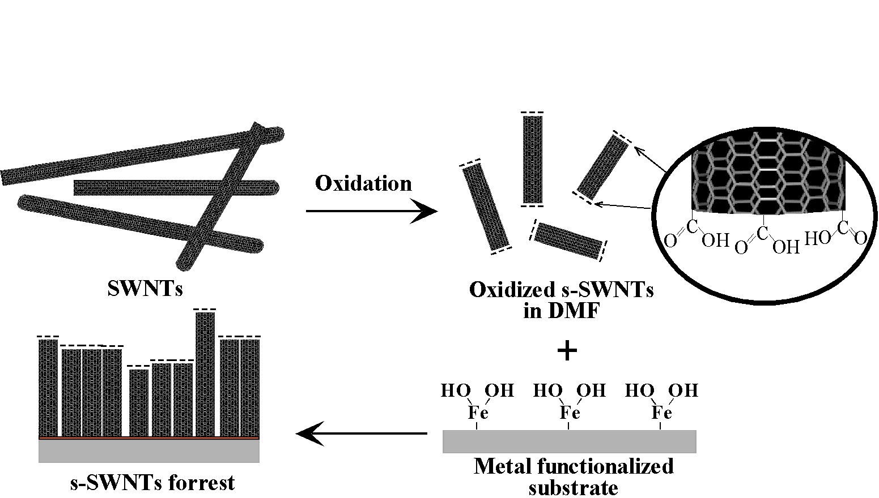
Single-Walled Carbon Nanotube
Forests: Antigen-Antibody Sensing
~1.4 nm diameter, high conductivity
SPAN or
Nafion
Chattopadhyay, Galeska, Papadimitrakopoulos, J. Am. Chem. Soc. 2001, 123, 9451.
End COOH groups allow chemical attachment to proteins (antibodies)
High conductivity to conduct signal (e’s) from enzyme label to meas. circuit

Slide 21
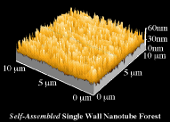
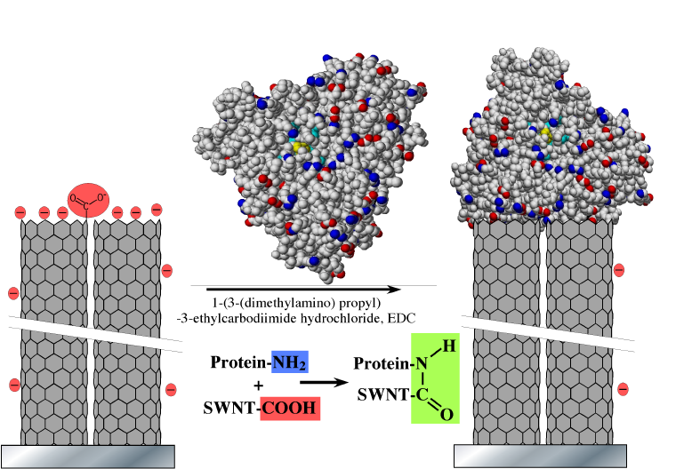
SWNT forests
bioconjugation

Slide 22
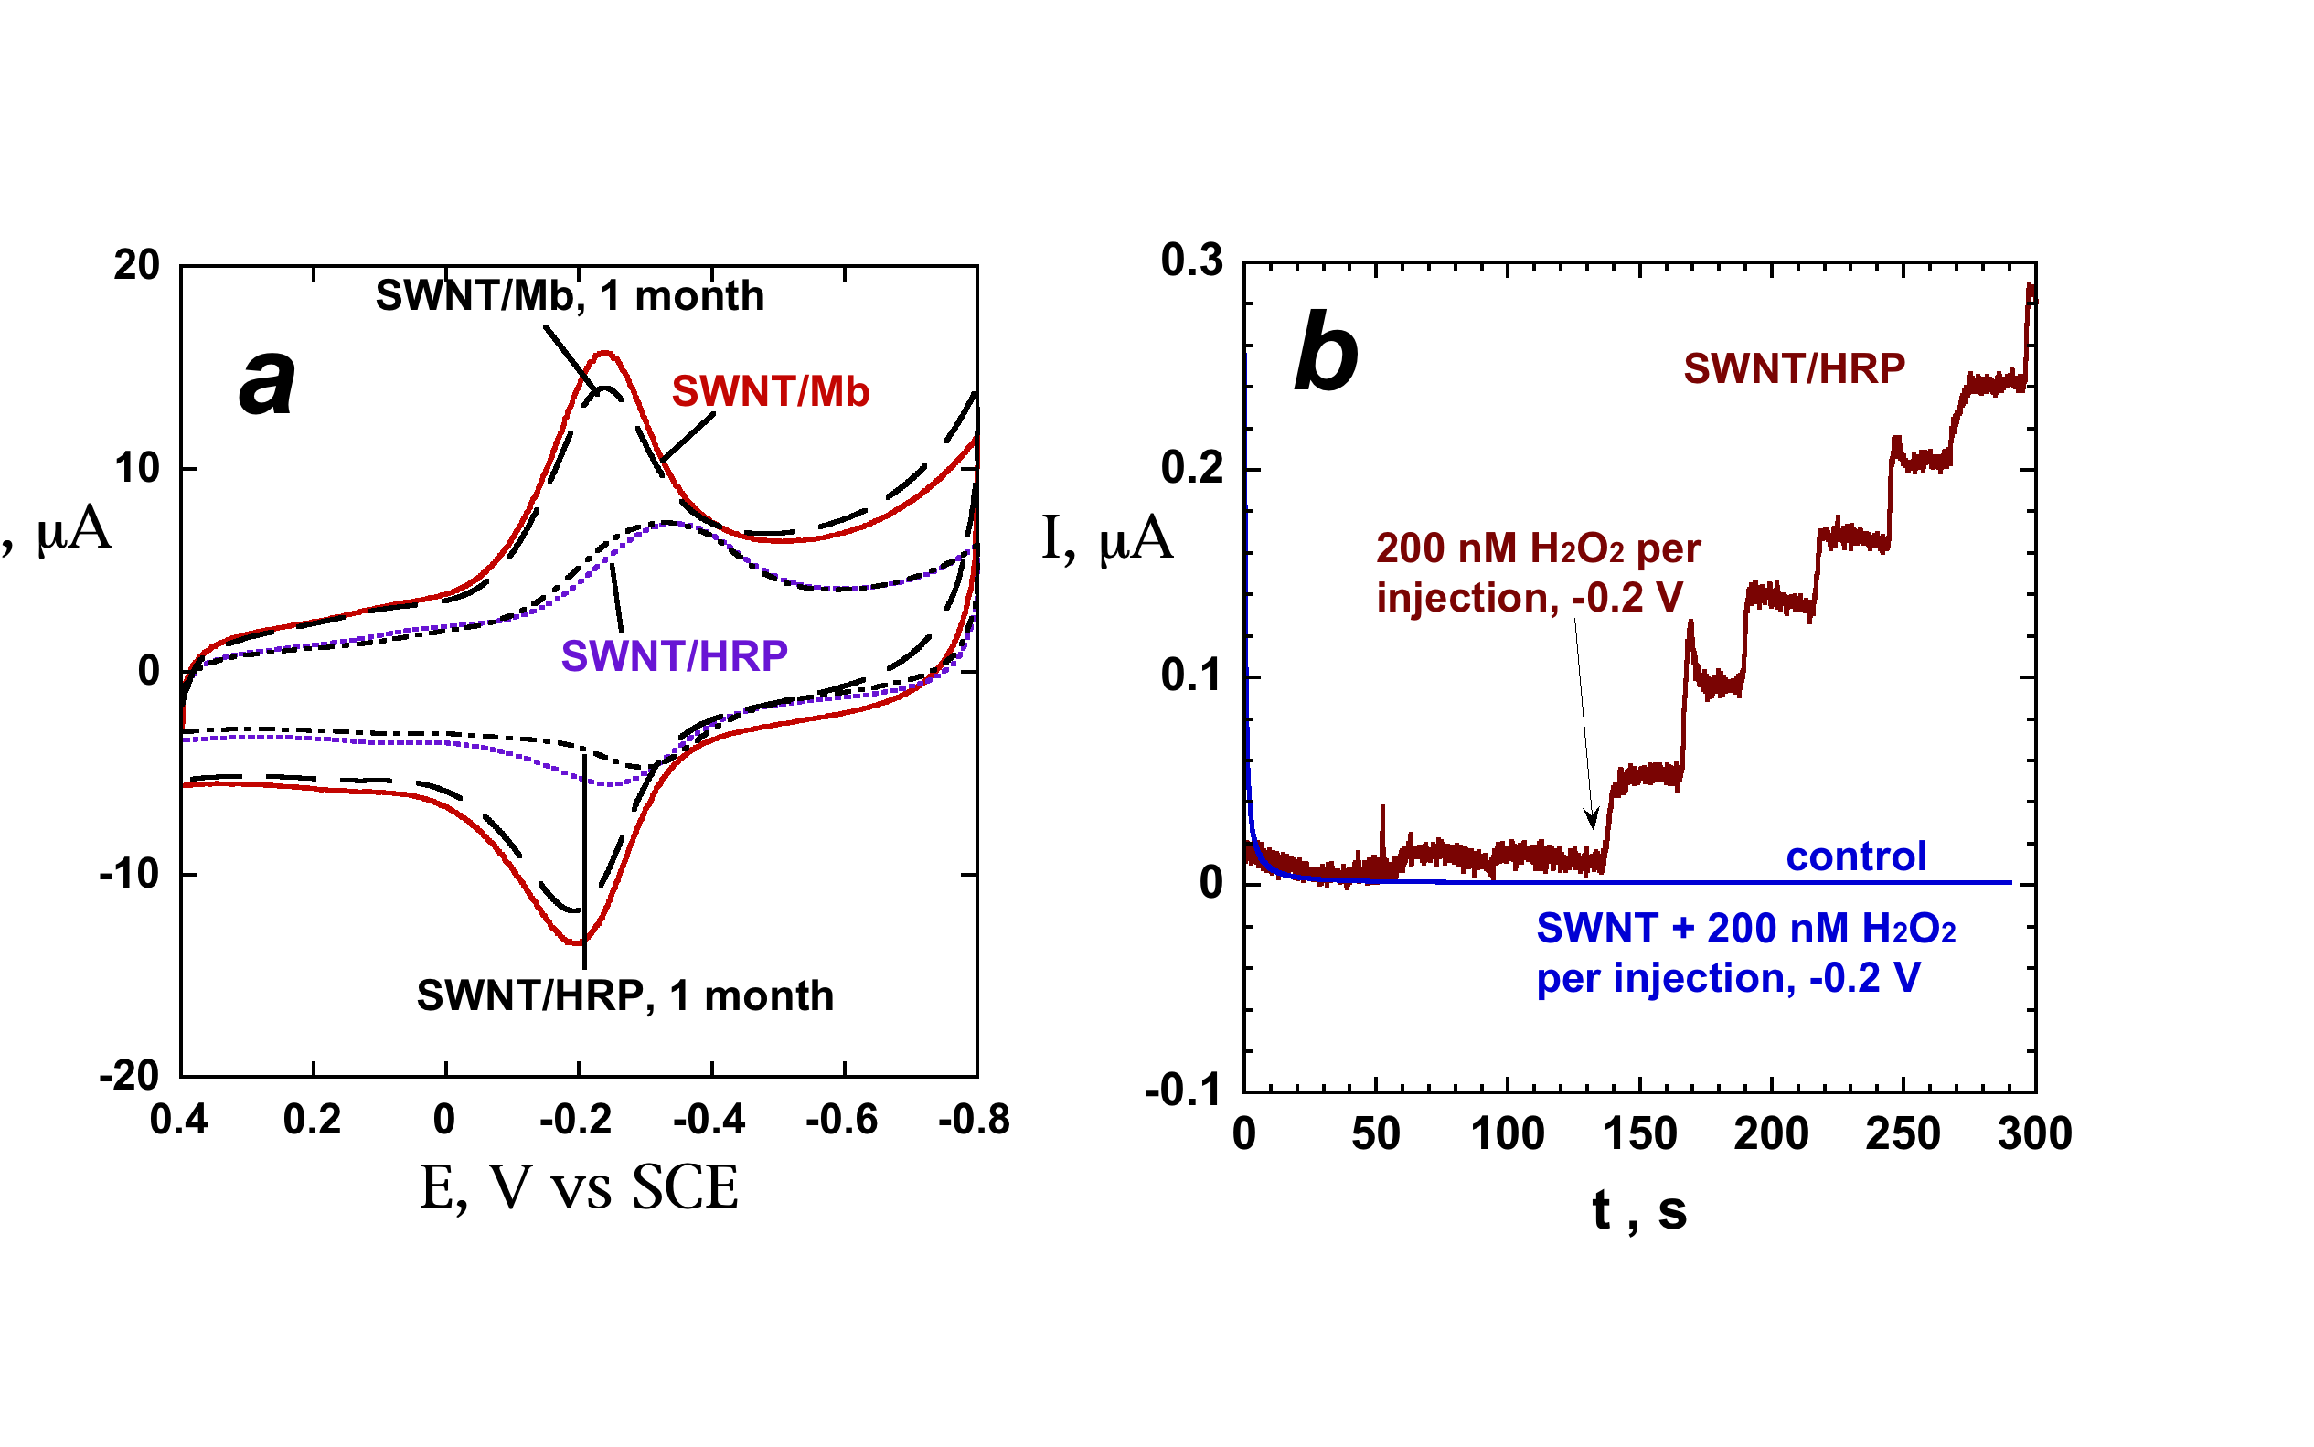
Direct voltammetry of redox enzymes on SWNT forests - vectorial electron transfer
Direct cyclic voltammetry at
300 mV s⁻¹ in pH 5.5 buffer
(b) Direct amperometry adding
H₂O₂ to HRP-SWNT; LOD 40 nM
not improved by mediator-->all HRP
is electrically wired
X. Yu, D. Chattopadhyay, I. Galeska, F. Papadimitrakopoulos, and J. F. Rusling, “Peroxidase activity of enzymes bound to the ends of single-wall carbon nanotubeforest electrodes”, Electrochem. Commun., 2003, 5, 408-411.

Slide 23
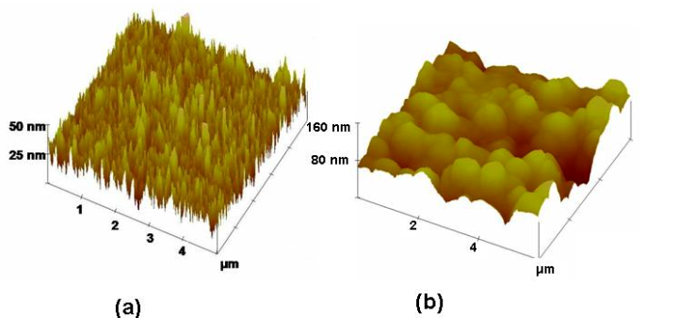
AFM of SWNT forest with and without anti-HSA attached
SWNT forest with anti-human serum
albumin (HSA) attached by amide links
SWNT forest on Si wafer

Slide 24
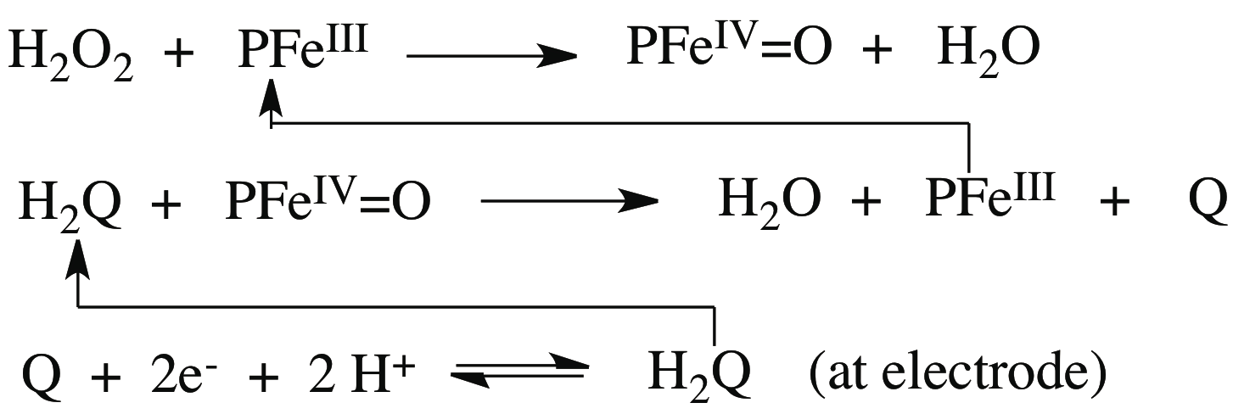
Enzyme Label Detection Chemistry:
use H₂O₂ and hydroquinone (HQ)
enzyme
A double catalytic process

Slide 25
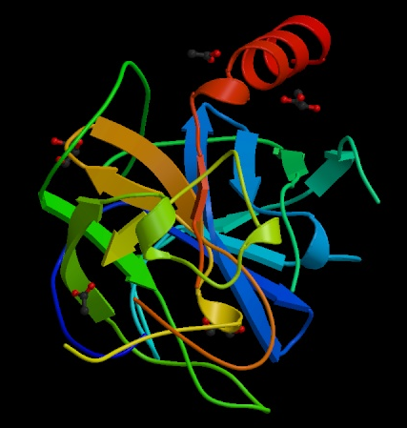
Cancer Biomarker Proteins: Prostate Specific Antigen
With Drs. Silvio Gutkind and V. Patel, NIH
PSA - Single chain glycoprotein , MW 33 kDa
Sensitive, specific biomarker for detection of prostate cancer up to 5 years before clinical signs of disease
Detection of PSA in serum: clinical method for detection of prostate cancer
Led to less invasive treatment protocols, avoid surgery
Adapted From Brookhaven Protein Databank

Slide 26
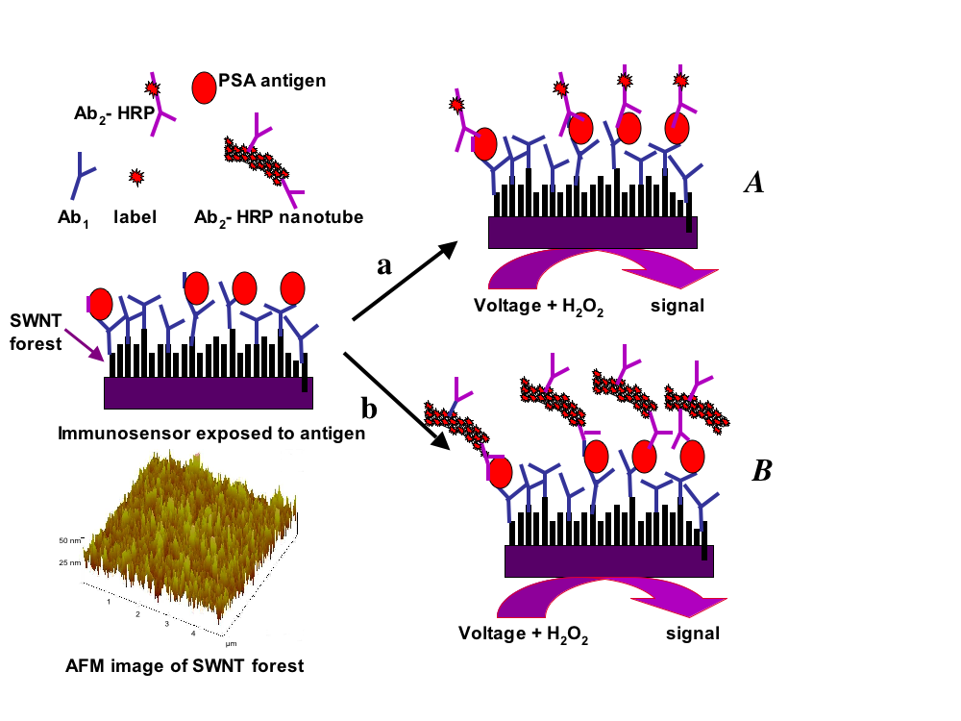
Nanotube Strategies for PSA detection
~170 labels
per PSA

Slide 27
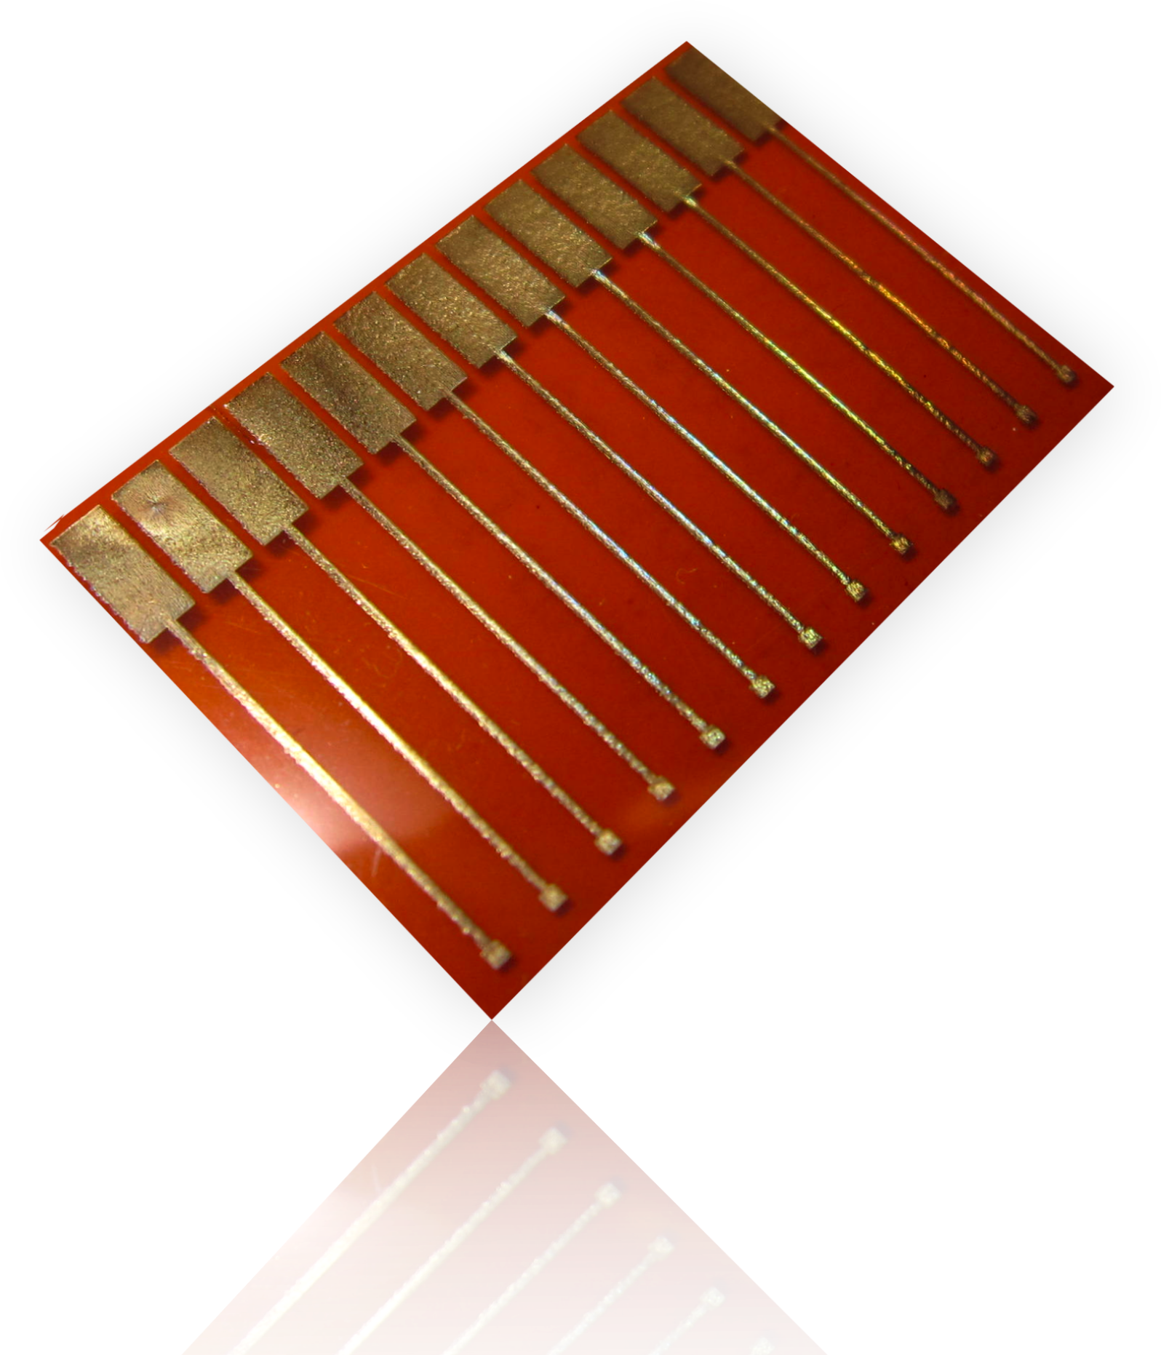
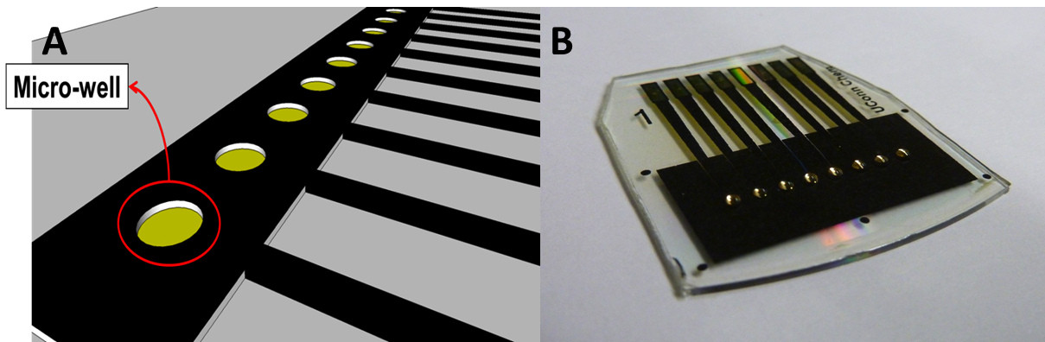
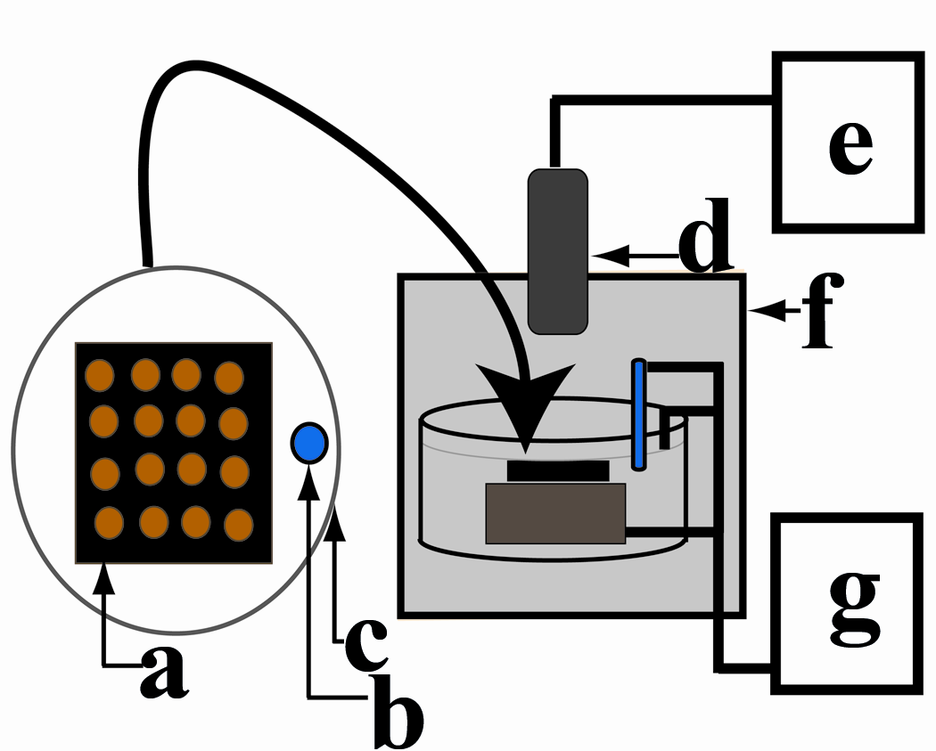
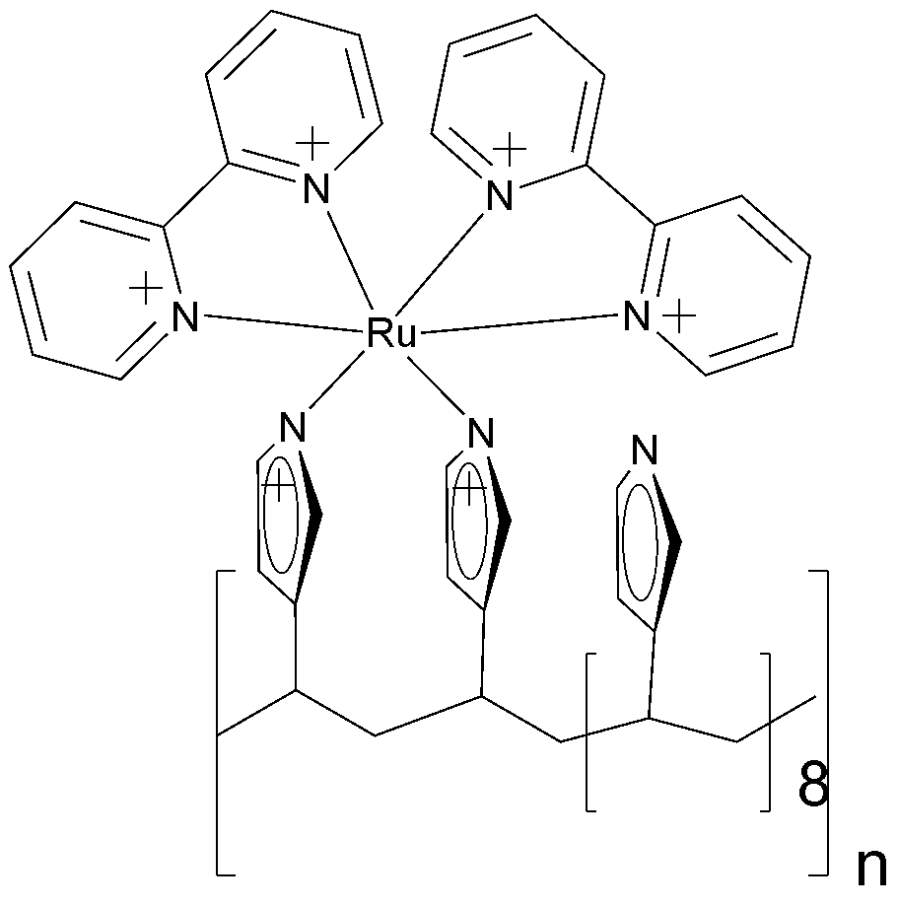
Arrays can detect many biomolecules at once
Ink-jet
printing
electrical
contacts
Processed gold CDs
Sensing electrodes
multi-electrode sensor arrays
An optical-
electrochemical
array
Polymer gives off light when electro-oxidized with proper co-reactant, e.g. DNA

Slide 28
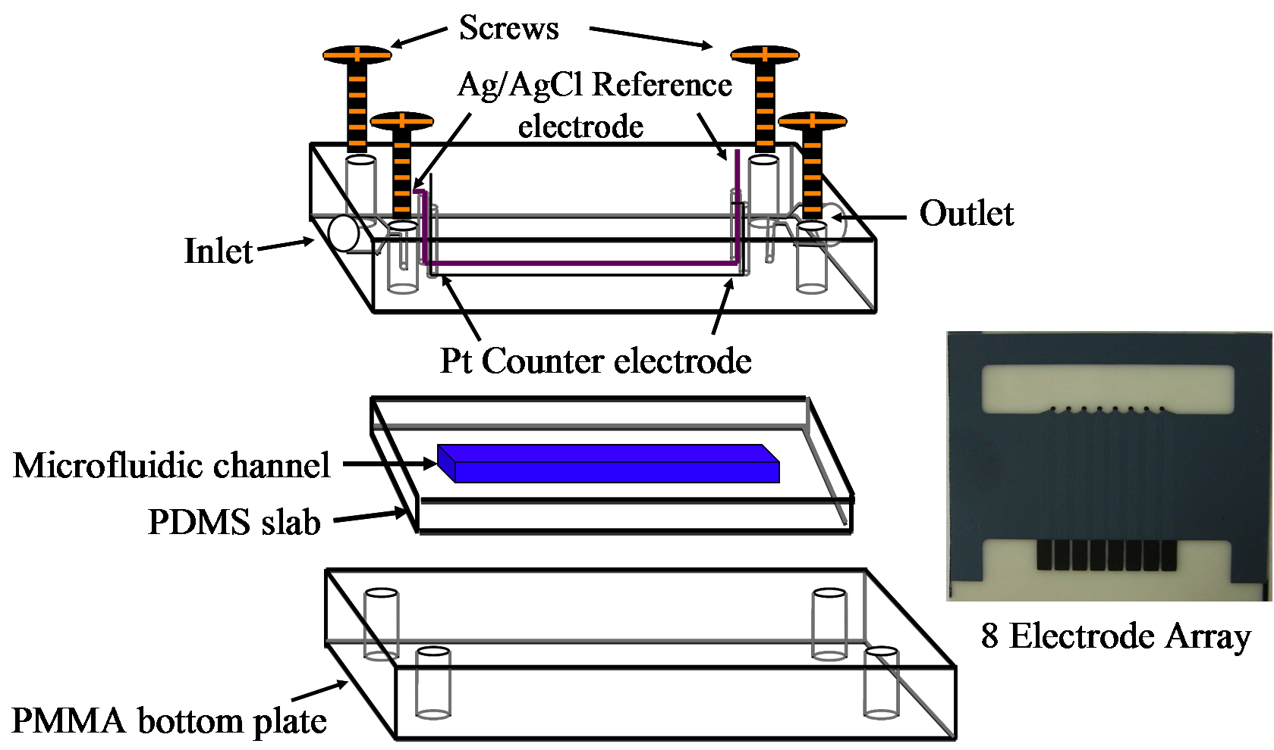
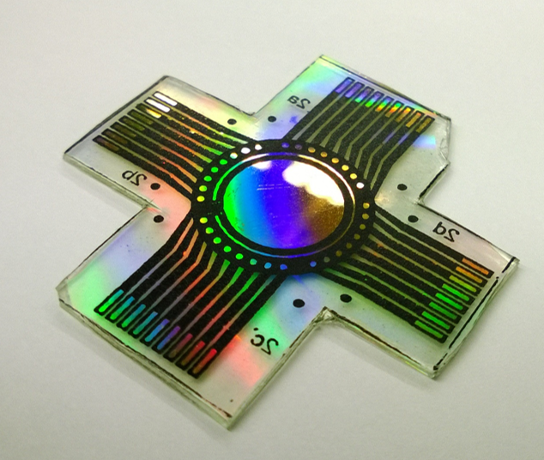
Microfluidic capture chamber and detector are machined Polymethyl-methacrylate (PMMA) + soft PDMS channel + 8 sensor array
Inkjet printed
4 nm AuNPs
Molded
Kanichi Ltd., UK
Detector assembly
32 sensor array: wet etched gold CD with
insulation and nanowells
printed with computer ink,
and heat-transferred onto the PG chip

Slide 29
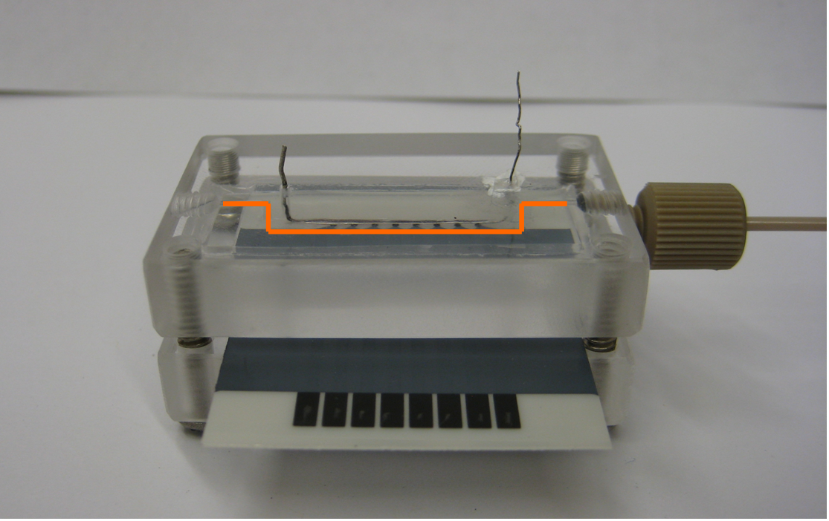
8-electrode PDMS fluidic array;
AuNP layer deposited on electrodes
electrodes
Electrical contacts
Bhaskara V. Chikkaveeraiah, Vigneshwaran Mani, Vyomesh Patel, J. Silvio Gutkind, and James F. Rusling, Microfluidic electrochemical immunoarray for ultrasensitive detection of two cancer biomarker proteins in serum, Biosensors & Bioelectron. 2011, 26, 4477– 4483.

Slide 30
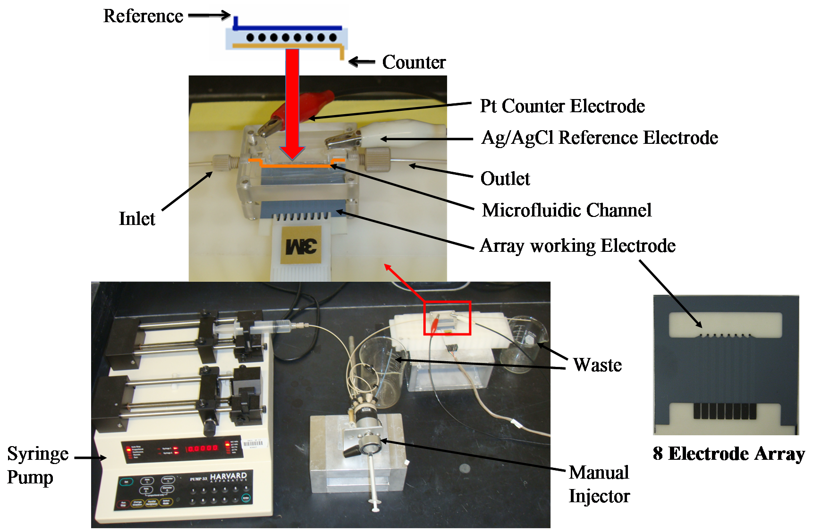
Microfluidic protein assay system

Slide 31


Protein analyte capture with magnetic beads
greatly lowers non-specific binding
+
Proteins in
sample
Multilabel Magnetic
bead-Ab₂
Protein captured by
bead, magnetically
separated
Label = HRP enzyme;
Activated by H₂O₂
Sensor surface captures bead
+ protein for detection; sensor never
sees sample matrix

Slide 32
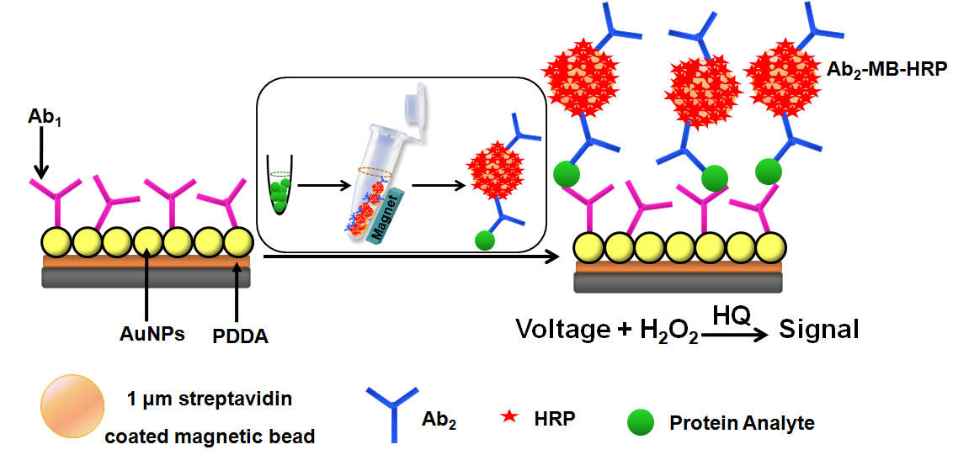
Multiplexed Detection of Oral Cancer Biomarker Proteins:
IL-6, IL-8, VEGF, and VEGF-C
protein capture on heavily
labeled particles
one sensor

Slide 33
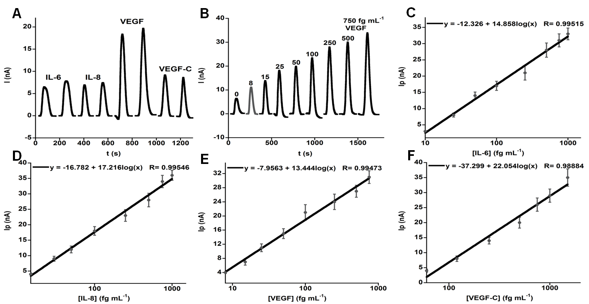
Cancer Biomarker Proteins in Diluted Serum

Slide 34
Biosensors
Future of medical diagnostics; use by patients or in doctors offices and clinics
Applications include cancer biomarkers, DNA, peroxide, etc.
Method of choice for blood glucose in diabetics
Rapid diagnostics may lead to more timely and effective treatment; need automation
Nanostructured electrodes and nanoparticle labels lead to high sensitivity

