Slide 1
An overview of ADME Studies
March 29, 2011
Dale E. Sharp, PhD, DABT
Boehringer Ingelheim Pharmaceuticals Inc.

Slide 2
Presentation Objectives
Give an overview of the types and objectives of ADME studies with an emphasis on practical aspects of their conduct and interpretation.
ADME – Absorption, Distribution, Metabolism, and Excretion
This talk will be limited to mass balance/plasma PK and tissue distribution studies.

Slide 3
Mass balance studies, why do we do them?
Investigation of the basic pharmacokinetics to aid the extrapolation of safety and efficacy data to humans.
Major results
  estimation of rate and extent of absorption
  estimation of first pass effect
  estimation of extent of metabolism
  metabolic pattern and ID
  excretion mass balance
  elimination behavior
  indication of sexual dimorphism
  determination of clearance mechanism

Slide 4
Mass balance studies, when do we do them?
At BI, rat ADME and QWBA are conducted concurrently with Phase Ia, nonrodent study roughly concurrent with Ib, mouse ideally before the Carcinogenicity Assessment Committee meeting, rabbit later (if at all)
Industry practice – varies, many companies complete ADME in toxicology species before Phase I, others wait as long as possible.

Slide 5
Considerations in the choice of radioisotope
  ADME studies are nearly always done with radiolabel.
  Almost all pharmaceutical studies with small molecules are done with ¹⁴C. (Most biologicals are ¹²⁵I labeled.)
  Other labels can be considered (³H, ³⁵S).
  ³⁵S t_{½} 87.5 days.

Slide 6
Position of Radiolabel in Molecule
  If portions of the molecule are metabolically cleaved from the label, this portion of the molecule can no longer be followed.
  If the molecule is cleaved into two roughly equal pieces, more than one label position may be needed to fully elucidate the metabolism.
  It is preferable to study the different label positions separately.

Slide 7
Advantages and disadvantages of ¹⁴C
  Advantages
  Long half-life (5500 y)
  Liquid scintillation counting is routine.
  Disadvantages
          Synthesis of specific label positions can be challenging.
  “Uniformly labeled” drugs should be avoided if quantitation by LC/MS/MS is desired.
    Uniformly labeled drugs usually consist of an unknown distribution of non-, single-, and multiply labeled molecules.
    Impossible to correct to get LC/MS/MS concentration.

Slide 8
Advantages and disadvantages of ³H label
  Advantages
    Easily synthesized.
    Very high specific activities can be achieved.
  Disadvantages
    Counting efficiency lower than ¹⁴C.
    Label stability can be a problem.

Slide 9
Advantages and disadvantages of ³H label
  Advantages
    Easily synthesized.
    Very high specific activities can be achieved.
  Disadvantages
    Counting efficiency lower than ¹⁴C
    Label stability can be a problem.

Slide 10
Case Study – Tritium labeled Naltrexone in an ADME Study (Castelli et al. 2003)
  For synthetic reasons tritiated naltrexone was used in an ADME study.
  Urine and plasma samples were measured before and after lyophilization to remove volatile tritium. Approximately 3% of the urinary radioactivity was water. At longer timepoints, PK of total radioactivity was consistent with the known PK of water in the species. (1.13 days in mouse and 3.53 days in rats).
  Extra work, but adequate metabolite ID and tissue distribution data obtained.

Slide 11
Advantages and disadvantages of ¹²⁵I label
  Advantages
    Easily synthesized.
    Gamma counting is very easy.
  Disadvantages
    Label stability is often a problem.

Slide 12
Case Study – Iodine Label
  Several studies with iodinated peptides delivered both plasma half-lives and tissue distribution consistent with literature data on iodide.
  Conclusion – label was lost quickly in the body.
  Iodine is taken into tissue by transporters.
  If extent of loss is low, data quality can be improved by administration of aqueous KI to competitively inhibit uptake.

Slide 13
Radiopurity of Compounds
  As high as possible, BI criterion 97% or greater.
  Case Study
    At a CRO, a client insisted on running (against our advice) ADME study with 66% radiopure material.
    34% of the dose was recovered as CO₂
    Client asked how much was from compound vis a vis impurities?
    ?

Slide 14
Formulation
  Something you know will work from previous studies!
  Should not cause emesis or diarrhea. Can cause problems with mass balance.
  Solution preferred.
  Suspensions can be considered although formulation stability and homogeneity can be a problem. Recommend a practice run with tracer label.

Slide 15
Dose Level Selection
  Something you know will be safe from toxicology studies!
  Case study . Drug was dosed in a QWBA study in pregnant rats on GD 18. All the rats died. Drug had not been given past GD 7. A subsequent tox study confirmed the result. Study was repeated at a lower dose.
  Case study. ADME in cynos successfully completed. Sponsor decided they wanted data at 10 x dose. First IV monkey died within 15 min., first PO monkey died within 30 min. A subsequent tox study confirmed the result.

Slide 16
Dose Level Selection (cont.)
  BI criteria: Rodents > ED50 in Pharmacology Model up to NOAEL.
  Rabbit, mice, and nonrodents NOAEL if possible.

Slide 17
Dose Administration
  Animals are typically fasted overnight (exception mice).
  It is vital that the amount of drug administered to the animals be accurately measured.
  Formulation is sampled at a volume similar to that administered before and after dosing by the doser using the dosing syringe in the animal room. A minimum of duplicate pre- and postdose samples, more if it is a tricky suspension.
  Adequate stirring can be a problem with a suspension.

Slide 18
Sample collection
  Urine and feces are collected at timed intervals postdose. Cages are rinsed at the end of the study, sometimes during. Carcasses are collected. Rinsing agent should both dissolve drug and free caked material from cage. Pure organic solvents not recommended with metal cages.
  CO₂ and organic volatiles can be collected, usually not necessary for pharmaceuticals. Typically only done with rodents but large animals are possible.
  Make sure CO₂ and volatiles collection are validated. Typical trapping solutions NaOH, ethanolamine, Carbosorb.
  Plasma is collected for total radioactivity PK and metabolite ID.

Slide 19
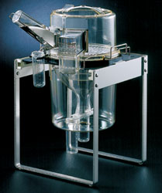
Typical rat metabolism cage

Slide 20
Dog Metabolism Cages (courtesy Covance Madison)

Slide 21
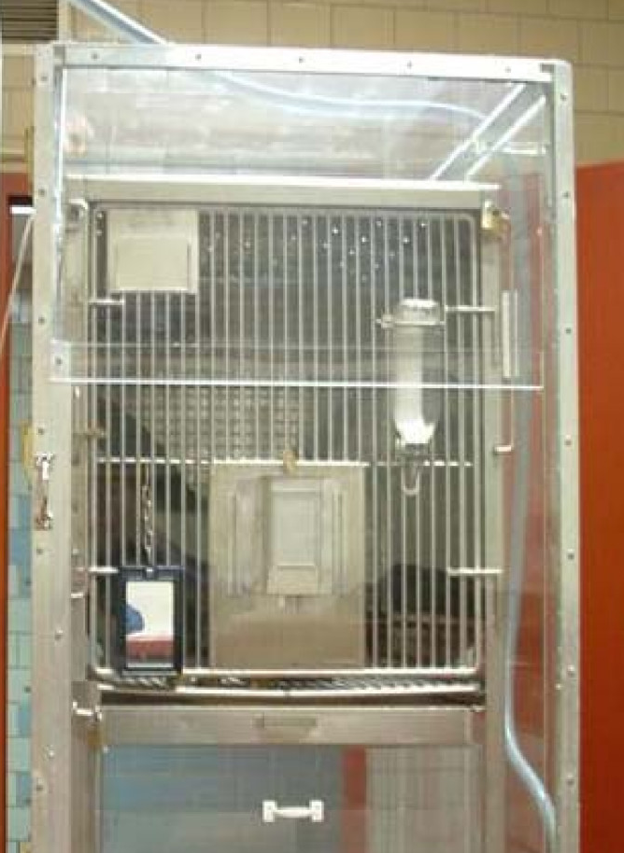
Monkey metabolism cage
The dashed line signifies good (top) and poor bottom) permeability.

Slide 22
Radioanalysis
  Samples are homogenized before analysis. Urine, plasma and cage wash are counted directly. Feces are typically mixed with liquid, ideally something that dissolves drug, because it helps homogeneity. The homogenates are either oxidized or digested.

Slide 23
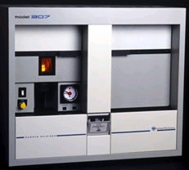
Sample oxidizer

Slide 24
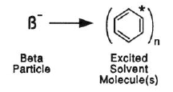
The scintillation process
Cocktail components: solvent, fluor, and emulsifiers (to aid in mixing of aqueous samples with organic solvents)
* All illustrations from Beckman Advanced Technology Guide.

Slide 25
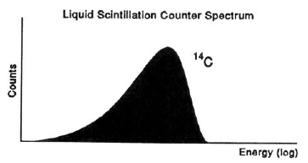
Energy spectra
³H

Slide 26
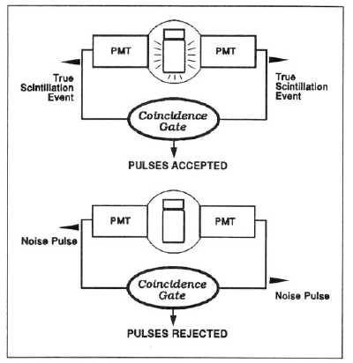
Detection
One “event” causes multiple photons to be produced, allowing detection by both PMTs.
“Coincidence” defined:
within 20 nanoseconds
If cpm are too high, they will overlap within this time window, leading to a decrease in counting efficiency. For this and other reasons, stay below 2x10⁶ cpm.

Slide 27
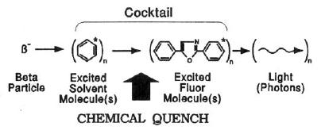
Quench
Chemical quench only affects liquid scintillation counting, not counting with a solid scintillator.

Slide 28
Quench
Chemical quench:
Shifts spectrum to lower energies
Color quench:
Shifts spectrum to lower energies
Changes shape of spectrum
Energy (log)
Both:
Decrease counting efficiency
Energy (log)

Slide 29
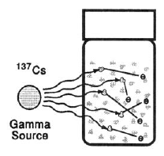
Quench correction
Monitoring quench with an external source
Energy (log)
H-Number
Beckman counters determine an “H-Number”
Named for Dr. Donald Horrocks (a Beckman scientist)
As quench increases, so does the H-Number.

Slide 30
Advantages and disadvantages of oxidation vs digestion
Advantages of oxidation
  No matrix effect on LSC.
  Small tissues can be burned whole without homogenization.
  High throughput (can be automated).
Disadvantages of oxidation.
  Machine needs regular use.
Disadvantages of digestion
  Most tissues require bleaching, tricky operation.

Slide 31
Results of Mass Balance Study
Criteria : Rodents >95% ideally, can live with >90%.
      Nonrodents >95% ideally, can live with high eighties.
To my knowledge, an ADME study has never been rejected by a regulator for poor mass balance.
Total radioactivity pharmacokinetics.
Samples for metabolite profiling.

Slide 32
Why do we do tissue distribution studies?
Pattern of distribution in tissues.
Estimation of the AUC, C_{max} and half-life in tissues.
  dosimetry for human ADME study.
Detection of deep compartments.
Assessment of the blood brain barrier.
Affinity to melanin.
In 2011, nearly always done by Quantitative Whole Body Autoradiography (QWBA). Excision rare.
Radiolabel required.

Slide 33
When do we do tissue distribution studies?
Phase Ia for QWBA.
Late in development for multiple dose studies.

Slide 34
QWBA Studies
Usually done in rats or mice. Other species possible.

Slide 35
Study design of standard rat QWBA
Pigmented and unpigmented rats are dosed orally with drug (PO and IV). One or two rats/timepoint are killed, exsanguinated, embedded, and frozen. Standards are frozen along with the carcass.
Slices prepared with a cryomicrotome, freeze-dried and exposed to a phosphoimager plate.
Plate read by a laser.
Both autoradiograms and numerical data are obtained.

Slide 36
Results of QWBA Studies
The pretty pictures.
Tables of tissue and plasma concentrations.
Tissue: plasma ratios.
Tissue PK, dosimetry calculations.
With excision, % of dose in tissues.

Slide 37
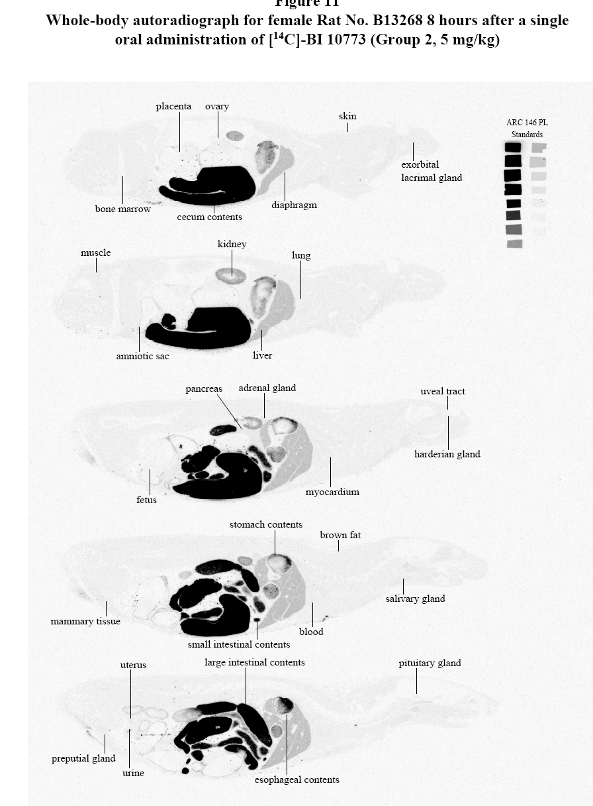
Results of QWBA Study

Slide 38
Things to check
Are all the tissues evaluated in each section in which they appear?
Case study on data interpretation: Drug was administered IV. At 5 min. postdose lungs had far more radioactivity than any other tissue. At 15 minutes lungs were fairly low. What does this mean?

Slide 39
Comparison of QWBA and excision
Advantages of QWBA
  With QWBA get pretty pictures and better resolution within tissues.
  Much faster and cheaper.
Disadvantages of QWBA
  Quantitation less reliable than LSC.
  Tissue values represent the slice, not the whole tissue.

