Slide 1


High Resolution Mass Spectrometers role in small molecule studies
TuKiet T. Lam, PhD
Chem 395: Bioanalytical Chemistry
April 12, 2011

Slide 2
Instrumentations, Fundamental Principles, and Advantages

Slide 3
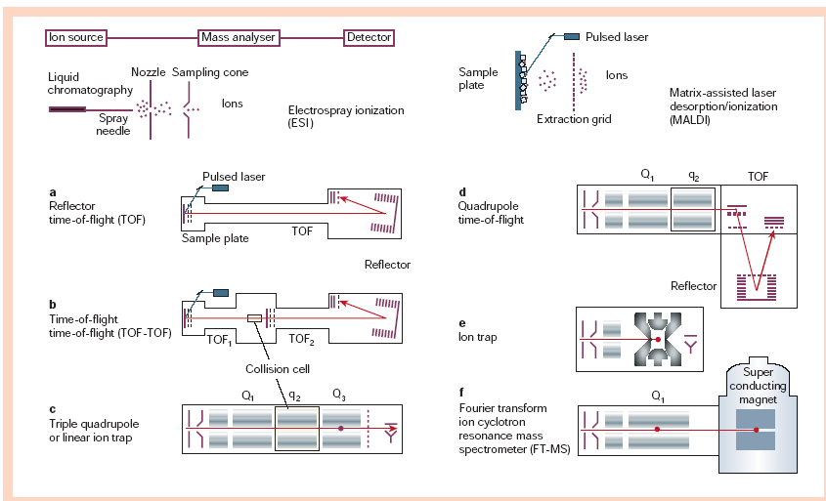
Various Forms of MS instruments
Aebersold and Mann (2003) Nature 422, 198-207
Notes:
Mass spectrometers used in proteome research. The left and right upper panels depict the ionization and sample introduction process in electrospray ionization (ESI) and matrix-assisted laser desorption/ionization (MALDI). The different instrumental configurations (a–f) are shown with their typical ion source. a, In reflector time-of-flight (TOF) instruments, the ions are accelerated to high kinetic energy and are separated along a flight tube as a result of their different velocities. The ions are turned around in a
reflector, which compensates for slight differences in kinetic energy, and then impinge on a detector that amplifies and counts arriving ions. b, The TOF-TOF instrument incorporates a collision cell between two TOF sections. Ions of one mass-to-charge ( m/ z) ratio are selected in the first TOF section, fragmented in the collision cell, and the masses of the fragments are separated in the second TOF section. c, Quadrupole mass spectrometers select by time-varying electric fields between four rods, which permit a
stable trajectory only for ions of a particular desired m/ z. Again, ions of a particular m/z are selected in a first section (Q1), fragmented in a collision cell (q2), and the fragments separated in Q3. In the linear ion trap, ions are captured in a quadruple section, depicted by the red dot in Q3. They are then excited via resonant electric field and the fragments are scanned out, creating the tandem mass spectrum. d, The quadrupole TOF instrument combines the front part of a triple quadruple instrument with a reflector TOF section for measuring the mass of the ions. e, The (three-dimensional) ion trap captures the ions as in the case of the linear ion trap, fragments ions of a particular m/ z, and then scans out the fragments to generate the tandem mass spectrum. f, The FT-MS instrument also traps the ions, but does so with the help of strong magnetic fields. The figure shows the combination of FT-MS with the linear ion trap for efficient isolation, fragmentation and fragment detection in the FT-MS section.

Slide 4
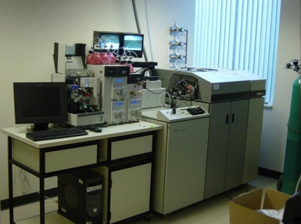
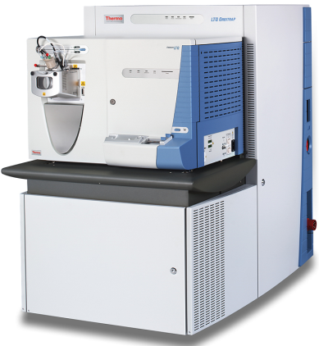
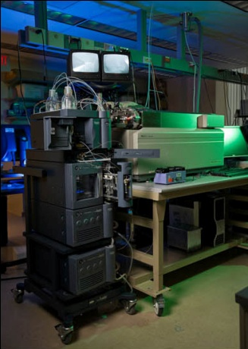
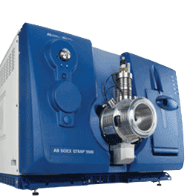
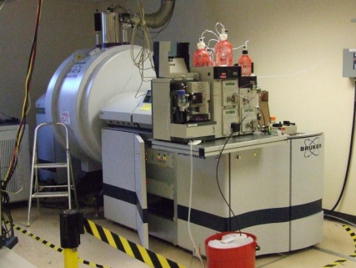
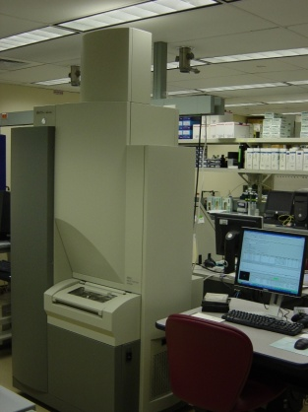
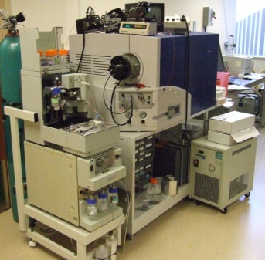
Mass Spectrometers
ABI ESI QSTAR Elite MS System
Thermo Fisher Scientific nano-UPLC ESI LTQ-Orbitrap MS system
ABI nano-UPLC ESI
QTRAP-4000 MS system
ABI API QTRAP 5500
Bruker APEX 9.4 Tesla ESI FT-ICR MS System
ABI 4800 MALDI TOF/TOF Tandem MS System
Waters CapLC-ESI QTOF Micro MS System

Slide 5
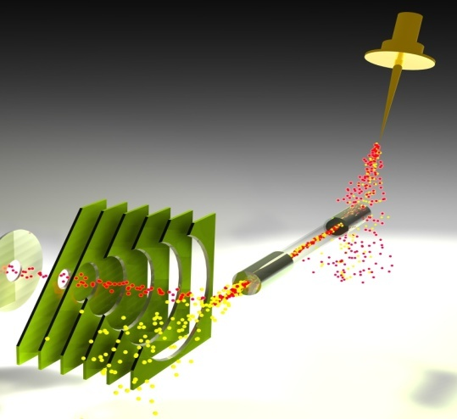
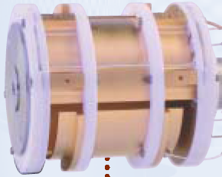
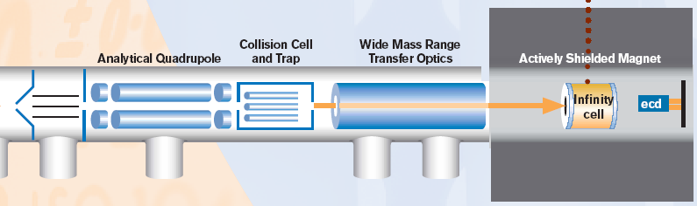
FT-ICR MS Ion Optics
--Apollo II Source
--Improved sensitivity (>10 x)
--Very robust,
--Less source Maintenance
Apollo II ESI source
ECD
Heated
Glass
Capillary
Collision
Cell
Transfer
Optics
IRMPD
Quadrupole

Slide 6
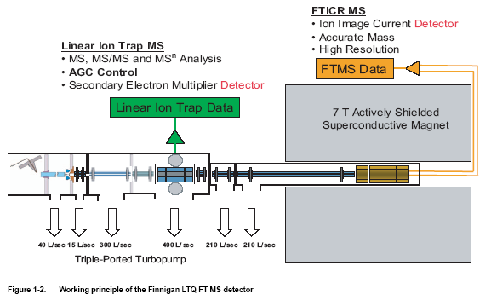
LTQ-FT

Slide 7
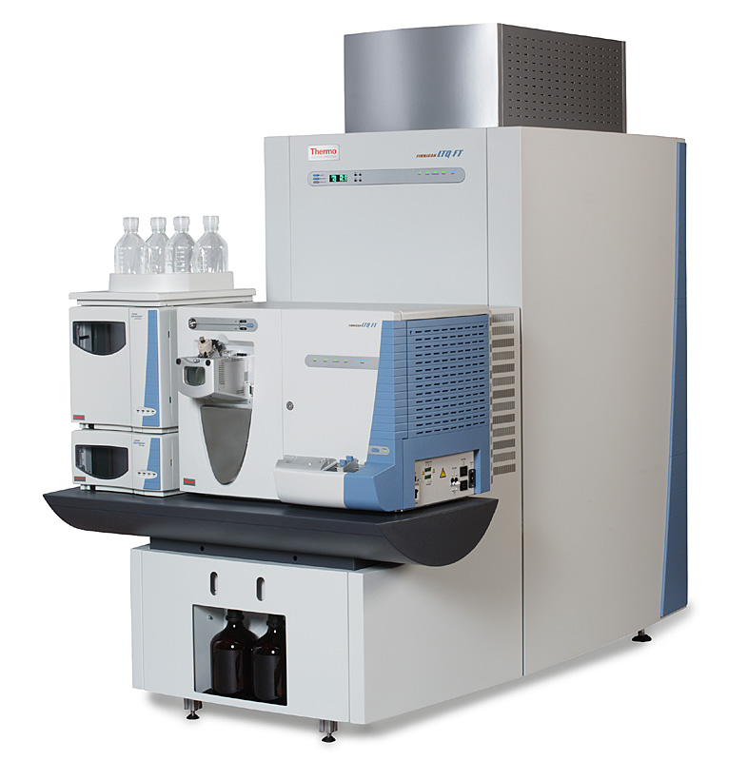
LTQ-FT specs
Resolution
  100 000 resolution at m/z 400 at 1 Hz
  repetition rate
  >500 000 resolution broadband mode
Mass Range
  m/z 50-4000 (standard range)
  1-order-magnitude in single scan
  (e.g. m/z 400-4000)
Mass Accuracy
  2 ppm RMS, external mass calibration
  <1 ppm RMS, internal mass calibration
Dynamic Range
  >500 000 between mass spectra
5000 within mass spectrum
IRMPD
ECD

Slide 8
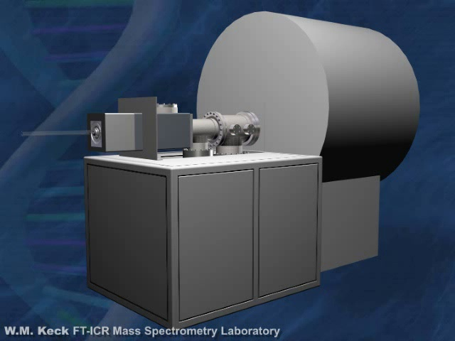
Courtesy from David C. Muddiman (Currently at Department of Chemistry at NCSU)

Slide 9
Why FT-ICR MS?
+
-
y
z
x
A.G. Marshall, C.L. Hendrickson, and G.S. Jackson. Mass Spectrometry Reviews, 1998, 17, 1-35.

Slide 10
Once the ion is trapped,
So we can calculate the mass of the ion
the magnet bends it into
We know the
a circular path.
Magnetic Field
B
We measure the frequency
q B
ω
=
m
m
“Light” Ions have a High frequency
“Heavy” Ions have a Low frequency

Slide 11
Image Current
0.05
Time-Domain Transient
0.04
0.03
Differential Amplifier
0.02
0.01
0
-0.01
-0.02
-0.03
-0.04
-0.05
0
100
200
300
400
500
600
700
800
Time (ms)
As the spiraling ion gets near
The signal is recorded for
a detect plate, it induces a
a period of time and then
current that is detected by
displayed by the software
our instrument.

Slide 12
Image Current
A Fourier Transform then
converts the “time” domain
0.05
Time-Domain Transient
signal into all the frequencies
0.04
0.03
that compose the “time” signal
0.02
0.01
We know how frequency relates
0
to mass, so we convert to the
-0.01
“Mass Spectrum”
-0.02
-0.03
FT
-0.04
-0.05
0
100
200
300
400
500
600
700
800
Time (ms)
Frequency Spectrum
Mass Spectrum
m
z
A
ν
+
B
ν²
=
0
50
100
150
200
250
300
500
600
700
800
900
1000
1100
1200
1300
1400
Frequency (kHz)
m/z

Slide 13
Our experiments get easier
at higher magnetic fields
Linear increases
Highest Non-Coalesced Mass
25 T
25 T
Mass Resolving Power
Scan Speed (LC/MS)
Increase as B²
Ion Energy
Number of Ions
Upper Mass Limit
9.4 T
Ion Trapping Time
7 T
9.4 T
14.5 T
7 T
14.5 T
0
25
0
25
B₀ (tesla)
B₀ (tesla)

Slide 14
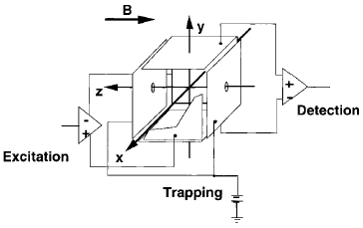
Once we make an ion, we move it into the center of the Magnet.
Then, we trap it before it can escape.
Electrostatic Barrier
Ion is now trapped in the magnet.
+
ION
Ion sees barrier
and is turned back
“Gate” shut before the ion escapes
From Primer 1998 Marshall.

Slide 15

Robust Accurate Mass
  5 ppm rms external calibration
  2 ppm rms internal calibration
High Resolution
  60,000 at m/z 400 with a scan repetition rate of 1 Hz
  Maximum Resolution >100,000
Mass Range
  50-2000; 200-4000
Sub-fmol Sensitivity (LC/MS)
MS/MS and MS^{n}
High Dynamic Range
  >2,500 within mass spectrum

Slide 16

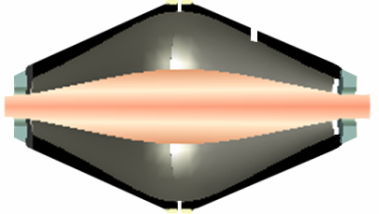

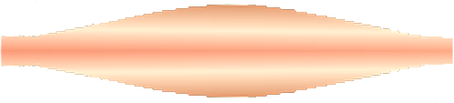
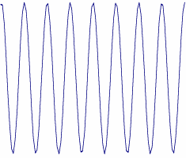
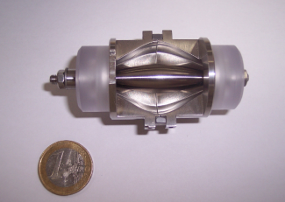
LTQ Orbitrap Operation Principle
1. Ions are stored in the Linear Trap
2. …. are axially ejected
3. …. and trapped in the C-trap
4. …. they are squeezed into a small cloud and injected into the Orbitrap
5. …. where they are electrostatically trapped, while rotating around the central electrode
and performing axial oscillation
The oscillating ions induce an image current into the two outer halves of the orbitrap, which can be detected using a differential amplifier
Ions of only one mass generate a sine wave signal

Slide 17
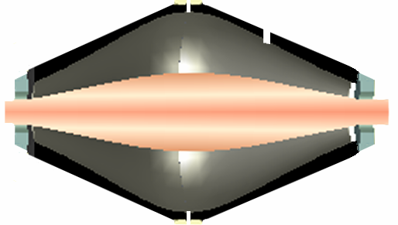
Ion Motion in Orbitrap
Only an axial frequency does not depend on initial energy, angle, and position of ions, so it can be used for mass analysis
The axial oscillation frequency follows the formula
w = oscillation frequency
k = instrumental const.
m/z = …. what we want!
A.A. Makarov, Anal. Chem. 2000, 72: 1156-1162.
A.A. Makarov et al., Anal. Chem. 2006, 78: 2113-2120.

Slide 18
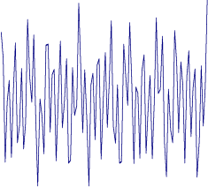
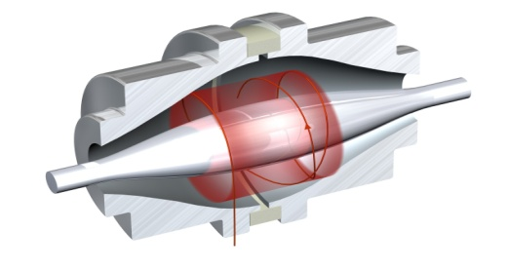
Ions of Different m/z in Orbitrap
Large ion capacity - stacking the rings
Fourier transform needed to obtain individual frequencies of ions of different m/z
Electrostatic Field Based Mass Analyser
r
z
Korsunskii M.I., Basakutsa V.A. Sov. Physics-Tech. Phys. 1958; 3: 1396.
Knight R.D. Appl.Phys.Lett. 1981, 38: 221.
Gall L.N.,Golikov Y.K.,Aleksandrov M.L.,Pechalina Y.E.,Holin N.A. SU Pat. 1247973, 1986.
φ

Slide 19
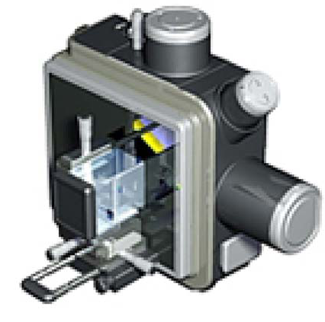
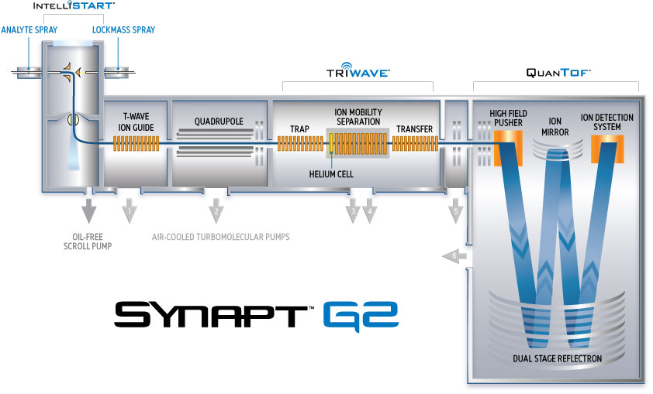
Physical Components of Instrument SYNAPT G2 HDMS
nanoFlowTMESI
APGC
ESI/APCI, ESCi(r)
APPI, APCI
Internal Component of SYNAPT G2 HDMS
Notes:
Instrumentation
Synapt G2 High Definition Mass Spectrometer
(Synapt G2 High Definition Mass Spectrometer material from Waters Corporation Website)
The second generation SYNAPT™ G2 platform from Waters provides a new dimension of performance to drive your scientific discovery like never before. We’ve combined QuanTof™ — breakthrough quantitative Tof technology — and enhanced High Definition MS™ technologies to provide you with intuitive operation, application flexibility, and a totally new level of performance for all your applications.
SYNAPT G2 MS is a high resolution exact mass MS/MS platform designed to get you to the right result, faster — no matter how challenging your application is — whether you specialize in metabolite profiling, proteomics, biomarker discovery, biopharmaceuticals, or screening applications.
Thanks to Engineered Simplicity™, SYNAPT G2 MS provides a high resolution exact MS/MS system with unique productivity advantages. Integrating new QuanTof technology from Waters, it is the product of our very latest innovations to deliver new levels of MS performance, productivity, and versatility to your laboratory:
IntelliStart™ Technology: for simplified system setup and automated control.
ACQUITY UPLC® Technology: for the highest chromatographic resolution, speed, and sensitivity.
QuanTof Technology: ensures you’ll capture the most complete and informative exact mass data in UPLC® timeframes, complemented by UPLC/MSE capability to capture all of the data all of the time.
MassLynx™ Informatics: combining the power of exact mass data and a built-in understanding of chemistry to deliver simple and rapid data interpretation and compound identification.
Unrivaled productivity and flexibility: allows you to customize the world’s most powerful MS system to your needs with multiple ionization options, unique system solution productivity, and future upgrade pathways.
Decisions made easy: thanks to Engineered Simplicity, which delivers the very highest performance and simplicity throughout your entire workflow. So experienced and novice users alike can generate high quality results. Consistently.
Webinar presentation - - -https://advionevents.webex.com/ec0605lb/eventcenter/recording/recordAction.do?theAction=poprecord&actname=%2Feventcenter%2Fframe%2Fg.do&actappname=ec0605lb&renewticket=0&renewticket=0&apiname=lsr.php&entappname=url0107lb&needFilter=false&&isurlact=true&rID=2888872&entactname=%2FnbrRecordingURL.do&rKey=e765f9cec416bfc8&recordID=2888872&siteurl=advionevents&rnd=4314042599&SP=EC&AT=pb&format=short
link to video on how system is built and works - - http://wn.com/Synapt_HDMS_System__Ion_Mobility_Mass_Spectrometry
To summarize, SYNAPT G2 provides:
IMS performance that is equivalent to the most powerful purpose-built academic instrumentation
Provides no compromise in sensitivity plus delivers additional capability of novel CID based investigations
When combined with QuanTof provides significantly enhanced data quality which delivers specificity researchers need for confident discovery.
When combined with DriftScope software all researchers can retrieve the maximum information form HDMS datasets and access unique capabilities that have traditionally only been accessible to dedicated leaders in the field.

Slide 20
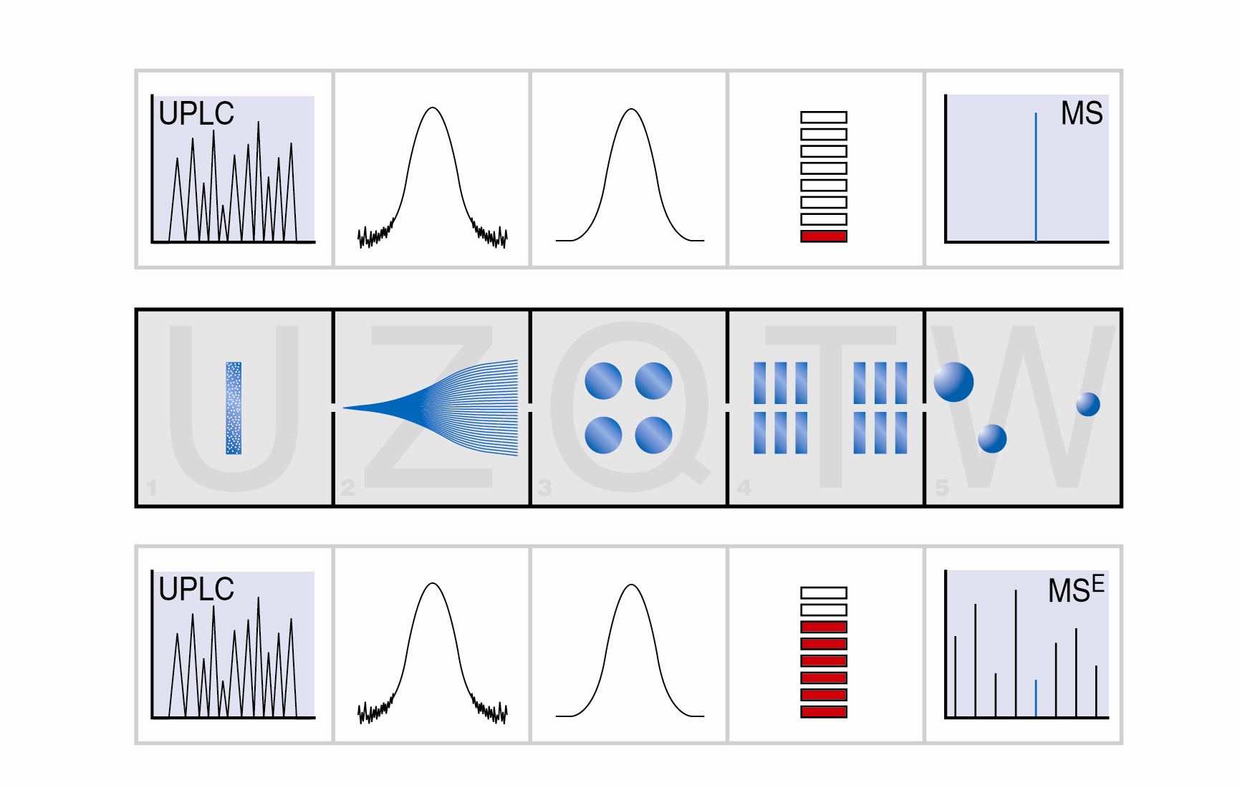
MS^{E} Alternating High/Low Energy Acquisition
1 sec
MS
Precursor
MS^{E}
Fragments
Retention Time

Slide 21
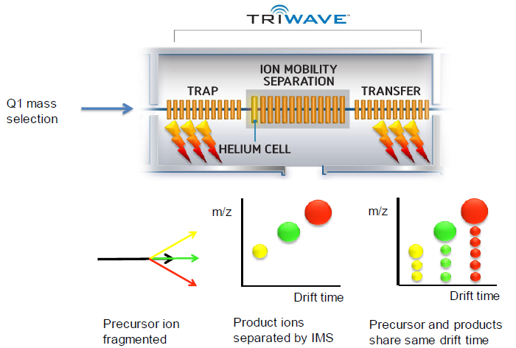
High Definition UPLC/MS^{E} analysis
Time Aligned Parallel (TAP) fragmentation
CID
IMS
CID

Slide 22
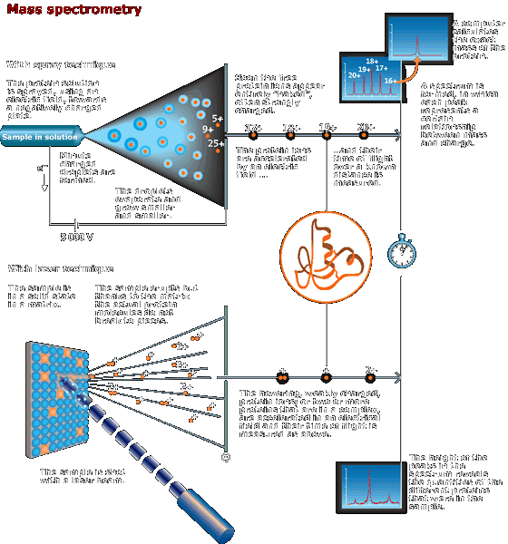


Ionization Methods
Nobel Prize in Chemistry 2002
Electrospray Ionization
John B. Fenn
Matrix Assisted Laser Desorption Ionization (MALDI)
Koichi Tanaka
(Nobel, e-museum)

Slide 23
Fourier Transform Ion Cyclotron Resonance (FT-ICR) MS
Resolution
Mass Accuracy
D
265.04713 (Cal.)
430.23262
Deuterated (D)
265.04689 (Exp.)
Zoom
0.00024 (Diff.)
P
430.22835
D
D
- 0.9 ppm (Error)
431.23617
432.23963
P
429.22657
P
263
264
265
m/z
266
267
430.22990
P
431.23346
Protonated (P)
220
260
300
340
380
m/z
P
429.22623
428
430
m/z
432
434
y₁
Fragmentation Capabilities
z₁·
m+nH^{n+}
R₁
O
R_{n-1}
O
R_{n}
O
H₂N
C
C
...
N
C
C
N
C
C
OH
Facile loss of H₃PO₄
X-P cleavage preferred
ECD
Retention of
labile modifications
No X-P cleavage
c_{n-1}
b_{n-1}
IRMPD
CID

Slide 24
Ultra-high Resolving Power
(m/z)_{max} - (m/z)_{min}
Peak Capacity =
Δm_{50%}
•
•
•
Δm_{50%}
(m/z)_{min}
m/z
(m/z)_{max}

Slide 25
Separation
Method
Maximum # of
Components
Maximum
Peak Capacity
Theoretical
Plates
HP-TLC
6
25
1,000
Isocratic LC
12
100
15,000
Gradient LC
17
200
60,000
HPLC
37
1,000
1,500,000
CE
37
1,000
1,500,000
Open Tubular GC
37
1,000
1,500,000
ESI FT-ICR MS
525
200,000
60,000,000,000
m/Δm_{50%} > 200,000
200 < m/z < 1,000
m_{average} +/- 0.25 Da
Skip Prior Chemical Separation
and Identify Components by MS!

Slide 26


Zoom
Resolving Power (m/z at 609)
609.2821
1,396
610.2754
611.2755
609.2817
2,840
610.2825
611.2790
609.2811
5,682
610.2840
611.2865
609.2811
22,621
610.2847
611.2877
609.2814
45,094
610.2850
611.2877
609.2818
93,767
610.2854
611.2890
607
607
607
607
607
608
608
608
608
608
608
609
609
609
609
609
609
610
610
610
610
610
610
611
611
611
611
611
611
612
612
612
612
612
612
613
613
613
613
613
613
m/z
m/z
m/z
m/z
m/z
m/z

Slide 27
Resolving Power vs Cycle Time
785.8419
100
R=5901
786.3435
R=5900
RP 7500
80
786.8447
0.2 s
60
R=5900
787.3463
40
785.5934
R=6000
787.8453
20
R=6200
R=5800
0
785.8421
786.3434
100
R=23801
R=23900
RP 30000
80
786.8446
60
R=24000
0.5 s
Relative Abundance
787.3457
40
785.5992
R=24100
787.8471
20
R=24300
R=15600
0
785.8419
100
R=48101
786.3435
RP 60000
80
R=47700
60
786.8446
0.9 s
40
785.5994
R=48200
787.3458
787.8477
20
R=47100
R=47500
R=42000
0
785.8413
786.3428
100
R=94801
R=95200
RP 100000
80
786.8442
60
R=93600
1.6 s
40
785.5989
787.3458
787.8477
20
R=95800
R=98000
R=89200
0
785.0
785.2
785.4
785.6
785.8
786.0
786.2
786.4
786.6
786.8
787.0
787.2
787.4
787.6
787.8
788.0
788.2
m/z

Slide 28
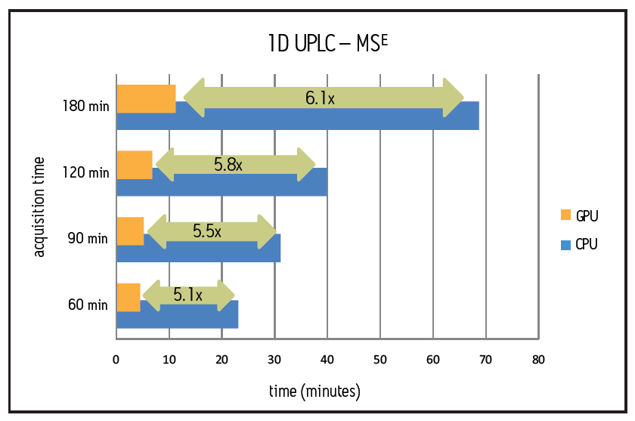
Computing Enhancement with GPU for more complex data set
Improvement in performance using a 240-core GPU compared with a quad-core CPU for processing LD/MSE data files of varying file size from different chromatographic Separation.

Slide 29
Measured Theoretical Assignment Error
361.23485 361.23548 C₂₀H₃₄O₄Na -1.7 ppm
#
361.10
361.14
361.19
#
361.23
361.27
375.21416 375.21474 C₂₀H₃₂O₅Na -1.6 ppm
375.11
375.15
375.19
375.24
375.28
*
*
300
320
340
360
380
400
420
# Peaks of interest
* Internal Calibrant
*
250
300
350
400
450
500
550
600
650
700
750
800
m/z
Johnston, Murray

Slide 30
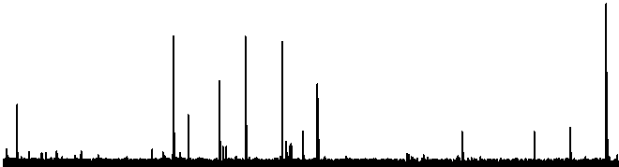
Bryostatin 2 (+ ion)
Quad Select 885 (+1) peak, then IRMPD at 12W 90ms
Parent
- 191
- 38
- 32
- 44
- 44
- 176
- 88
- 44
- 44
- 18
150
300
450
600
750
900
[M+Na]+ = Exp. 885.4257 ± 0.9 ppm
Theo. 885.4249
Quad Select 885 (+1) peak
*
Broadband with int. cal.
*
* Internal Calibrants
*
Manning, Thomas, … Lam, TuKiet, et al., Natural Product Research, 19, 467, (2005).

Slide 31
Dynamic Range in a Single Spectrum
(0.75 sec Acquisition)

Slide 32
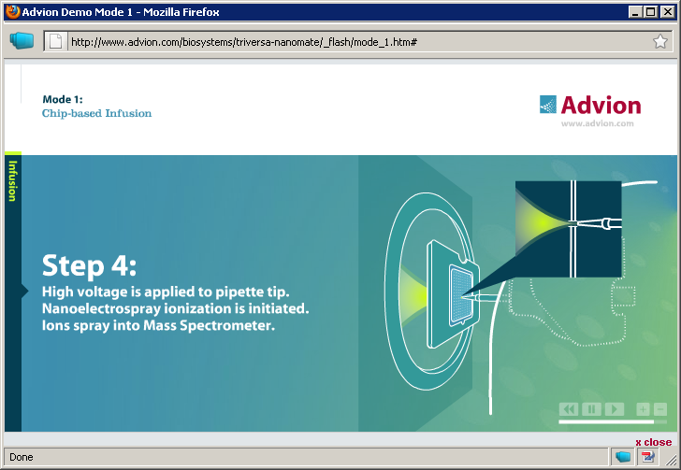
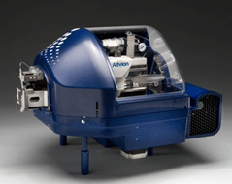
Orifice to FT-ICR MS
384-nozzle nanoESI chip
TriVersa NanoMate

Slide 33
Parallel Detection in Orbitrap and Linear Ion Trap
RT: 41.57
MS/MS of m/z 598.6
Scan # 4870
RT: 41.56
High resolution
Full scan # 4869
High resolution full scan in Orbitrap and 5 MS/MS in linear ion trap
0.0 0.5 1.0 1.5 2.0 2..5
RT: 41.58
MS/MS of m/z 547.3
Scan # 4871
RT: 41.59
MS/MS of m/z 974.9
Scan # 4873
Time
[sec]
RT: 41.58
MS/MS of m/z 777.4
Scan # 4872
RT: 41.60
MS/MS of m/z 1116.5
Scan # 4874
Total cycle is 2.4 seconds
1 High resolution scan with accuracies < 5 ppm
External calibration
5 ion trap MS/MS in parallel

Slide 34
Small Molecule Analyses

Slide 35
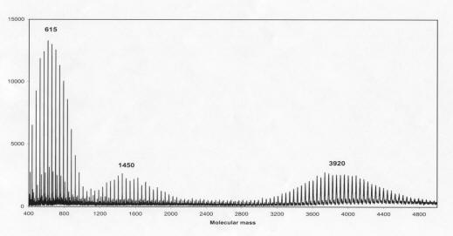

The mass spectrum is obtained for a surface sample from a PEG 4000 treated board on the Vasa’supper gun deck Each peak corresponds to a certain molecular mass. The difference between the major peaks is 44 mass units, which corresponds to one -CH2CH2O- entity (n ± 1) in the PEG chain. The three clusters of peaks with mean values of about 615, 1450 and 3920 mass units show that commercial compounds labelled PEG 600, PEG 1500, and PEG 4000 consist of a distribution of molecules, and that the PEG 600 from inside the board has penetrated into the PEG 4000 surface layer.

Slide 36
PEG: Polyethylene glycol
1031.6
943.6
420.5
899.5
1361.8
855.5
811.5
749.5
1725.0
470.0
705.4
617.4
573.4
2425.4
2234.3
0
400
600
800
1000
1200
1400
1600
1800
2000
2200
2400
m/z

Slide 37
PEG: Polyethylene glycol
987.6
1031.6
943.6
1075.7
1119.7
1141.7
1097.6
899.5
1053.6
1009.6
855.5
925.6
965.6
1108.6
1152.6
811.5
881.5
837.5
1063.6
800
850
900
950
1000
1050
1100
m/z

Slide 38
943.6
987.6
PEG: Polyethylene glycol
965.6
969.6
949.5
975.5
993.6
967.6
947.5
953.6
984.1
991.6
957.1
962.0
979.1
959.5
981.6
946.1
963.5
0
940
945
950
955
960
965
970
975
980
985
990
m/z

Slide 39
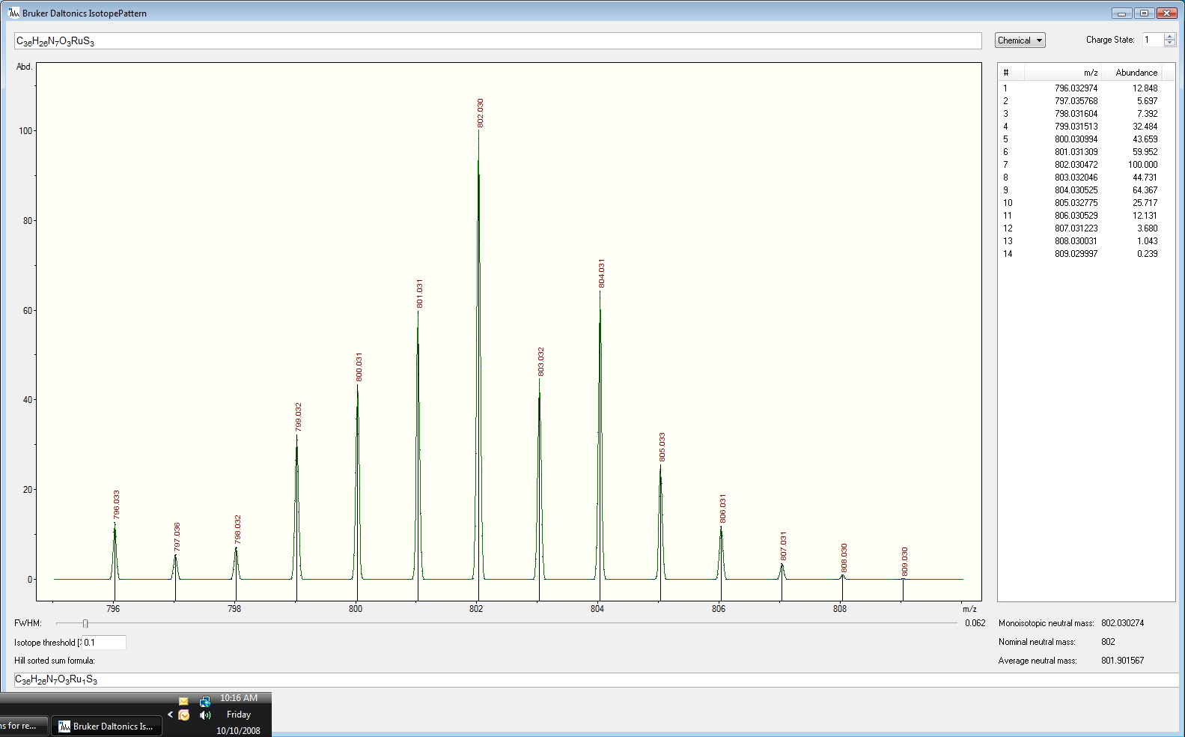
Theoretical – 796.0330
Experimental – 796.0344
Error – 1.6ppm
Resolving Power ~71,000
656.7787
716.7460
578.8010
483.1826
Zoom
Theoretical isotopic distribution of Ruthenium containing compound
898.9883
600
800
1000
m/z
1200
1400
1600
* - detectable isotope of molecule of interest
W. McNamara; T. Lam; T. Voss

Slide 40
351.1336
351.1627
351.1336
351.06
351.10
351.14
351.18
351.22
m/z
Zoom
353.1306
352.1370
349.1100
354.1338
349
350
351
352
353
354
355
356
m/z
351.1336
293.1755
Zoom
520.9085
429.1493
609.3397
656.8838
792.8607
-MS, 16.5-16.6min #(865-874)
300
400
500
600
700
800
900
m/z
McCarty, K; Lam, TT

Slide 41
Intens.
x10
7
1.25
811.12458
1.00
Deuterated
0.75
0.50
0.25
808.10563
812.12800
0.00
7
x10
6
5
808.10398
4
Protonated
3
2
809.10860
1
0
x10
7
5
808.10538
4
Mix
3
2
1
809.10891
811.12406
0
807
807
807
808
808
808
809
809
809
810
810
810
811
811
811
812
812
812
813
813
813
m/z
m/z
m/z
D. Spiegel; T. Lam

Slide 42
Intens.
Intens.
x10
6
x10
7
808.10563
1.25
811.12458
1.25
1.00
Deuterated
Peak Area
2,047
1.00
0.75
Peak Area
18,999
0.75
0.50
0.50
0.25
0.25
0.00
7
0.00
5
x10
x10
6
2.5
5
808.10398
2.0
Protonated
4
1.5
3
1.0
2
1
0.5
0
0.0
6
x10
7
x10
8
5
808.10538
811.12406
Mix (Manual)
6
4
Resolution
~473,700
Peak Area
13,340
3
Resolution
~666,500
Peak Area
62,633
4
2
2
1
0
0
811.04
811.04
811.04
811.08
811.08
811.08
811.12
811.12
811.12
811.16
811.16
811.16
m/z
m/z
808.04
m/z
808.04
808.04
808.08
808.08
808.08
808.12
808.12
808.12
808.16
808.16
808.16
m/z
m/z
m/z
D. Spiegel; T. Lam

Slide 43
B
A
Positive Mode
A
B
B
Zoom
A
Negative Mode
A
A
A – Isotopic peaks of Compound 3-hydroxybenzo[a]pyrene
B – Isotopic peaks of Compound 3-hydroxybenzo[a]pyrene + H⁺
K. McCarty; T. Lam

Slide 44
Reproducibility of MALDI FTICR at 12T
459.24732
* = peak compared below
701.40696
616.95886
701.40689
770.98423
701.40695
701.40695
*
946.99101
1073.40991
1260.46798
701.40689
701.40690
701.40701
200
400
600
800
m/z
1000
1200
1400
DHB_POS_10_M19.d: +MS
701.40701
701.40705
701.40670
701.40
701.45
701.50
701.55
701.60
m/z
701.65
DHB_POS_10_M10.d: +MS
DHB_POS_10_M11.d: +MS
DHB_POS_10_M12.d: +MS
DHB_POS_10_M13.d: +MS
DHB_POS_10_M14.d: +MS
DHB_POS_10_M15.d: +MS
DHB_POS_10_M16.d: +MS
DHB_POS_10_M17.d: +MS
DHB_POS_10_M18.d: +MS
DHB_POS_10_M19.d: +MS
P. Mistry; M. Easterling; T. Lam
Notes:
For some reason the this slide does not show when you are in “notes page” viewing, but the normal view has it.
You will probably know what to say here… I took at random 10 runs of DHB (I realized the I meant to use the THARP positive files after finish making this slide, but I think this is OK since the purpose of the slide is to show the reproducibility of the data/instrument in MALDI mode.

Slide 45
Comparison of Positive and negative MALDI FT-ICR MS of lipid/small molecule for a post treatment patient sera
459.24756
518.32084
812.46106
701.40760
266.94300
THAP_POS_8_A15.d: +MS
1013.64937
1249.73056
1437.77929
737.10609
THAP_NEG_10_A15.d: -MS
547.08271
550.62722
542.26098
551.63059
Zoom
546.35200
548.47723
544.33635
547.35530
552.88097
554.31827
545.30465
541.06590
543.05142
546.07041
552.03578
548.08614
545.06717
547.08271
542
544
546
548
m/z
550
552
554
357.05897
200
400
600
800
1000
1200
1400
m/z
P. Mistry; M. Easterling; T. Lam
Notes:
Lipid/small molecule extraction procedure.
1) 20 µL aliquots of plasma samples were extracted overnight at −20°C in safe-lock Eppendorf tubes with 75 μl of mixed methanol/chloroform (2:1, v/v) followed by vortex mixing and centrifugation at 1,500×g for 5 min.
2) The next day, the supernatant was transferred to a glass vial, and the residue was extracted one more time with 50 µL of mixed methanol/chloroform/water (2:1:0.8, v/v/v), vortex, and centrifuged at 1,500×g for 5 min.
3) The supernatant extracts from step 3 were then combined, and 20 µL of chloroform, followed by 20 µL of water, was added. The combined extract was vortex and centrifuged at 1,500×g for 5 min. The upper (aqueous) phase was carefully pipette into a fresh tube and lyophilized in a SPD1010 speed-vac concentrator. The lyophilized residue was re-suspended in 10 μl of water, followed by 30 μl of methanol, and then centrifuged to remove any precipitated protein.
Solution is stored at -80°C until in preparation for MALDI (Bruker) and ESI (Yale) FT-ICR MS analyses.

Slide 46
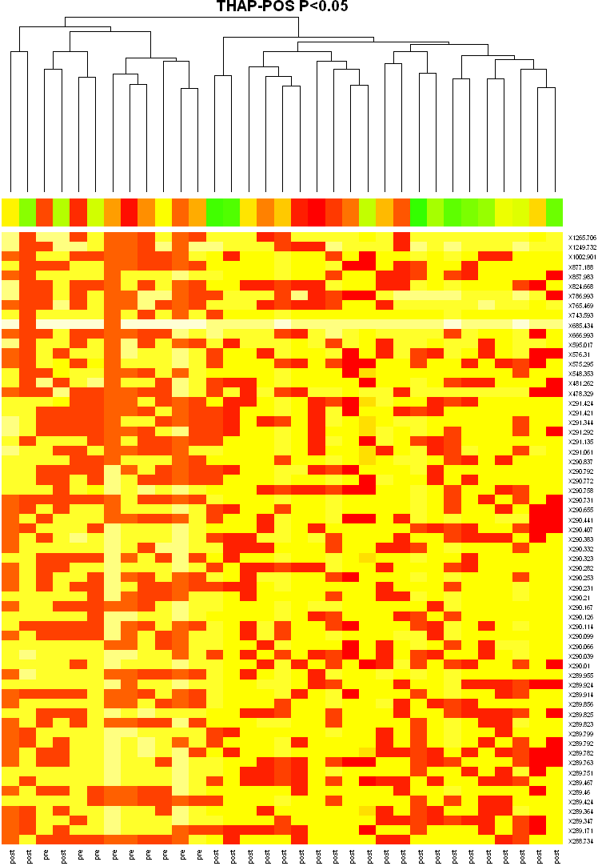
Hierarchal cluster of Lipid/small molecule from sera of patients pre/post treatment analyzed with MALDI FTICR (THARP matrix)
Mass
Post-Treatment
P. Mistry; J. Lee; T. Lam
Notes:
The cluster shows that the data peaks (based on intensity and mass) “cluster” well to differentiate spectral feature which are from pre and which are from post treatment. The upper part of the diagram shows how well the cluster are linked; read this as though of a “grouping” like depiction. Things that group together are more closely related. Coloration in the diagram indicate the increase/decrease in intensity (darker red indicate higher/increase in intensity. The data were processed by inhouse software within our Keck Biostatistics Resource. Make sure to acknowledge Ji Young Lee from the Keck Biostatistics Resource.

Slide 47
Intens.
x10
7
(Isolation and Fragmentation of m/z at 325)
5
250.99233
4
3
2
142.99257
272.97436
1
93.02141
117.49194
164.06702
182.97512
202.04189
227.51176
0
x10
7
6
250.99238
4
2
142.99256
93.02141
108.32685
272.97453
0
164.06712
202.04194
227.51170
x10
7
4
250.99232
3
2
272.97431
93.02140
142.99251
1
108.32687
182.97500
216.59026
239.59321
0
100
100
100
120
120
120
140
140
140
160
160
160
180
180
180
200
200
200
220
220
220
240
240
240
260
260
260
280
280
280
m/z
m/z
m/z
A. Nassar; T. Lam

Slide 48

A. Nassar; T. Lam

Slide 49
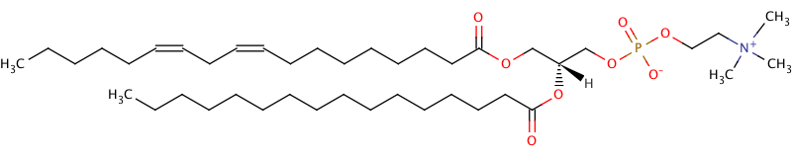
780.5535
780.5535
629.1546
758.5718
786.6029
808.5854
828.5522
844.5264
760
770
780
790
800
810
820
830
840
m/z
585.2792
899.4229
539.1089
510.3395
987.1921
1046.2339
500
600
700
800
900
1000
m/z
063010_Araujo_SL1_BB_000001.d: +MS
I. Araujo; T. Lam; E. Voss

Slide 50
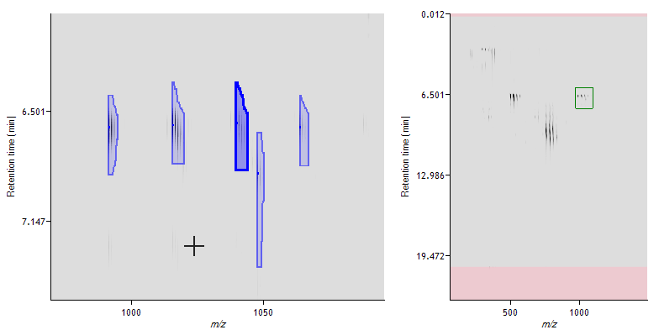
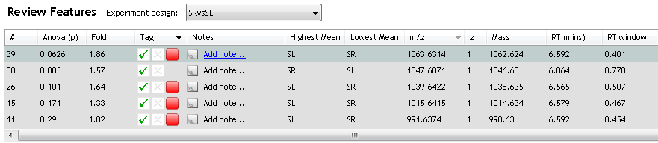
15
(Δ1.33)
26
(Δ1.64)
11
(Δ1.02)
39
(Δ1.86)
24 Da
24 Da
24 Da
I. Araujo; T. Lam; E. Voss

Slide 51
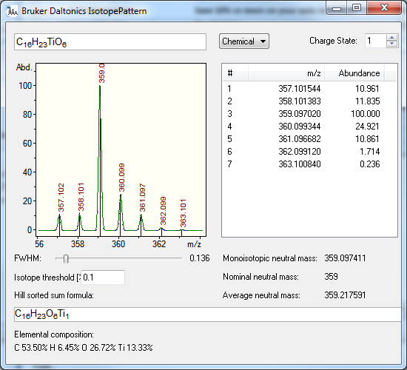
K. Buettner; T. Lam; E. Voss

Slide 52
T. Biederer; T. Lam; E. Voss

Slide 53
N-Glycosylation at the SynCAM (Synaptic Cell Adhesion Molecule) Immunoglobulin Interface Modulates Synaptic Adhesion*
Adam I. Fogel‡1, Yue Li‡, Joanna Giza‡, Qing Wang‡2, TuKiet T. Lam§, Yorgo Modis‡, and Thomas Biederer‡3
From the ‡Department of Molecular Biophysics and Biochemistry and the §W. M. Keck Foundation Biotechnology Resource
Laboratory, Yale University, New Haven, Connecticut 06520
Received for publication, March 8, 2010, and in revised form, August 3, 2010 Published, JBC Papers in Press, August 25, 2010, DOI 10.1074/jbc.M110.120865
T. Biederer; T. Lam; E. Voss

Slide 54
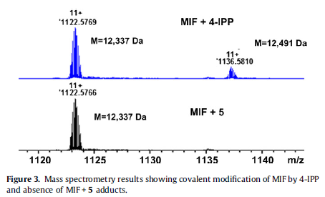
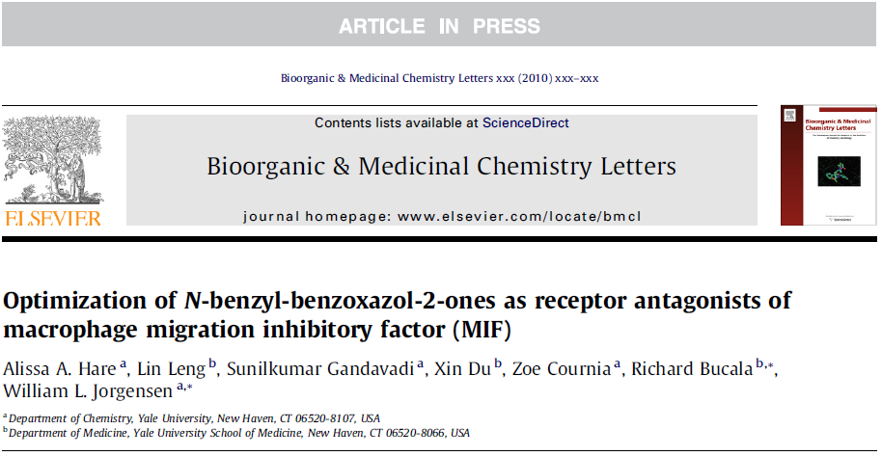
L. Leng; T. Lam; E. Voss

Slide 55
7+
F-DTXR Fragment 30-115:
IAERLEQSGPTVSQTVARMERDGLVVVASDRSLQMTPTGRTLATAVMRKHRLAERLLTDIIGLDINKVHDEACRWEHVMSDEVERR
F-DTXR fragment 30-115
7+
~93% Fluorinated
nonF-DTXR fragment (~18 Da less)
1,395
1,400
1,405
8+
1,410
*
m/z
Trypsin Fragment
6+
Tryptic digest of F-DTXR
1,200
1,300
1,400
1,500
1,600
1,700
* Calibrants
*
*
*
500
750
1,000
m/z
1,250
1,500
1,750
Logan, T; Lam, TT

Slide 56
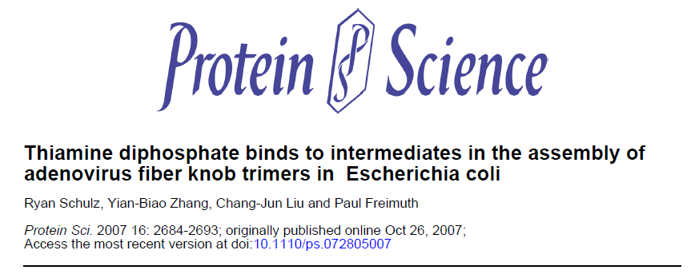
P. Freimuth; T. Lam

Slide 57
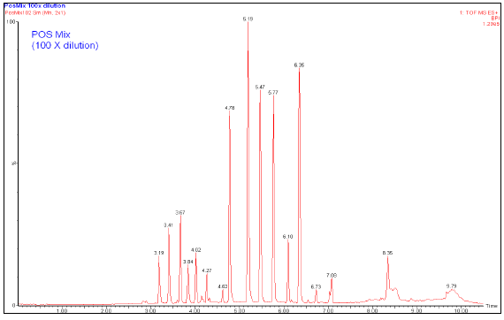
25 Compounds mixture from Chemistry Department
S. Lai; T. Lam; E. Voss

Slide 58
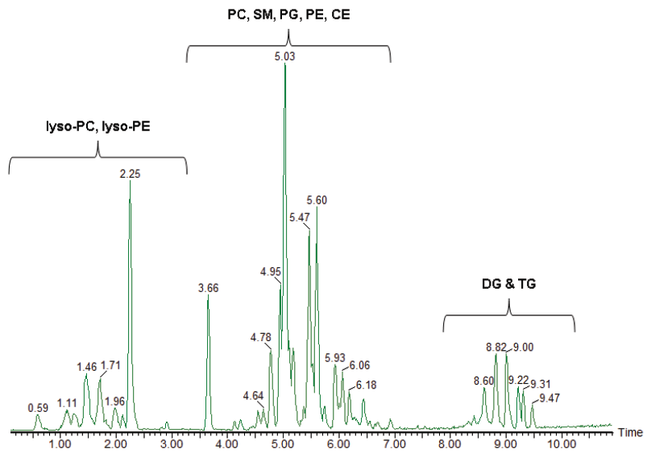
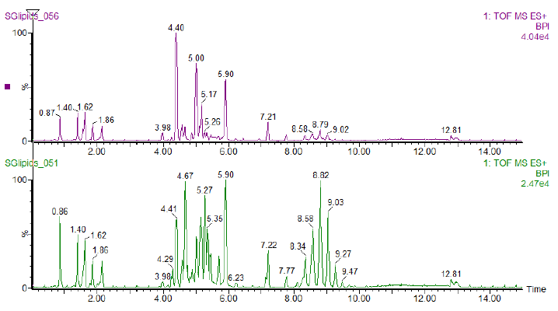
Separation of lipid classes by Chromatographic Means
Sample A
Sample B

Slide 59
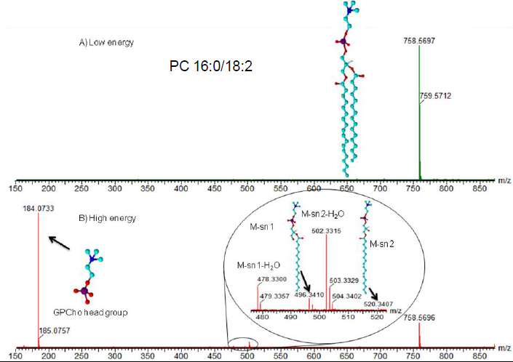
Low Energy
High Energy

Slide 60
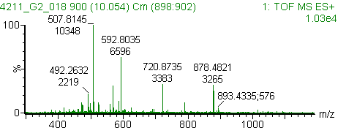
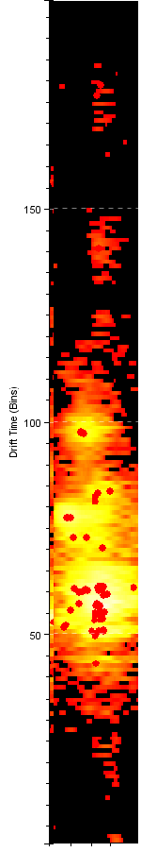
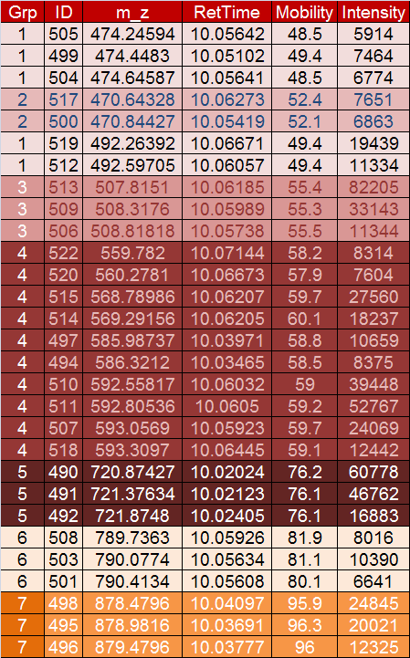
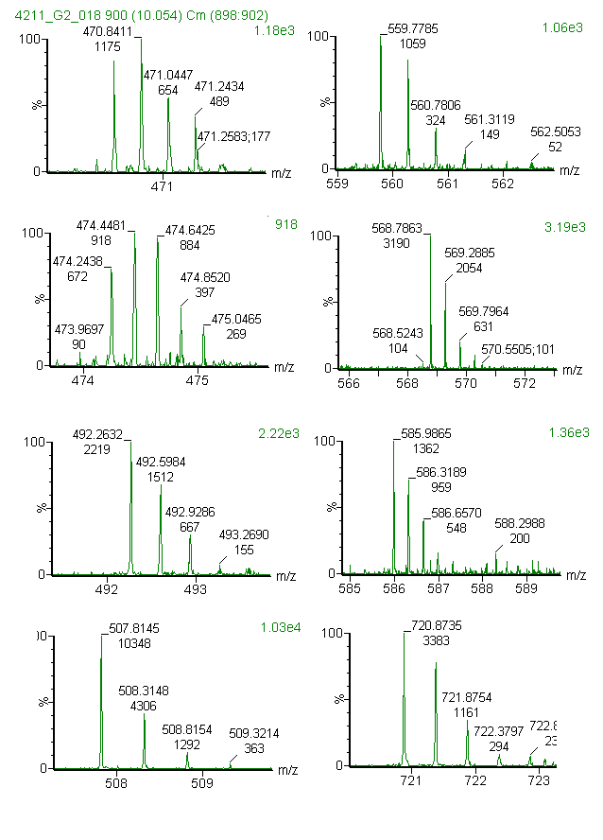
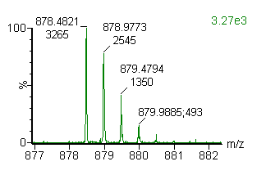

Separation of lipid classes by Ion Mobility (note similarity in RT)
3
4
5
7
1
4
6
2
4
2
7
1
4
6
1
4
4
RT
3
5
11 different precursors elute in 3 seconds
LC-IMS-MS^{E} analysis groups all ions by drift time
In normal LC-MS^{E} analysis, all product ions would be shared
Notes:
60

Slide 61
Zoom
M. Lopalco; T. Lam; E. Voss

Slide 62
M. Lopalco; T. Lam; E. Voss

Slide 63
Zoom
M. Lopalco; T. Lam; E. Voss

Slide 64


NIH SIG Application Submitted (March 2011): Synapt G2 Mass Spectrometer. PI: Tukiet Lam
Key Feature: Mobility separation by charge and shape – provides additional separation modality within the MS
Potential applications:
  Lipids (e.g., separation of isomeric lipids varying by position of cis/trans double bonds)
  Small molecule (e.g. metabolites)
  Carbohydrate analysis with Ms^{e} capability useful for mapping sites of glycosylation
Separation of Isomeric Compounds
Glycosylation Analysis
Meta-, Ortho-, Para-
hydroxylated
Mobility (Drift Time separation)
Notes:
Cost about $700K

Slide 65



YPED for routine accurate/exact mass analyses services
Separate module for Chemistry analyses
Editable sample submission form built into YPED
Results uploaded onto YPED
FT-ICR MS analysis
Sample TTL_234
Schematic Workflow
PowerPoint Slide MS Results
User submit sample & submission form
Samples analyzed based on services selected
PP slides are upload onto YPED & stored on secure FTP site
Results reported onto PowerPoint slide
Users can visualize & download results
Service charges uploaded onto FMP**
** Currently under construction.

Slide 66

High End Fourier Transform ICR Mass Spectrometry for Protein and Small Molecule Applications
Resolution (170,000)
  Uses
  Exact/Accurate mass of small molecules, peptides, oligos (RNA/DNA), lipids, and intact proteins, drugs, etc.
  Structural Elucidation of small molecule
  Protein Post Translational Modification
  Protein Identification & Peptide sequencing
  Comparative protein/peptide profiling.
  Advantages
  Ultra High Resolution for separation of molecular masses less than 0.002 Da.
  High Mass Accuracy (<3ppm with Ext. Calibration) for elemental assignment
  Multi-fragmentations capabilities for structural elucidation and protein PTM analysis.
  Impact
  Since Feb2008, >1250 samples from 94+ Yale Chemistry Faculties, Postdocs, Graduate Students, and As. Res. Scientist have been analyzed. Additionally 300+ analyses from 30+ investigator from Yale and non-Yale institutions.

Slide 67








Acknowledgement
The Keck Group
Ken Williams (The Boss)
Kathy Stone (The Overseer)
Erol Gulcicek (The Phospho Guy)
Chris Colangelo (The MRM Guy)
Terence Wu (The Gel Guy)
Mary LoPresti (The SamplePrep Lady)
Jean Kanyo (The MALDI Lady)
Tom Abbott (The 2nd MRM Guy)
Kathrin Wilczak-Havill (The iTRAQ Lady)
Matt Berberich (The Velos Man)
Ted Voss (The ICR Protector)
All collaborators and clients
Fundings
(FT-ICR) NIH/NCRR 1 S10 RR17266-01
(NBC) Proteomics Core

