Slide 1
The development of SPR biosensor
Xixian Ye
3.1.2011

Slide 2
presentation
Principle of SPR
Recent development

Slide 3
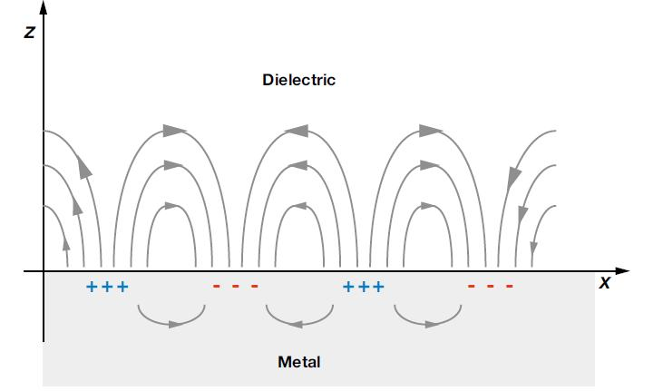
surface plasma resonance
the resonance caused by evanescent wave and plasma wave
Picture Reference: http://baike.baidu.com/image/8697397f690e0c3628388ac5

Slide 4
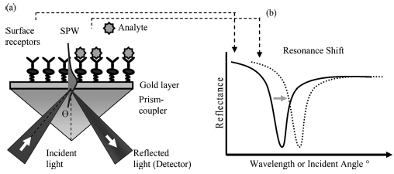
Tracking surface absorption by SPR (a) prism-coupled configuration and (b) resonance shift in the reflected light spectrum.
Reference: Towards integrated and sensitive surface plasmon resonance biosensors: A review of recent progress, Biosensors and Bioelectronics, X.D. Hoa, A.G. Kirk and M. Tabrizian , Volume 23, Issue 2, 30 September 2007, Pages 151-160

Slide 5
The incident angle is dependent on the optical characteristics of the system, e.g. on the refractive indices of the media at both sides of the metal, usually gold. While the refractive index at the prism side is not changing, the refractive index in the immediate vicinity of the metal surface will change when accumulated mass adsorb on it. Hence the surface plasmon resonance conditions are changing and the shift of the angle is suited to provide information on the kinetics of e.g. protein adsorption on the surface

Slide 6
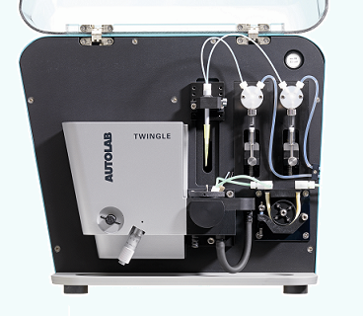
Reference: http://www.ecochemie.nl/news/Twingle.html

Slide 7
A microfluidic system for handling of the samples
An opto-electronic system for the excitation and detection of the SPR
A biointerface functionalized with surface receptors
A data analysis module to extract the relevant information

Slide 8
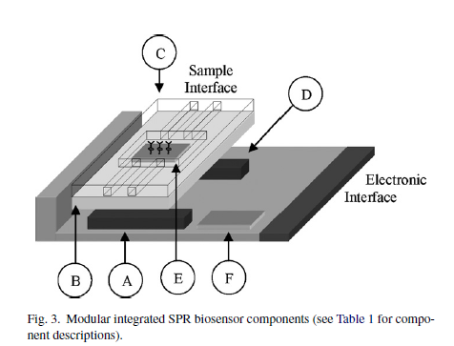

Slide 9
SPR biosensors
based on prism-coupled SPR configuration
simple, sensitive and robust
not amenable to miniaturization and integration

Slide 10
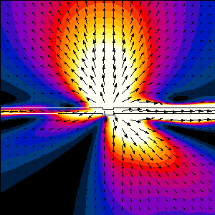
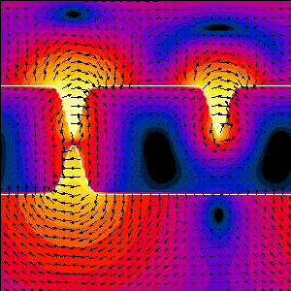
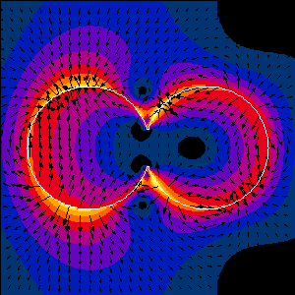
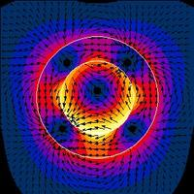
The new SPR biosensors
integrated
low-cost
reusable
sensitive

Slide 11
sensitivity
The amount of analytes detectable on the golden surfaces
Dependant on the strong electromagnetic enhancement of the SPW, particularly dependent on surface functionalization
The main challenge of the development of the technique*
*:Towards integrated and sensitive surface plasmon resonance biosensors: A review of recent progress

Slide 13
 | Components | Technology
A&D | Light source and photodetector | Low-cost LEDs with large spectrum available Sensitive photo-detector arrays
B | Optics | Low-cost micro-lens array and diffractive grating mirrors for focusing and redirecting light Molding and rapid fabrication techniques for mass production of optical components Sensitive fiber and waveguide-SPR approach Integrated multilayer and distributed Bragg reflector for improved sensitivity Imaging SPR
C | Microfluidics | Plastic materials Fast replication techniques Surface passivation (Poly-ethylene glycol grafting, Oxygen plasma)
E | Sensor surface chemistry | 2D and 3D probe receptor matrix using polymer chain and self-assembled monolayer Porous matrix with increased surface area Nano-particle (gold, latex, etc.) enhancement Chemical patterning using soft-lithography Regenerative surface chemistry
F | Data analysis electronic control | Statistical analysis Parameter fitting, SPR curve polynomial fitting, averaging, centroid method Integrated temperature control Silicon SPR substrate Integrated semi-conductor component for sensingor control

Slide 14
Recent development
SPR approach for integrated biosensing
Fiber- and waveguide- SPR
SPR on silicon material
Multi-analyte SPR
Development of key biosensor components
Integrated SPR biosensor platforms

Slide 15
SPR approach for integrated biosensing
Fiber- and waveguide- SPR
silicon material on SPR
Multi-analyte SPR

Slide 16
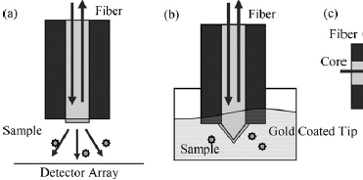
Fiber- and waveguide- SPR
Notes:
Optical fibers are ideal media to guide light for the excitation of the surface plasmon wave
use single mode fiber with polished and metal-coated tip
the fiber tip can be optimized using micro-fabrication technology to etch a micro-cone into the polished end of the fiber as to form a micro-prism

Slide 17
silicon material on SPR
Use silicon materials as substrates: reduce noise, raise the sensitivity
Use silicon prism: the incident light wavelength in the infrared spectrum leads to a larger penetration depth and narrower resonance width

Slide 18
Multi-analyte SPR
The phase or reflectivity(light intensity) is simultaneously measured over a large surface area via a collimated light source and photo-array detector
Enable the detection of multiple analytes simultaneously

Slide 19
Development of key biosensor components
Find different strategies to passivate the surface against non-specific adsorption
Self-assembled monolayer (SAM) and long polymer chains to create a stable, uniform probe surface or three-dimensional receptor matrices
Added functionality via surface chemistry

Slide 20
Integrated SPR biosensor platforms
Notes:
interfere

Slide 21
reference
Towards integrated and sensitive surface plasmon resonance biosensors: A review of recent progress, X.D. Hoa, A.G. Kirk and M. Tabrizian, Biosensors and Bioelectronics, Volume 23, Issue 2, 30 September 2007, Pages 151-160
Measurement of biomarker proteins for point-of-care early detection and monitoring of cancer, James F. Rusling,abd Challa V. Kumar,ac J. Silvio Gutkinde and Vyomesh Patele, Analyst, 2010, 135, 2496–2511

Slide 22
Thank You !

