Slide 1
DRUG Metabolism and toxicity
Umesh M. Hanumegowda MVSc PhD DABT
Discovery Toxicology
Bristol-Myers Squibb, Wallingford, CT
Bioanalytical Chemistry 22nd March, 2011

Slide 2
DRUG METABOLISM
Metabolic pathways
Metabolizing enzymes & transporters
Species differences and Polymorphisms

Slide 3
Metabolic Pathways
Biotransformation: Conversion of xenobiotics to water-soluble compounds favoring elimination
Phase I
  Hydrolysis, reduction, oxidation
  Ex., procaine, prontosil, alcohol
Phase II
  Glucuronidation, sulfation, methylation, glutathione conjugation, acetylation
  Ex., acetaminophen, chloramphenicol, histamine, chlorobenzene, isoniazid

Slide 4
Metabolizing Enzymes & Transporters
Microsomal
  CYP, FMO, UGT, ALDH, Esterases, Epoxide hydrolases
Mitochondrial
  CYP, MAO, ALDH
Cytosolic
  NAT, ADH, ALDH, AO, SULT, Esterases, Epoxide hydrolases, GST, Peroxidases
Transporters
  MDR, MRP, BCRP, BSEP

Slide 5
Species differences & Polymorphisms
Species differences
  Ex., Acetylation in dogs, glucuronidation in cats
  Ex., Aflatoxin tumorigenesis in rats but not in mice
Genetic polymorphisms
  Leading to variability
    Ex., Slow metabolizers: CYP2D6 ~7% of Caucasians; CYP2C19 ~20% of Asians; FMO3 & fish odor syndrome
  Potential for toxicities
    Ex., Irinotecan in UGT1A1 deficient population

Slide 6
DRUG TOXICITY
Classification
General scheme
Molecular mechanisms with selected examples
Adaptation

Slide 7
Classification
Exaggerated pharmacology
  Ex., Hypotension from beta-blockers
Off-target pharmacology
  Ex., QT prolongation with terfenadine
Immunological
  Ex., Halothane hepatitis
Reactive metabolites
  Ex., Agranulocytosis with clozapine
Idiosyncratic reactions
  Ex., Hepatotoxicity with carbamazepine

Slide 8
General Scheme of Toxicity
DRUG
  Exaggerated on-target pharmacology
  Off-target pharmacology
  Trigger immune response
  Concurrent inflammation
  Exaggerated on-target pharmacology
  Off-target pharmacology
Metabolite
Reactive
Non-reactive
Adducted Protein
Altered DNA
Generation of ROS
  Loss of function
  Enzyme inhibition
  Trigger immune response
  Deplete cell defense
  Trigger cell death pathway
  Carcinogenesis
  Teratogenesis
  Deplete cell defense
  Cell death
  Carcinogenesis
  Teratogenesis
TOX I C I TY
From Drug Metabolism Handbook Concepts and Applications

Slide 9
Molecular Mechanisms of Toxicity
Loss of function of cellular macromolecules
  Covalent modification
  Reactivity of intermediate
  Examples
    Tienilic acid hepatitis
      Inactivation of CYP2C9
    Methapyrilene hepatotoxicity
      Binding to mitochondrial proteins
    NSAIDs liver/intestinal toxicities
      Ex., Zomiperac, diclofenac acyl glucuronides

Slide 10
Molecular Mechanisms of Toxicity
Oxidative stress
  ROS (hydrogen peroxide, superoxide, hydroxyl)
  Overwhelm cellular defenses
    Enzymes (SOD, catalase) reduced glutathione, ascorbate
  Oxidative damage of DNA/protein/lipids
Monocrotaline
Normal liver
PMN-induced HOCl modified proteins

Slide 11
Molecular Mechanisms of Toxicity
11
Oxidative stress
  Examples
    Alcoholic liver disease
    ARV and atherosclerosis
    DES carcinogenesis
      Adenocarcinoma in offspring
    Thalidomide teratogenicity
      Radical-trapping agent prevent teratogenicity

Slide 12
Molecular Mechanisms of Toxicity
Altered balance of cell survival and cell death
  p53-dependent apoptosis by disulfiram
  Neuronal loss in HIV dementia by NRTI
  Acetaminophen toxicity – protection by neutralization of Fas ligand/TNF
Immune-mediated
  Primarily haptenation
  Ex., Autoantibodies to CYP2E1 in halothane hepatitis; Hypersenitivity reactions with abacavir

Slide 13
Molecular Mechanisms of Toxicity
Concurrent inflammation
  Predispose to toxicity
    Idiosyncratic toxicity?
  Ex., acetaminophen, ranitidine, chlorpromazine hepatotoxicities precipitated by low-grade inflammation
    Kupffer cell depletion protects from acetaminophen toxicity
  Inflammatory mediators influence metabolism/toxicity

Slide 14
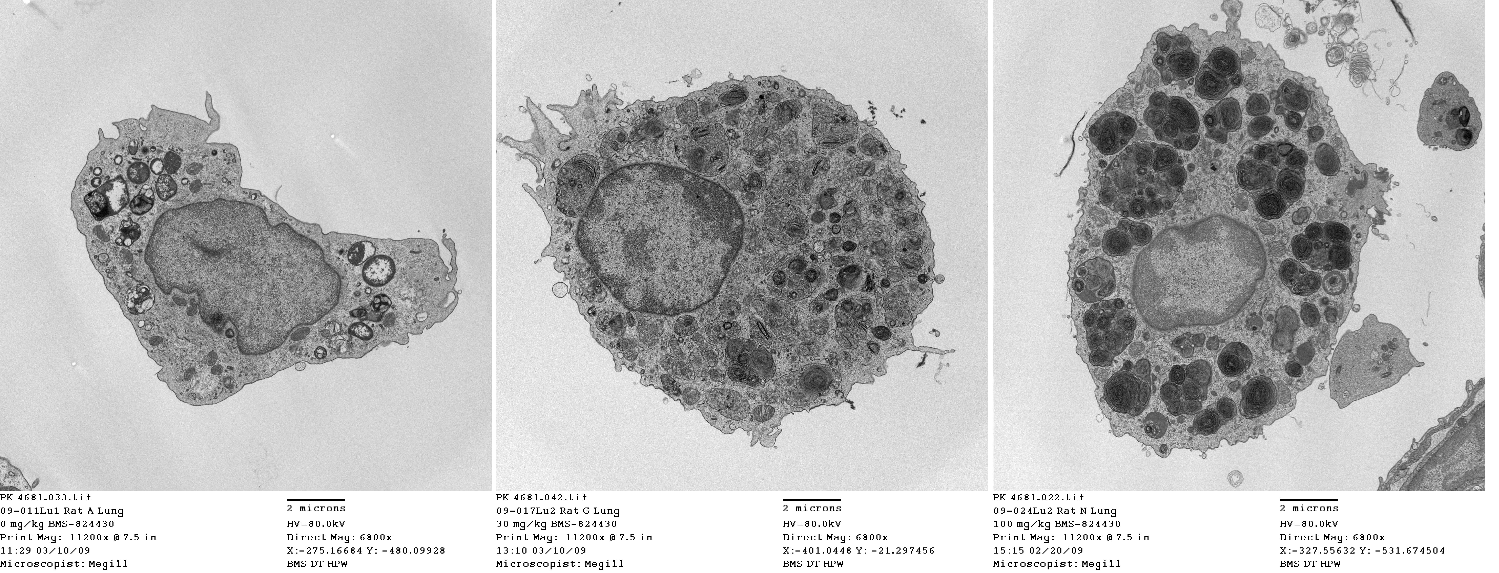
Adaptation
Tachyphyllaxis
  Decreased response with subsequent doses
    Ex., antidepressants, antipsychotics
Storage
  Phospholipidosis with CADs (Ex., Amiodarone)
BMS-Y
Alveolar Macrophage

Slide 15
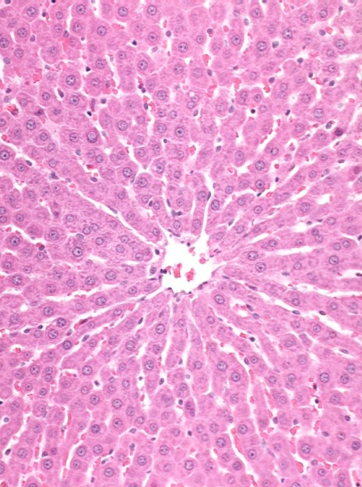
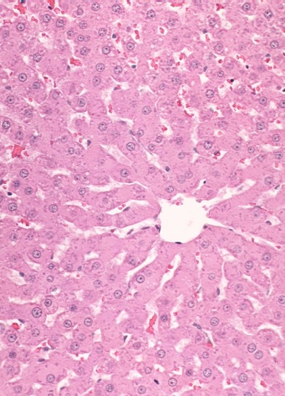
Adaptation
Enzyme induction
  Induction, Autoinduction
    Ex., Phenobarbital, Carbamazepine
    Relevance to carcinogenesis
BMS-X
Normal liver
Hypertrophy

Slide 16
EXAMPLES OF METHODS TO EVALUATE METABOLISM-MEDIATED TOXICITY
Metabolic fractions
Time-dependent inhibition
Metabolism competent cells
Reactive metabolite trapping

Slide 17
Metabolic Fractions
Liver S9
  Standard for genotoxicity testing ex., Aroclor-induced rat liver S9 in Ames
Microsomes
  Hepatic, intestinal, renal
  NADPH/ UDPGA fortified
Supersomes
  Reaction phenotyping

Slide 18
Time-dependent Inhibition
Microsomes
  NADPH supplemented
  Rate of disappearance of parent/substrate
    Ex., Verapamil – moderate time-dependent inhibitor of CYP3A4 (Midazolam as substrate)
IC50, T0= 9.3 µM (± 0.7)
IC50, T30= 0.7 µM (± 0.07)

Slide 19
Metabolism Competent Cells
Primary cells/cell lines
  Ex., hepatocytes, renal proximal tubule cells
    Limitations ex., Cisplatin in HK2 not predictive
Engineered cells
  Individual CYP expressing cells

Slide 20
Trapping/ Covalent binding
Glutathione, N-acetyl-cysteine, phenyl-lysine
  Epoxides, nitrenium, acyl glucuronide etc.,
Potassium cyanide, sodium cyanide
  Aldehydes, iminium
Microsomal protein covalent binding

Slide 21
Thanks to………..
Yang Wu
Richard Diters
John Megill
Vinod Arora
Tatyana Zvyaga
Robert Roth
Stephen Adams

