Slide 1
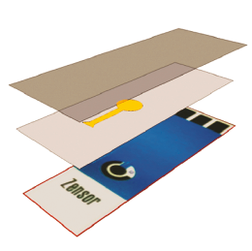
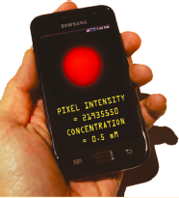
Electrogenerated Chemiluminescence Detection in Paper-Based Microfluidic Sensors
Advisor: Dr. James Rusling
Boya Song
Feb. 24, 2011

Slide 2
Outline
What is Microfluidic sensor ?
Why paper-based ?
How to make the Microfluidic sensor ?
How does the Microfluidic sensor work ?
How to combine the ECL with Microfluidic sensor ?
Notes:
follow

Slide 3
Microfluidic Sensor (μPAD)
What is microfluidics? “It is the science and technology of systems that process or manipulate small (10⁻⁹ to 10⁻¹⁸ litres) amounts of fluids, using channels with dimensions of tens to hundreds of micrometres.” ^{[1]}
Micro
Microfluidic devices :
Very small quantities of sample,
Limit reagent use,
High resolution and sensitivity,
Low cost,
Short times.
small volumes (nl, pl, fl)
small size
low energy consumption
effects of the micro domain
[1] Whitesides, M.G. Nature. 2006, 442, 27.

Slide 4
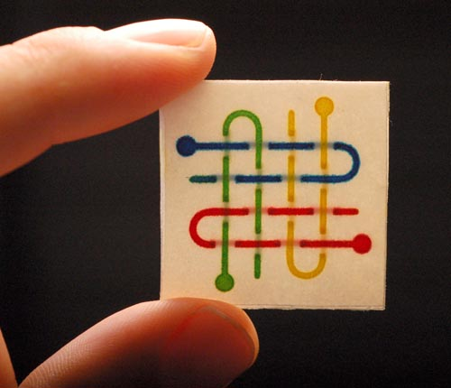
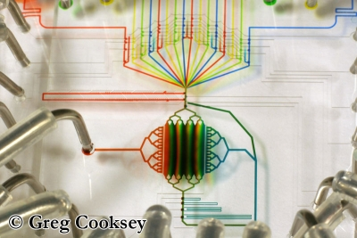
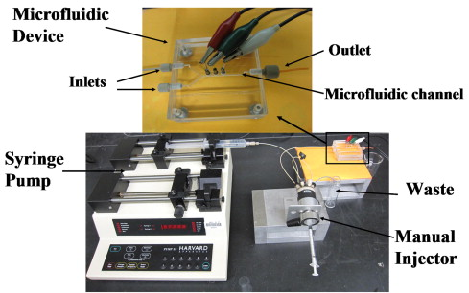

Slide 5
Why paper-based
Ubiquitous, inexpensive.
Easy to store, transport, and manipulate.
Has minimal weight per accessible surface area.
Paper wicks fluids well; this wicking eliminates the need for external sources of power to pump fluids through a device. (Capillary action)
Paper can filter particulates (solids, gels, cells) from a contaminated sample.
Can be readily disposed of safely via incineration. (Environment friendly)

Slide 6
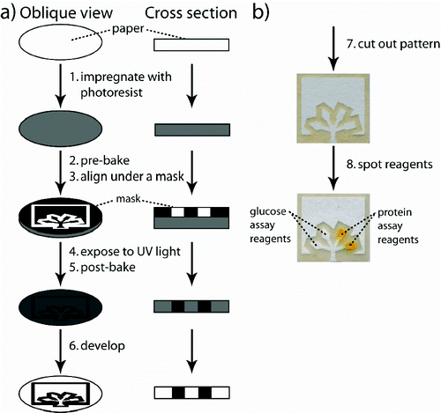
How to make the Microfluidic Sensors
Wet the paper (cellulose) in a kind of hydrophobic polymer solution (SU-8 2010 dissolved in cyclopentanone )
1st bake: to remove to the solvent cyclopentanone
Irradiated it with UV through the mask (inkjet printer + transparencies)
2^{ed} bake: cross linking polymerization
Wash out the unexposed resist by soaking in the PGMEA (propylene glycol monomethyl ether acetate )
hydrophobic
Martinez, A W, et al. Anal. Chem. 2008, 80, 3699-3707.
Notes:
cellulose
the unexposed resist was removed by soaking the paper in propylene glycol monomethyl ether acetate (PGMEA) and by washing the pattern with propan-2-ol. The patterned paper was allowed to dry in a fume hood at 25 °C.

Slide 7
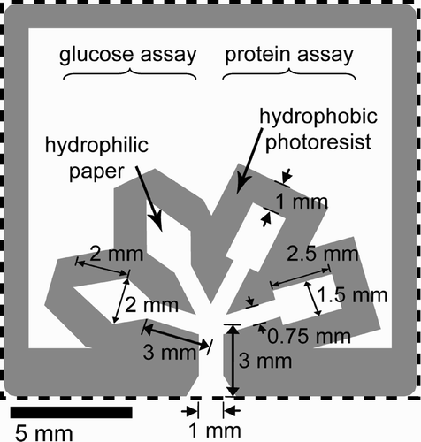
How to design the Microfluidic Sensors
Glucose assay reagents
Protein assay reagents
Color: from colorless to brown (I⁻ to I₂)
Color: from yellow to blue
(NPB of TBPB to proteins. )
Martinez, A W, et al. Anal. Chem. 2008, 80, 3699-3707.
Notes:
We use glucose and protein as example analytes. The glucose assay is based on the oxidation of glucose to gluconic acid and hydrogen peroxide (catalyzed by glucose oxidase) and the subsequent reduction of hydrogen peroxide and oxidation of iodide to iodine (catalyzed by horseradish peroxidase). The associated change in color from colorless to brown (I⁻ to I₂) indicates the presence of glucose.(42) The protein assay is based on the nonspecific binding of tetrabromophenol blue (TBPB) to proteins. TBPB binds to proteins through a combination of electrostatic (sulfonate) and hydrophobic (biaryl quinone methide) interactions.(44, 45) When bound, the phenol in TBPB deprotonates and the color of the dye shifts from yellow to blue.(45, 46)

Slide 8
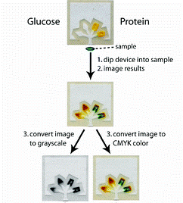
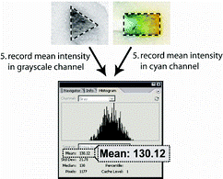
How the Microfluidic Sensor Work
Glucose
BSA (bovine serum albumin, a model protein for human albumin in urine)

Slide 9
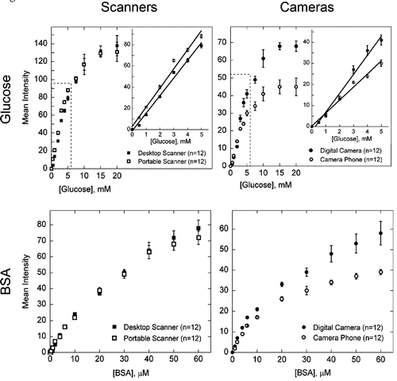
Detection Method
LOD: 0.5 mM
LOD: 4 μM
Figure 1. Analytical calibration plots for different concentrations of glucose and protein in artificial urine. The mean intensity for each data point was obtained from the histogram in AdobePhotoshop. Clinical practice.

Slide 10
Table 1. Use the calibration curves to quantify the levels of BSA and glucose in test samples of artificial urine; we were able to accurately measure 2.5, 3.5, and 4.5 mM glucose and 25, 35, and 45 μM BSA.
The results suggest that camera phones are nearly as effective as scanners for acquiring quantitative data.
Notes:
Bias
In a real-life scenario it would be necessary to run a standard sample so that the results of the assay could be calibrated appropriately.

Slide 11
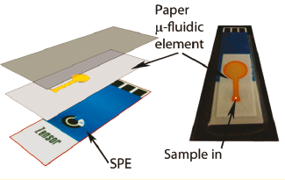
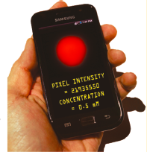
2008
2011

Slide 12
ECL-based sensing using Paper-Based Microfluidic Sensors
Electrogenerated Chemiluminescence (ECL)
A chemiluminescence reaction initiated and controlled by the application of an electrochemical potential.
ECL reagent:
Tris(2,2’-bipyridyl)ruthenium(II), (Ru(bpy)₃²⁺)
Good stability and ECL efficiency in aqueous media,
Favorable electrochemical properties,
Compatibility with a wide range of analytes.

Slide 13
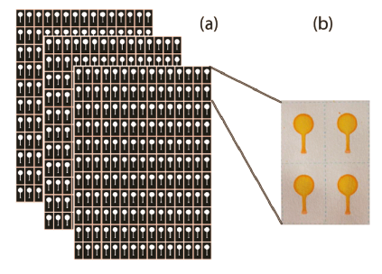
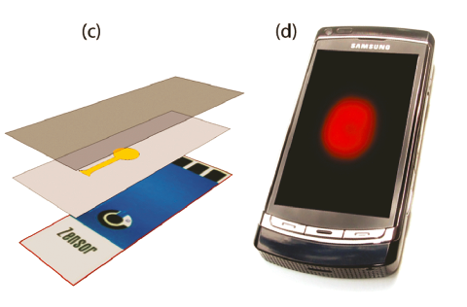
Setup of the Sensor
Patterns were printed onto A4-size filter paper with an alkenyl ketene dimer (AKD)-heptane solution using a digital inkjet printer.
Then heated it.
The printed area is hydrophobic, whereas the unprinted channel is still wettable, allowing fluids to wick.

Slide 14
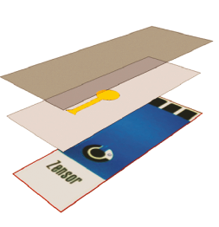
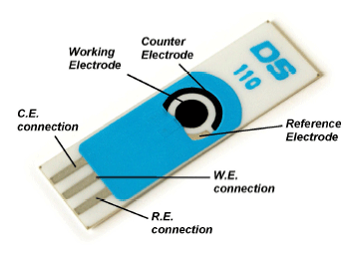
Screen-printed Electrodes (SPEs)
Screen-printed Carbon Electrodes
http://www.dropsens.com/en/screen_printed_electrodes_pag.html

Slide 15
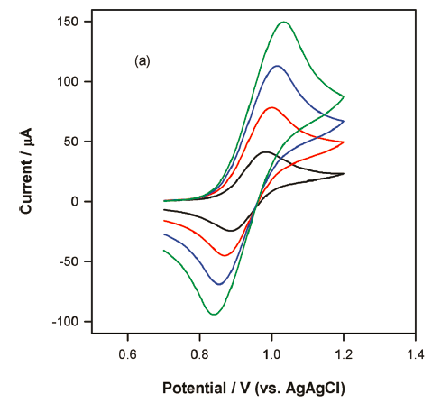
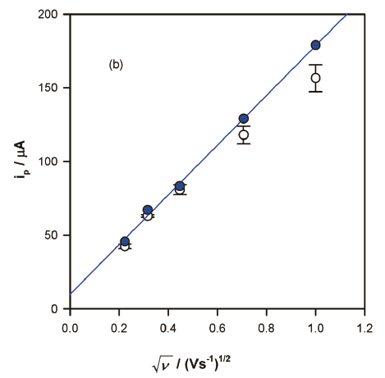
The electrochemical response of (Ru(bpy)₃²⁺) in paper
Figure 2. Cyclic voltammetry of paper soaked in 5 mM Ru(bpy)₃²⁺/pH 7.5 0.1 M phosphate buffer in contact with a screen-printed electrode at scan rates of 0.05, 0.2, 0.5, and 1.0 V s⁻¹ (a). Dependence of peak current on the square root of the scan rate (b). The blue markers indicate the results for the free solution without paper, and the open circles represent the relationship in the presence of paper. The blue line represents the linear regression line between i_{p,ox} and (ν)^{1/2} for the filled circles only.
Notes:
Dependence of peak current on the square root of the scan rate. The case with the paper.
responses are chemically reversible.
between 0.01-0.4 V s-1, The value of blue circles is identical to that in the absence of paper, showing that mass transport is unaffected by the paper.

Slide 16
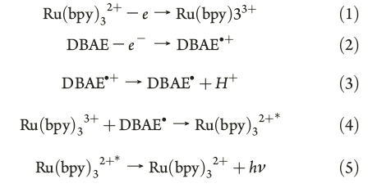
ECL in Paper Microfluidics
The response was tested using solutions of two well-known
ECL coreactants: 2-(dibutylamino)ethanol (DBAE) and NADH.
Bard, J.A. Electrogenerated chemiluminescence.; Marcel Dekker: New York, 2006; pp 247.
Notes:
mechanism

Slide 17
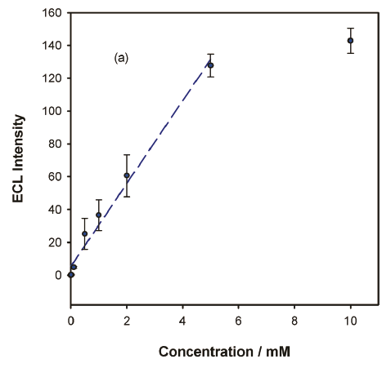
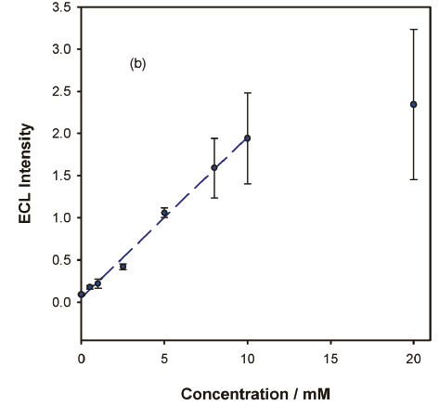
The ECL response of the sensor
Figure 4. Calibration curves for DBAE between 3 μM and 10 mM (a) and NADH between 0.2 mM and 20 mM (b) using the paper microfluidic ECL sensors. The straight line depicts the linear range in both. The conditions and experimental parameters were the same as in Figure 3.
PMT: photomultiplier tube, a custom-built light-tight Faraday cage with a high voltage power supply biased at 500 V.

Slide 18
Mobile Phone Detector
Simple; cheap; commonplace and portable.
Use the Samsung I8910 HD icon mobile phone as the photodetector.
Set to “FIREWORK” setting
(Use longer exposure time to photograph bright objections against a dark background)
The pictures were analyzed using a program written in Python, which output the numerical total values of pixels intensities. it could be run on a PC or on the mobile phone itself.
Ambient light:
“In the daylight, they used the Perspex clamp completely blackened except for a small disk opposite the working electrode, which was left transparent. Thus, when the clamp was held against the camera aperture, all external light was blocked.”

Slide 19
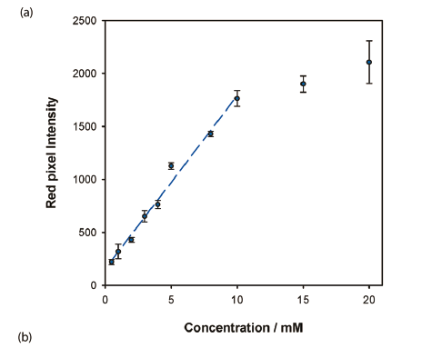
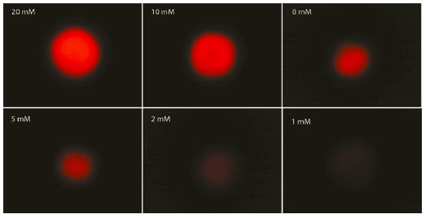
ECL Detection Using a Camera Phone
Figure 5. (a) Calibration curve between 0.5 mM and 20 mM for DBAE using paper microfluidic ECL sensor with mobile camera phone as the detector. The magnitude of the ECL signal is proportional to the intensity of the red pixels in the digital image. (b) Digital photographic images of ECL emission from the paper fluidic sensor obtained for various concentrations of DBAE using a camera phone. The ECL was initiated in each case by stepping the potential of the sensor from 0 to 1.25 V following application of a drop of sample.

Slide 20
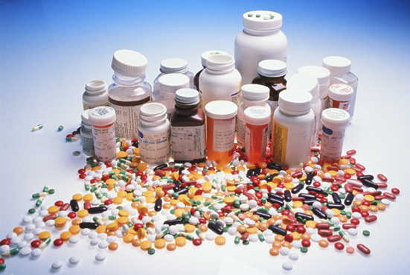
Future work
A lower detection limit is almost certainly achievable with further optimization of chemistry and camera parameters.
The settings on the phone do not allow direct manipulation of the exposure time. The ability to do so would undoubtedly enhance sensitivity because the ECL emission can be sustained for several seconds.
Market prospect.

Slide 21
References
[1] Whitesides, M.G. The origins and the future of microfluidics. Nature. 2006, 442, 27.
[2] Martinez, A W, et al. Simple telemedicine for developing regions: Camera phones and paper-based microfluidic devices for real-time, off-site diagnosis. Anal. Chem. 2008, 80, 3699-3707.
[3] Delaney, L.J.; Hogan, F.C.,; Tian, J.; Shen, W. Electrogenerated Chemiluminescence Detection in Paper-Based Microfluidic Sensors. Anal. Chem. 2011, 83, 1300–1306.
[4] Bard, J.A. Electrogenerated chemiluminescence.; Marcel Dekker: New York, 2006; pp 247.

Slide 22
Thank you for
your attention!
Questions?

